Slide 1
Using Library of Congress Faceted Vocabularies
Adam L. Schiff
Principal Cataloger, University of Washington Libraries
aschiff@uw.edu
OLA-WLA Preconference Workshop
Vancouver, Washington
April 17, 2019

Slide 2
Workshop Outline
Background
LCGFT
Documentation
Where Can You Find LCGFT Terms?
General Principle
Exercises
General Terms
Exercises
Literature Terms
Exercises
Moving Image Terms
Music Terms
Cartographic Terms
Artistic and Visual Works Terms

Slide 3
Workshop Outline
LCDGT
Audience and Creator/Contributor Characteristics
MARC 385/386
Where Can You Find LCDGT Terms?
Assigning LCDGT
Exercises
Other Facets (Briefly)
Music Medium of Performance
Time Period of Creation
Language
Place of Creation
Country of Producing Entity

Slide 4
Background
LCSH for many decades included headings and subdivisions that were used to describe what a resource is rather than what it is about. Headings can describe numerous non-subject aspects, including:
Genre/form
Symphonies World maps Comedy films Sports posters
Creator info
Canadian fiction Film posters, Swiss
American poetry--Women authors
African American children's writings Music by Jewish composers
Place of origin
Almanacs, Argentinian Folk music--Appalachian Region
Notes:
I’ve used different colors to show the different aspects that are mixed in many LCSH terms and subject strings. Red indicates the genre/form aspect.

Slide 5
Language
Arabic essays--Egypt Short stories, Zambian (English)
Audience
Young adult fiction Teen films Cats--Juvenile poetry
Music for hearing impaired children
Time period of creation
Rock music--1961-1970 Tales, Medieval
Moon--Maps--Early works to 1800
Music medium of performance
Balloon music Piano quintets Concertos (Bassoon, flute, oboe)
Flutes (3) with orchestra Horn and viola music
Guitar--Methods (Blues)
Notes:
I’ve used different colors to show the different aspects that are mixed in many LCSH terms and subject strings. Red indicates the genre/form aspect.

Slide 6
Background
Starting with genre/form in 2007, LC has been developing new controlled vocabularies to describe some of these aspects, with the long-term goal of limiting LCSH to describe what a resource is about and using the new vocabularies to describe what it is
2007- : Library of Congress Genre/Form Terms (LCGFT)
2014- : Library of Congress Medium of Performance Thesaurus for Music (LCMPT)
2015- : Library of Congress Demographic Group Terms (LCDGT) -
used for audience and creator/contributor characteristics
Notes:
The initial group of LCGFT terms were established as subject authority records coded 155. In May 2011 they were formally separated from LCSH as a completely different genre/form vocabulary.

Slide 7
Background
New MARC fields/subfields for
Form of work (380)
Music medium of performance (382)
Demographic group characteristics (385, 386)
Place of origin (370)
Time period of creation (046 $k/$l and $o/$p, 388)
Existing MARC fields for
Genre/form (655)
Language (008/35-37, 041)
Country of production (257)
Notes:
Partly for RDA, and partly as part of the effort to implement LCGFT and LCDGT, new MARC 21 fields and subfields were created for some of the genre/form and related aspects that we’ve been looking at. In addition, existing fields will continue to be used.

Slide 8
Background
LC has not yet fully implemented LCGFT in all of its cataloging
No changes yet to LCSH policies. Continue to assign LCSH according to the Subject Headings Manual and assign LCGFT, LCDGT, and LCMPT in addition
LC has no plans at this time to cancel any of the LCSH headings or form subdivisions that overlap with the genre/form terms

Slide 9
LCGFT
Library of Congress Genre/Form Terms

Slide 10
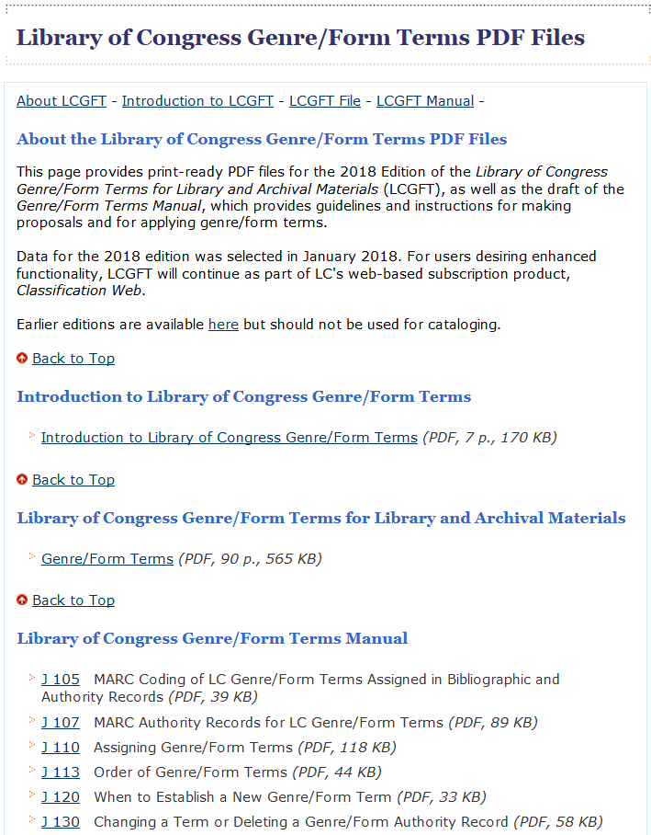
LCGFT Documentation
Draft LCGFT Manual at http://www.loc.gov/aba/publications/FreeLCGFT/freelcgft.html
Notes:
Artistic/visual works terms were developed with the Art Libraries Society of North America (ARLIS)
General terms were developed with the ALA Subject Access Committee Subcommittee on Genre/Form Implementation General Terms Working Group
Law terms were developed with the American Association of Law Libraries’ Classification and Subject Cataloging Policy Advisory Working Group
Literature terms were developed with the ALA Subject Access Committee Subcommittee on Genre/Form Implementation Working Group on LCGFT Literature Terms
Music terms were developed with the Music Library Association Bibliographic Control Committee Form/Genre Task Force
Religion terms were developed with the American Theological Library Association, coordinating with members of the Association of Jewish Libraries, the Catholic Library Association, and the Council on East Asian Libraries

Slide 11
LC Genre/Form Terms
Currently includes terms for:
Artistic/visual works
Cartographic materials
“General” materials (e.g., dictionaries, games, guidebooks, newspapers)
Law materials
Literature
Moving images (films, video, and television programs)
Music (scores and sound recordings)
Radio programs and other non-musical sound recordings
Religious materials
SACO proposals for additional terms and revisions to existing terms may be made for all of the areas listed above except artistic/visual
Notes:
Artistic/visual works terms were developed with the Art Libraries Society of North America (ARLIS)
General terms were developed with the ALA Subject Access Committee Subcommittee on Genre/Form Implementation General Terms Working Group
Law terms were developed with the American Association of Law Libraries’ Classification and Subject Cataloging Policy Advisory Working Group
Literature terms were developed with the ALA Subject Access Committee Subcommittee on Genre/Form Implementation Working Group on LCGFT Literature Terms
Music terms were developed with the Music Library Association Bibliographic Control Committee Form/Genre Task Force
Religion terms were developed with the American Theological Library Association, coordinating with members of the Association of Jewish Libraries, the Catholic Library Association, and the Council on East Asian Libraries

Slide 12
Where Can You Find LCGFT Terms?
OCLC and SkyRiver Authority Records
Classification Web
Catalogers Desktop (if you also have a Classification Web subscription)
Library of Congress Genre/Form Terms PDF Files (https://www.loc.gov/aba/publications/FreeLCGFT/GENRE.pdf)
LC Linked Data Service (http://id.loc.gov/authorities/genreForms.html)
Library of Congress Authorities (http://authorities.loc.gov)

Slide 13
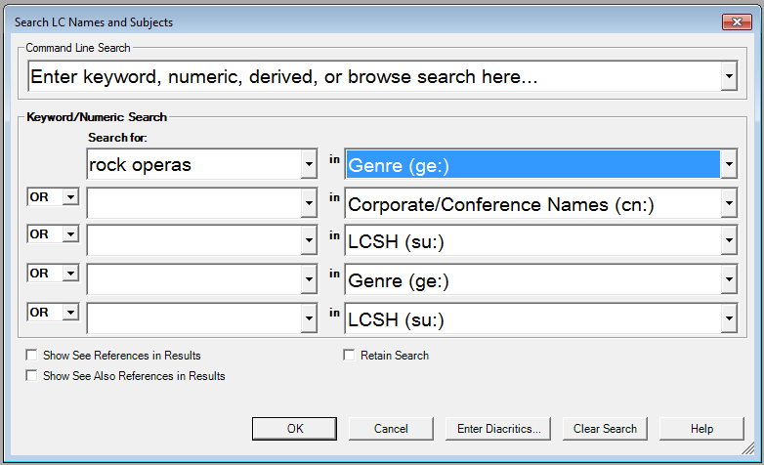
Notes:
Keyword search of genre/form authority records in OCLC Connexion

Slide 14
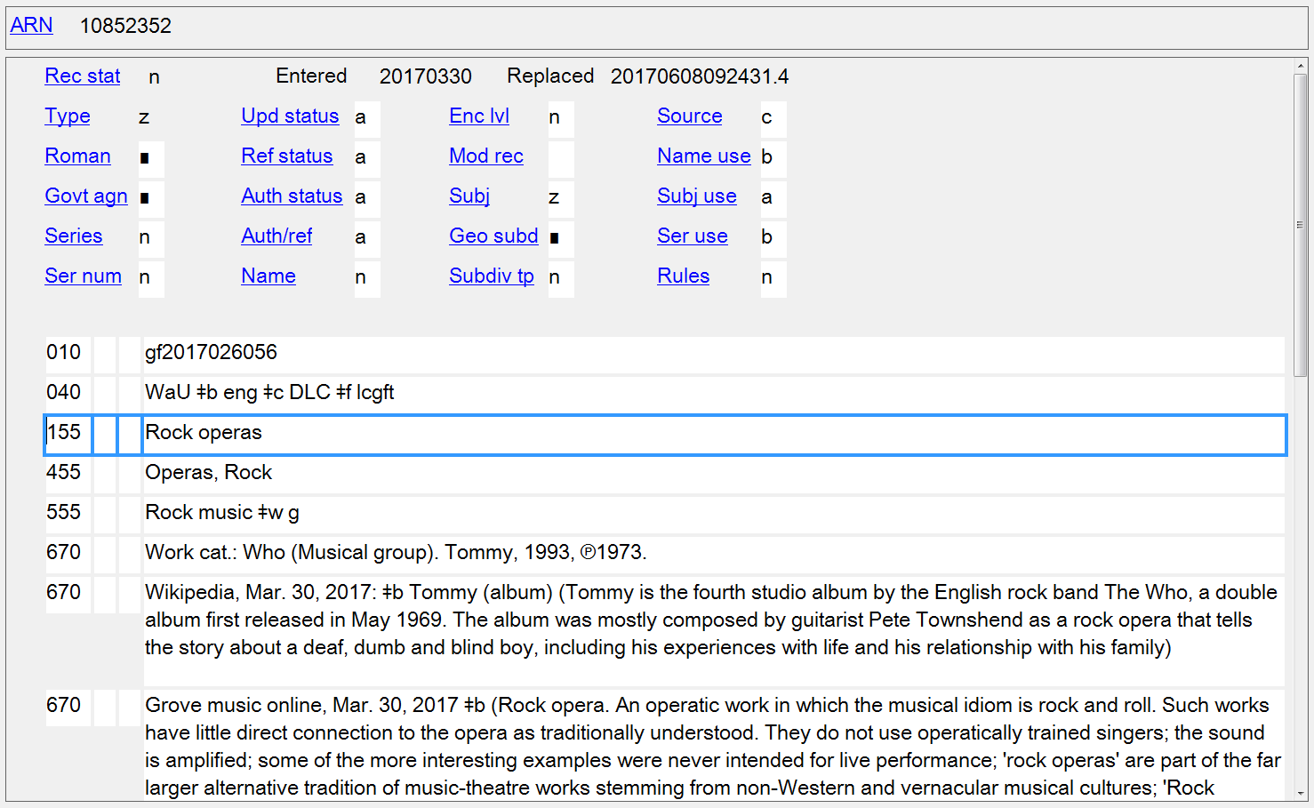
Notes:
ANIMATED SLIDE - Click to bring in scope note.
LCGFT authority record in OCLC Connexion Client.
When viewing authority records, be sure to check if there is a scope note (field 680).

Slide 15
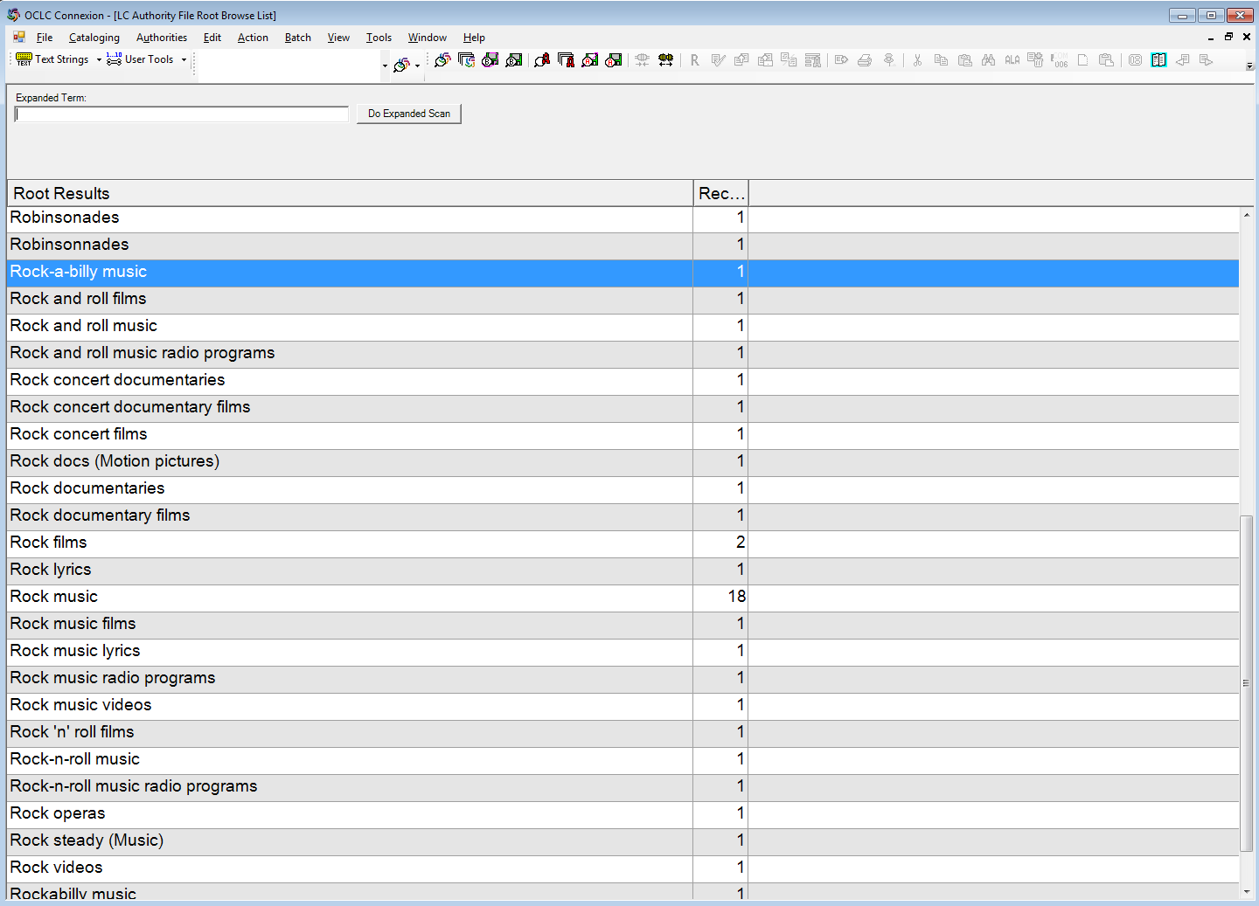
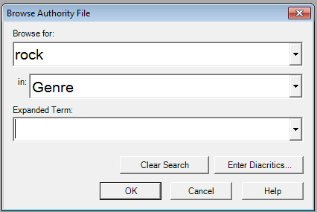
Notes:
ANIMATED SLIDE
Browse search of genre/form authority records in OCLC Connexion

Slide 16
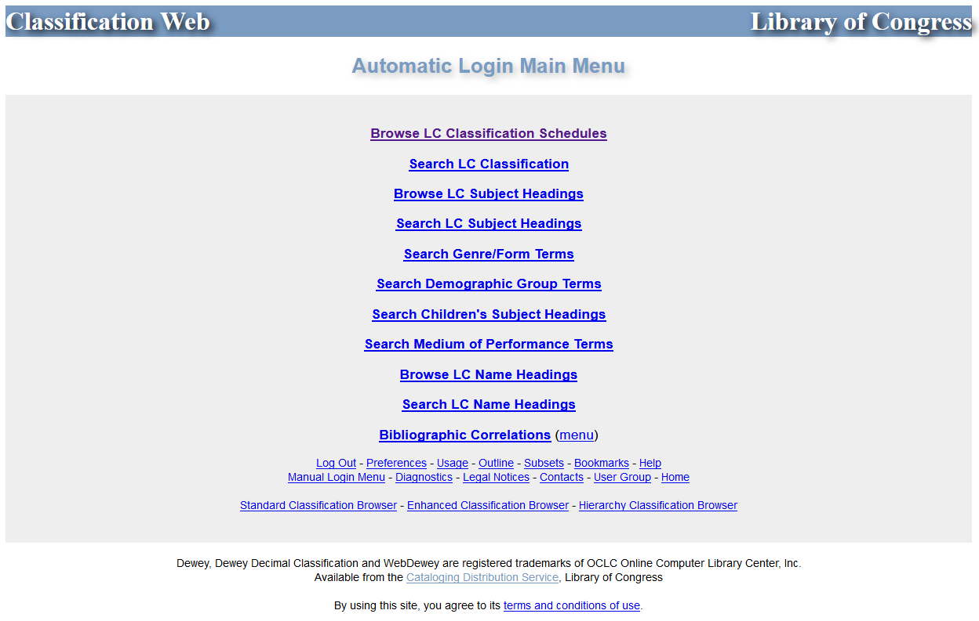
Notes:
Classification Web

Slide 17
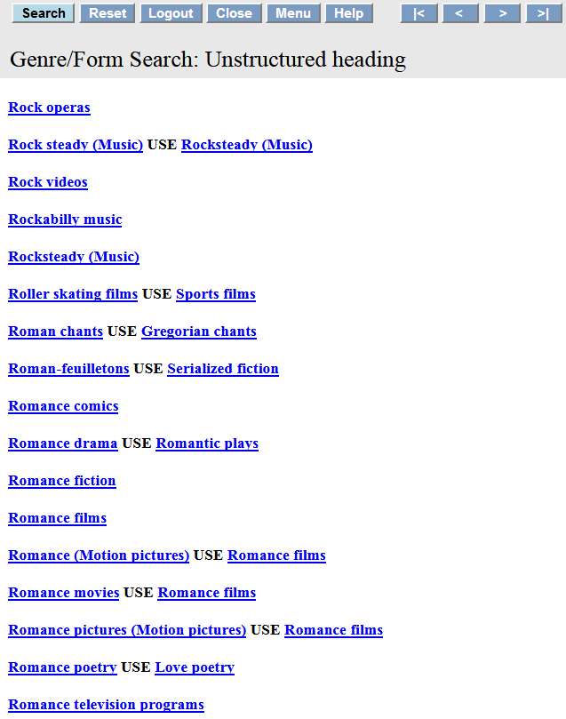
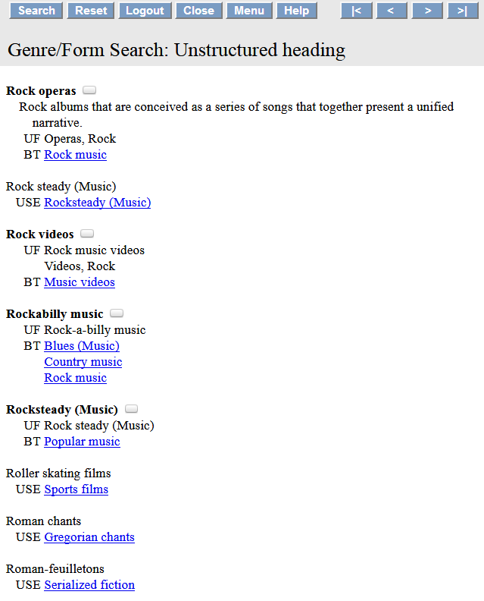
Scope note
Notes:
Classification Web search results for “Rock operas”

Slide 18
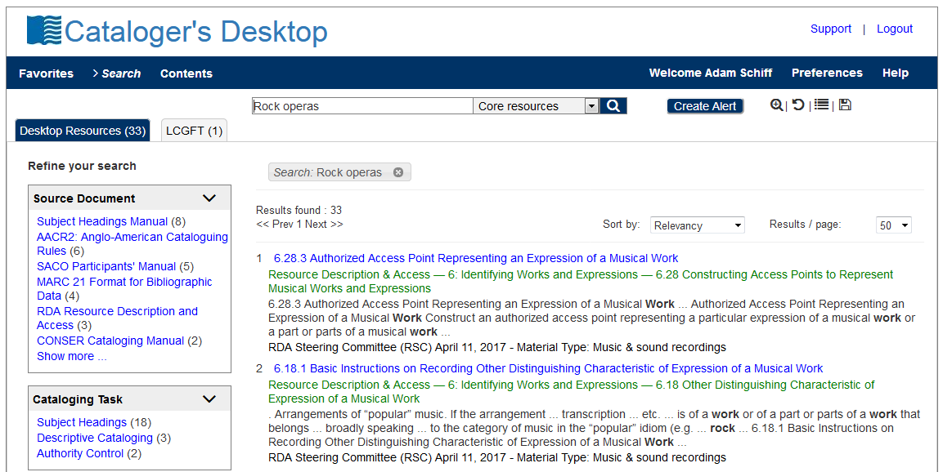
Notes:
Cataloger’s Desktop now includes searching of Classification Web, provided that you have a Class Web subscription.

Slide 19
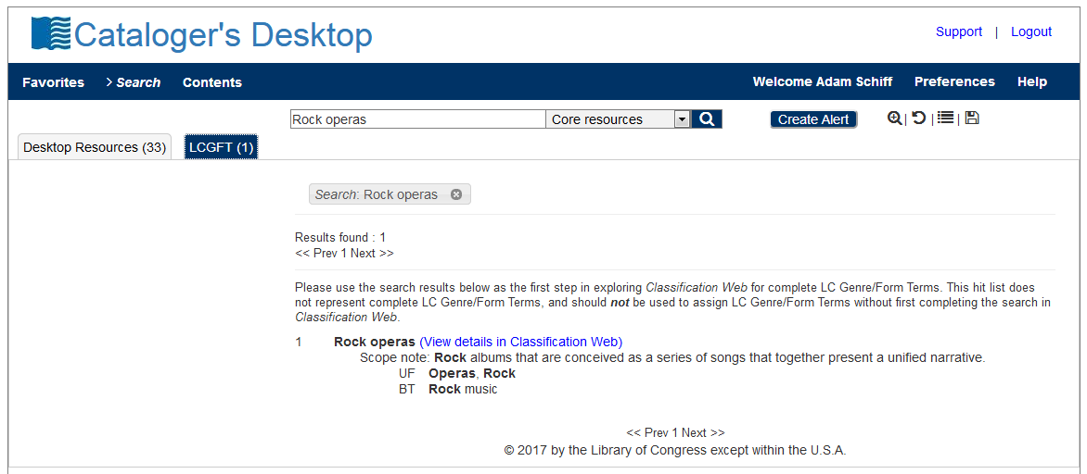

Slide 20
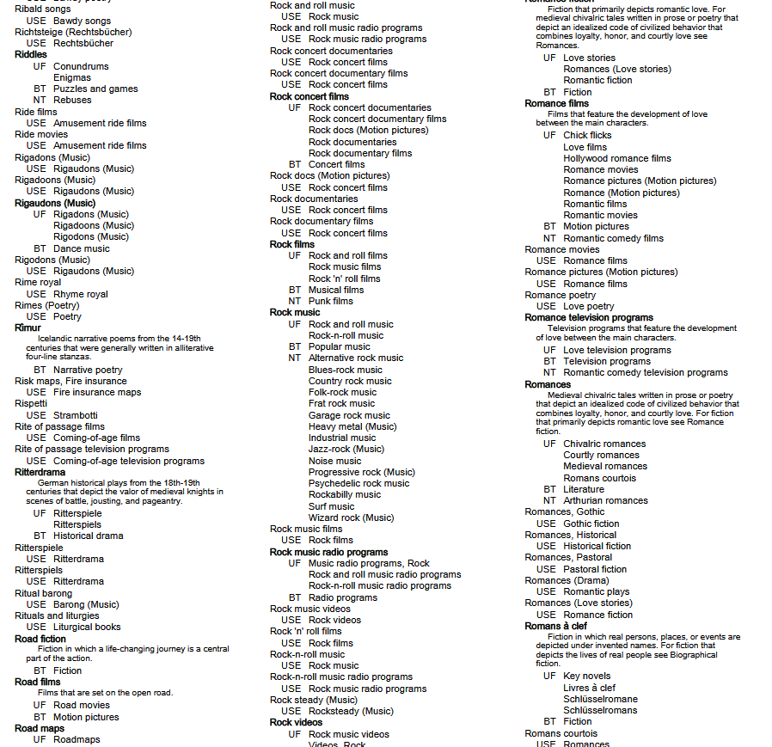
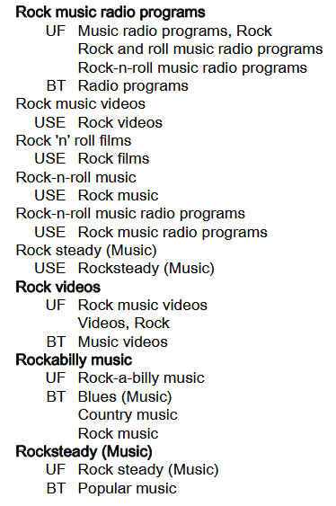
Notes:
ANIMATED SLIDE
This is a screenshot from PDF file of the 2017 Edition of the Library of Congress Genre/Form Terms for Library and Archival Materials (LCGFT). You will notice that our example, “Rock operas,” is not here. This illustrates the drawback of using the PDF file, as it is only compiled once a year, at the beginning of the year. Any terms added after will not be found in the PDF list until the following year.

Slide 21
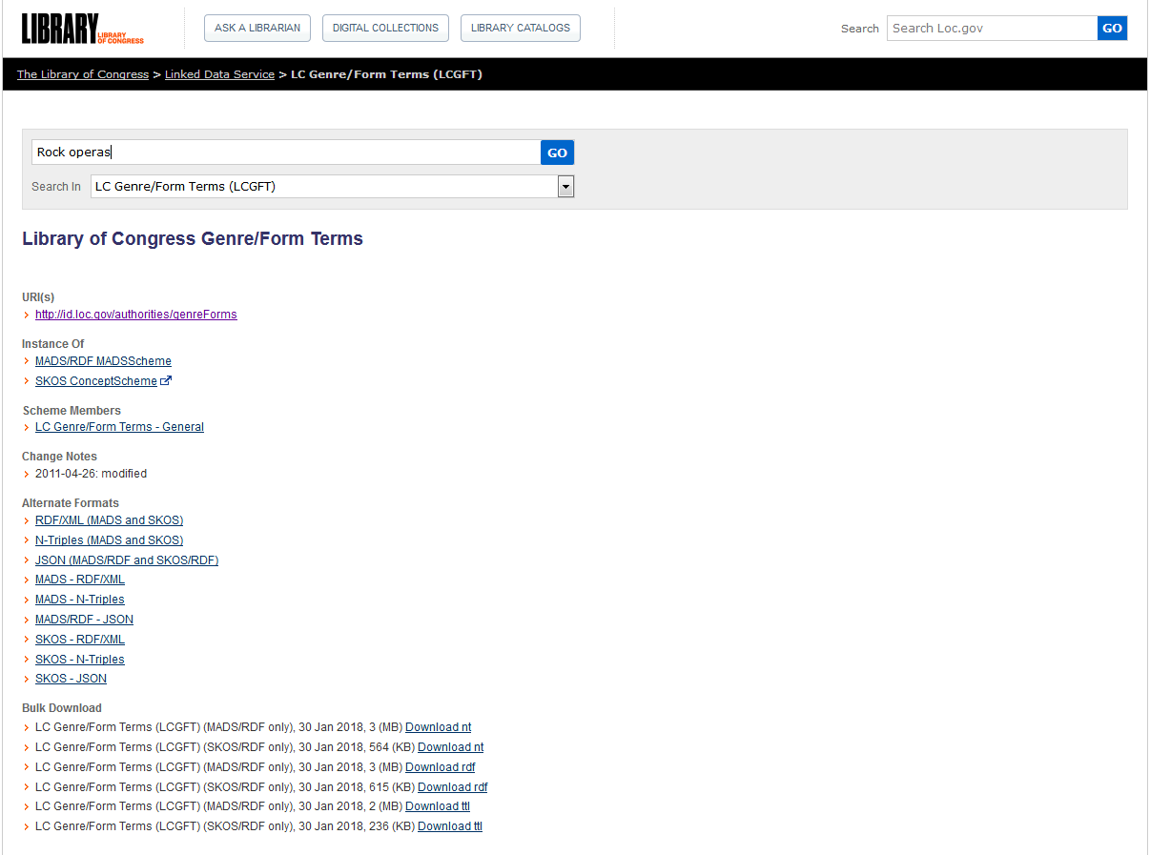
Notes:
LC Linked Data Service

Slide 22
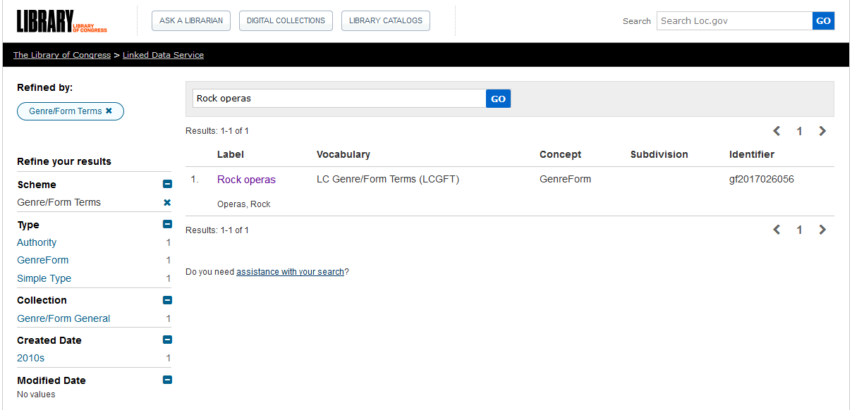

Slide 23
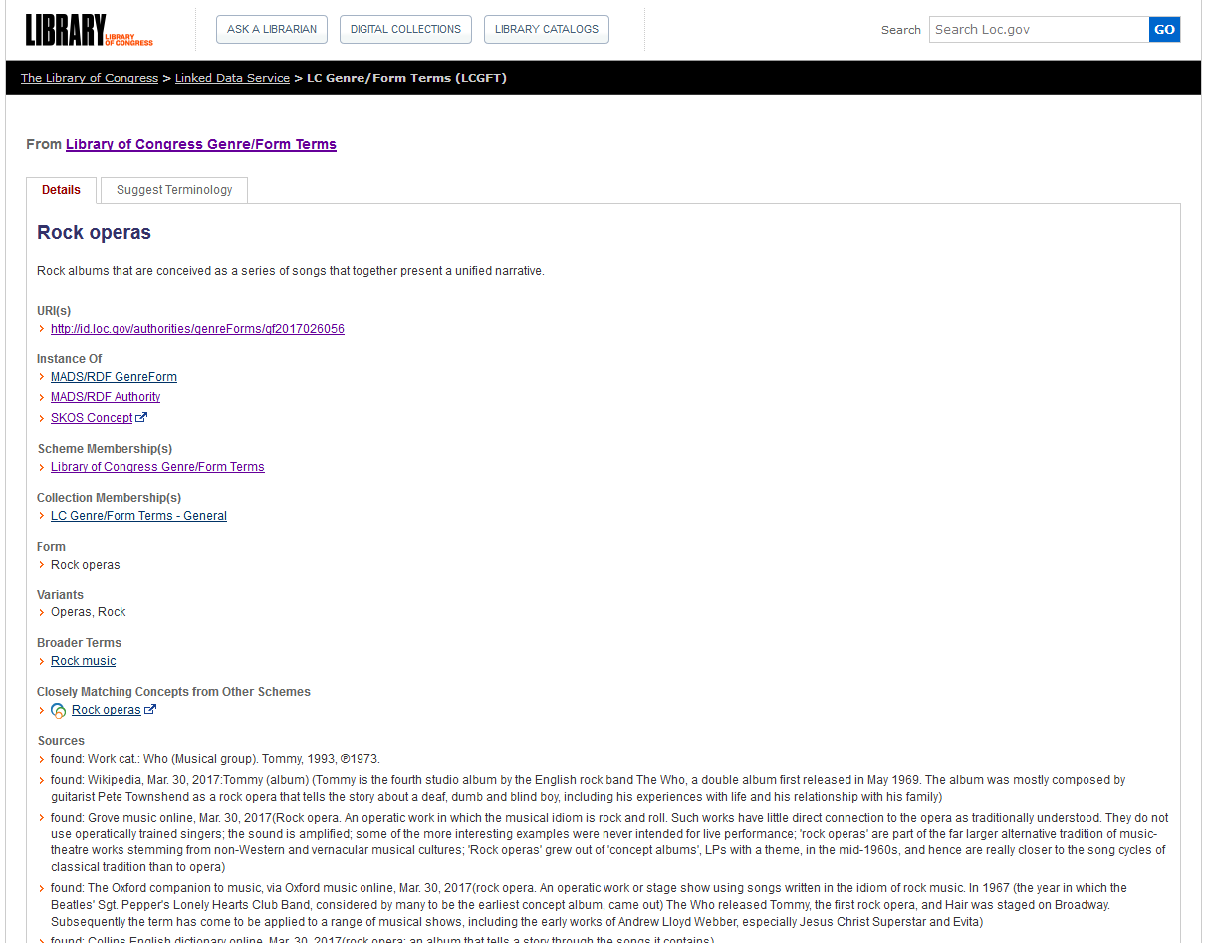
Notes:
LC Linked Data Service

Slide 24
Notes:
Library of Congress Authorities also includes authority records for LCGFT as well as LCSH.

Slide 26
LC Genre/Form Terms
General principles
Consult Introduction to Library of Congress Genre/Form Terms for Library and Archival Materials and the Library of Congress Genre/Form Terms Manual (http://www.loc.gov/aba/publications/FreeLCGFT/freelcgft.html)
Assigned to individual works and to compilations
Terms that describe works and expressions are eligible: terms for the intellectual or artistic expression of the work and also the original mode of issuance, where applicable

Slide 27
LC Genre/Form Terms
General principles
Terms that describe manifestation attributes generally are ineligible (e.g., DVDs; Large print books; Paperbacks)
A few exceptional manifestation-level terms are in LCGFT (e.g., Internet videos; Video recordings for the hearing impaired), but they should not be considered precedents

Slide 28
LC Genre/Form Terms
General principles
Definition: “Genres and forms may be broadly defined as categories of resources that share known conventions. More specifically, genre/form terms may describe the purpose, structure, content, and/or themes of resources. Genre/form terms describing content and themes most frequently refer to creative works and denote common rhetorical devices that usually combine elements such as plot and setting, character types, etc. Such terms may be closely related to the subjects of the creative works, but are distinct from them.”

Slide 29
LC Genre/Form Terms
General principles
Exclusions: Several other characteristics of works and expressions are closely related to genres and forms, but are not eligible for explicit inclusion in LCGFT:
ethnicity, nationality, or other characteristics of creators
Korean drama; Russian folk songs; Artists' writings; Films by children; Music by women composers; Shinto poetry; Taoist music; Mexican American posters
intended audience
Children’s stories; Young adult drama; Music for the hearing impaired; Spanish language--Conversation and phrase books (for police)
time period of creation
Medieval music; Han poetry; 19th century maps; Sixties rock ‘n roll

Slide 30
LC Genre/Form Terms
General principles
Exclusions: Several other characteristics of works and expressions are closely related to genres and forms, but are not eligible for explicit inclusion in LCGFT:
language
French fiction; Tagalog drama; Esperanto wit and humor; Chinese films
place of creation
East Asian periodicals; Southern African newspapers; Inland Empire poetry
country of production
Canadian films; Mexican television programs
geographic location
fiction set in Portland, Oregon; films set in Tokyo

Slide 31
LC Genre/Form Terms
General principles
Exclusions: Several other characteristics of works and expressions are closely related to genres and forms, but are not eligible for explicit inclusion in LCGFT:
popularity of the work
blockbusters; flops
medium of performance
Trumpet music; Choruses (Mixed voices); Bassoon, oboe, violin, cello with orchestra
terms that by their nature require a value judgment on the part of catalogers and users
racist films; patriotic music; feminist poetry

Slide 32
LC Genre/Form Terms
General principles
Excluded characteristics may be implicit within a genre or form, e.g.
Fu is a Chinese poetic form from the Han Dynasty
Chansons de geste are a type of Old French epic poetry
Kur̲avañci plays are Tamil musical dance dramas from the 17th and 18th centuries
Silent films generally come from a particular time period of the 20th century
Rubble films are set in the rubble of bombed-out European cities
LCGFT has a few exceptional terms indicative of audience which should not be considered precedents, e.g.
Children's films; Law for laypersons; Television programs for people with visual disabilities

Slide 33
LC Genre/Form Terms
MARC coding
Use MARC 655 (Index Term--Genre/Form) and 380 (Form of Work) in bibliographic records
Use MARC 380 (Form of Work) and perhaps 372 (Field of Activity) in authority records
Include $2 lcgft in MARC fields when LCGFT terms are used
100 1_ Copland, Aaron, $d 1900-1990, $e composer.
240 10 Billy the Kid. $p Suite
245 10 Billy the Kid : $b ballet-suite / $c Aaron
Copland.
250 __ Orchestral score.
655 _7 Suites. $2 lcgft
655 _7 Ballets (Music) $2 lcgft
655 _7 Excerpts. $2 lcgft
655 _7 Scores. $2 lcgft
130 _0 Wo hu cang long (Motion picture)
380 __ Motion pictures $a Action and adventure
films $a Martial arts films $a Romance films
$a Film adaptations $a Fiction films $a
Feature films $2 lcgft
430 _0 Crouching tiger, hidden dragon (Motion
picture)
Notes:
The RDA element “Form of work” can be recorded in bibliographic records, but is much more likely to be used in authority records. If 655 is used in bib records, the use of 380 is probably redundant.
OLAC’s Best Practices for Cataloging DVD-Video and Blu-ray Discs Using RDA and MARC 21, Version 1.1 (November 2017), does have a recommendation to include a 380 field in video records:
Best Practice Recommendation: Provide a high-level term for the form of work if readily ascertainable. Take the term from a controlled vocabulary (e.g., LCGFT, LCSH, etc.) and capitalize the first word to provide consistency.
380 ## $a Television programs $2 lcgft
380 ## $a Motion pictures $2 lcgft

Slide 34
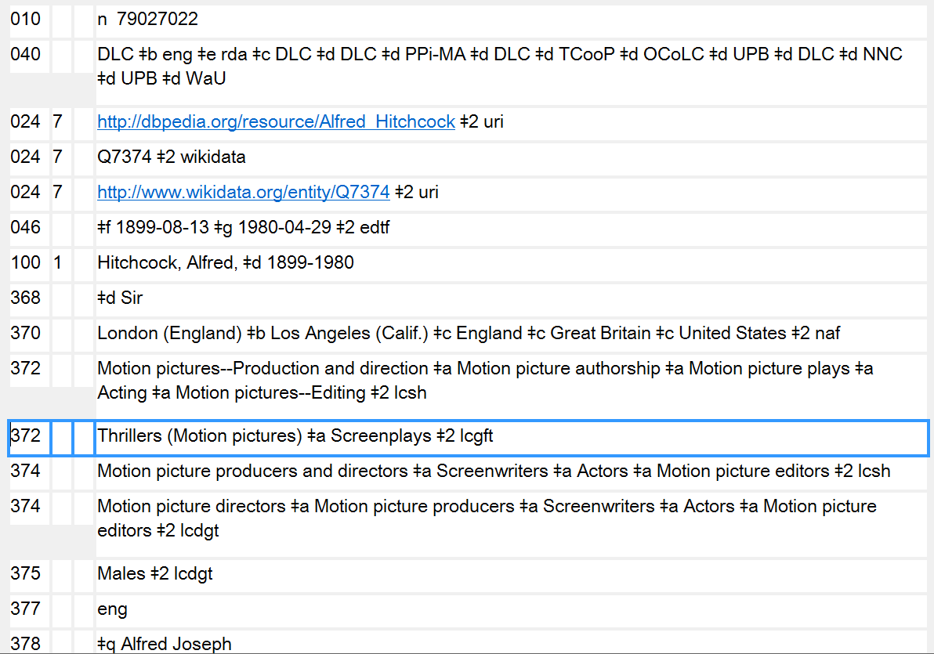
372 - Field of Activity in authority records may also contain genre/form terms
Notes:
Here’s an example of LCGFT terms used for Field of Activity (MARC 372). Alfred Hitchcock is well known as a director of suspense films and as a screenwriter.

Slide 35
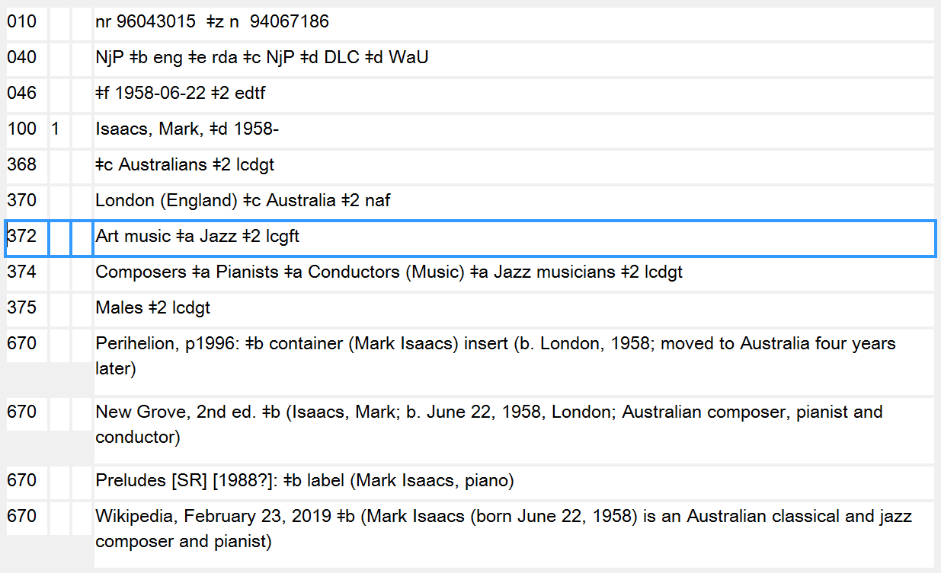
372 - Field of Activity in authority records may also contain genre/form terms
Notes:
Here’s another example of LCGFT terms used for Field of Activity (MARC 372). Mark Isaacs is a composer of classical music (“Art music” in LCGFT) and jazz.

Slide 36
LC Genre/Form Terms
General principles
May use subfield $3 when a term only applies to a part of a resource
245 04 The gold rush ; $b plus, Pay day / $c Film de Dam ; written and directed by Charlie Chaplin.
655 _7 Comedy films. $2 lcgft
655 _7 Silent films. $2 lcgft
655 _7 Fiction films. $2 lcgft
655 _7 $3 Gold rush: $a Feature films. $2 lcgft
655 _7 $3 Pay day: $a Short films. $2 lcgft
Notes:
The slide shows an example of using $3 in the 655 field. The DVD being cataloged contains two films. Both of the films are comedy films, silent films, and fiction films, so the first three 655s in the record apply to all the works. However, one of the works is a feature film and the other is a short film. In this example, the titles of the works that the genre/form term applies to have been used in the $3. But anything appropriate can go into the subfield, e.g. volume numbers, “1st work”, “2nd work”, accompanying disc, and so on. Use whatever is appropriate and makes the most sense.

Slide 37
LC Genre/Form Terms
General principles
May use subfield $3 when a term only applies to a part of a resource
245 00 Seascapes.
505 0_ Tintagel / Bax (14:47) -- Ports of call / Ibert (14:35) -- Four sea interludes from Peter Grimes / Britten (16:12) -- The sea, opus 28 / Glazunov (15:03) -- Beautiful Melusine / Mendelssohn (10:10).
655 _7 Program music. $2 lcgft
655 _7 $3 Tintagel: $a Symphonic poems. $2 lcgft
655 _7 $3 Ports of call: $a Suites. $2 lcgft
655 _7 $3 Four sea interludes from Peter Grimes: $a Interludes (Music) $2 lcgft
655 _7 $3 The sea: $a Fantasias (Music) $2 lcgft
655 _7 $3 Beautiful Melusine: $a Overtures. $2 lcgft
Notes:
An example of a sound recording with different genre/forms of works. $3 may be used to identify the work to which the genre/form term applies. The first term, “Program music,” applies to the compilation as a whole.

Slide 38
LC Genre/Form Terms
General principles
May use subfield $3 when a term only applies to a part of a resource
245 00 Tennessee River Civil War driving tour.
300 __ 1 audio disc (approximately 18 min.) : $b digital ; $c 4 3/4 in. + $e 1 videodisc (approximately
23 min. : sound, color ; 4 3/4 in.) + 1 color map (27 x 19 cm, on sheet 44 x 28 cm, folded to 14
x 11 cm)
520 __ Driving tour of Civil War sites in Tennessee, specifically along the Tennessee River and
surrounding area. Includes audio tour CD with accompanying map. The map includes an
audio CD legend of attractions and GPS coordinates, and URLs to local area tourist websites.
The accompanying DVD covers the same sites referenced on both the audio CD and map.
655 _7 $3 CD: $a Audiobooks. $2 lcgft
655 _7 $3 CD: $a Guidebooks. $2 lcgft
655 _7 $3 Accompanying DVD: $a Travelogues (Motion pictures) $2 lcgft
655 _7 $3 Accompanying DVD: $a Nonfiction films. $2 lcgft
655 _7 $3 Accompanying DVD: $a Short films. $2 lcgft
655 _7 $3 Accompanying map: $a Tourist maps. $2 lcgft
Notes:
Here’s a multipart monograph consisting of an audio disc, videodisc, and map. The use of $3 in 655 helps to identify what LCGFT terms apply to what part of the resource.

Slide 39
LC Genre/Form Terms
General principles
Specificity applies to genre/form the same as it does to subjects. Assign LCGFT terms that are specific to the resource being cataloged. A seemingly broad term like Poetry is specific when you’re cataloging a collection of poems in many different forms.
Assign genre/form terms only as they come readily to mind after a superficial review of the resource being cataloged.
Assign genre/form terms that correspond to the cataloging treatment of the resource. If cataloging a continuing resource such as a periodical, a monographic series, or a collected set, assign terms that characterize the resource as a whole. If cataloging a work as an analytic, assign terms that characterize the analytic.

Slide 40
LC Genre/Form Terms
General principles
Assign terms based on analysis of the resource being cataloged. Genre/form terms do not need to be justified by descriptive cataloging elements
Assign to the resource being cataloged genre/form terms that describe the resource as a whole. Sometimes one term is sufficient, while at other times a complement of terms is necessary
Assign broader or more general terms when it’s not possible to establish a more specific term, when an array of terms is needed (e.g., for a Western romance novel, three terms are needed: Western fiction, Romance fiction, and Novels), or when the LCGFT Manual includes special instructions to do this

Slide 41
LC Genre/Form Terms
General principles
It is permissible to assign both a broader and a narrower term (for a compilation that consists of a predominant genre or form but includes a “significant proportion” of works that would be assigned another term in the hierarchy)
Example: for a poetry collection primarily containing limericks but also containing a significant proportion of other types of humorous poetry, may assign both Limericks and Humorous poetry
If there is a predominant genre/form, assign that term first; if predominant genre/form needs two terms to express it, assign them first
Notes:
First bullet:
GFTM J 110 says “Note: The use of the phrase ‘significant proportion’ is deliberate. Catalogers should take the intent of the resource into account and display good judgment when assigning terms from
multiple levels of the hierarchy in this manner.”

Slide 42
LC Genre/Form Terms
General principles
Don’t assign genre/form terms to works that have no discernible genre/form (e.g., a history of U.S. foreign relations in the 20th century)
For resources with separate parts (e.g., text plus an extensive bibliography or a section of maps; book with accompanying disc) also assign separate terms for the individual parts or materials if they are judged to be significant. May use $3 to identify the part to which a term applies
Notes:
LCGFT Manual J 110

Slide 43
LC Genre/Form Terms
General principles
Number of terms
If a resource consists of two or three genres that make up a broader genre, and that broader genre includes no other than those two or three genres within its scope, assign the broader genre instead of the two or three narrower genres
Title: The best Rosh ha-Shanah and Yom Kippur music : music of the High
Holidays
Term assigned: High Holiday music (rather than Rosh ha-Shanah music and Yom Kippur music)
Notes:
LCGFT Manual J 110
6. Two or three related terms. If a term exists, or can be established (see J 120), that (1) represents the two or three genres or forms displayed by a resource, and (2) includes no other genres or forms within its scope, assign one term instead of two or three narrower terms.

Slide 44
LC Genre/Form Terms
General principles
Number of terms - Rule of Three
If a genre/form term includes in its scope more than three sub-genres or forms, but the resource being cataloged consists of only two or three of those sub-genres or forms, assign the appropriate two or three terms instead of the broader term
Title: Time machine: the history of Canadian 60’s garage, punk, and surf, 1985-95
Terms assigned: Garage rock music
Punk rock music
Surf music
not Rock music, the broader term, because it has more than three NTs
Notes:
LCGFT Manual J 110
7. Rule of three. If a genre/form term includes in its scope more than three sub-genres or forms, but the resource being cataloged consists of only two or three of those sub-genres or forms, assign the appropriate two or three terms instead of the broader term.
If a resource displays more than three of the narrower terms of a single broader term, assign the broader term unless the rule of four, described below, applies.

Slide 45
LC Genre/Form Terms
General principles
Number of terms - Rule of Three
If a resource displays more than three of the narrower terms of a single broader term, assign the broader term unless the rule of four applies
Number of terms - Rule of Four
For resources that display four sub-genres or forms of a broader term, if the four sub-genres or forms comprise only a small portion of the scope of the broader term (i.e., the broader term has many narrower terms in addition to the four in question), assign the four sub-genres or forms instead of the broader term.
Example: poetry anthology that consists of four Japanese forms: Haiku, Senryu, Tanka, and Kyōka. Assign the four specific terms rather than Poetry
Notes:
LCGFT Manual J 110
7. Rule of three. If a genre/form term includes in its scope more than three sub-genres or forms, but the resource being cataloged consists of only two or three of those sub-genres or forms, assign the appropriate two or three terms instead of the broader term.
If a resource displays more than three of the narrower terms of a single broader term, assign the broader term unless the rule of four, described below, applies.
8. Rule of four. In certain circumstances it may be preferable to assign terms for four sub-genres or forms of a broad term. If a term covers a broad range and each sub-genre or form comprises only a small portion of that whole range, assign the four sub-genres or forms. For example, a poetry anthology that consists of haiku, senryu, tanka, and kyōka may be assigned terms for those
four genres instead of the broad term Poetry.
LC practice: Do not exceed four sub-genres or forms under any circumstances.

Slide 46
LC Genre/Form Terms
General principles
Bring out or account for each genre or form in the title and subtitle if they accurately represent the genre(s) and/or form(s) of the resource and if they are useful for retrieval
If the title is general but the work is actually of a more specific genre and/or form, assign terms for the specific genre or form
If many genres and/or forms are listed on the title page in the manner of a table of contents, treat them as a table of contents
Follow additional instructions in the manual for kinds of resources and disciplines (e.g., literature)
Notes:
LCGFT Manual J 110

Slide 47
LC Genre/Form Terms
General principles
Objectivity: Avoid assigning terms that express personal value judgments and opinions about resources being cataloged. Consider the intent of the author or publisher, and if possible assign terms for this orientation without being judgmental (e.g., if collection says it’s humorous poetry, assign the appropriate term even if you don’t find the poems funny)
LCGFT terms are not authorized for any type of subdivision (no $x, $y, $z, or $v)
Not valid: 655 _7 Science fiction $z France. $2 lcgft
655 _7 Science fiction $y 19th century. $2 lcgft
Valid: 655 _7 Science fiction. $2 lcgft
655 _4 Science fiction $z France.
655 _4 Science fiction $y 19th century.
Notes:
LCGFT Manual J 110
The last two valid examples are uncontrolled genre/form access points. They could be added in addition to the controlled form, but they may not be coded as being LCGFT.

Slide 48
LC Genre/Form Terms
General principles
If the classification number reflects the genre/form of the resource, record that genre/form term first
050 00 DS1.5 $b .I58a
111 2_ International Symposium on Asian Studies, $e author.
245 10 Proceedings of the ... International Symposium on Asian Studies.
651 _0 Asia $v Congresses.
651 _0 Asia $x Study and teaching $v Congresses.
655 _7 Conference papers and proceedings. $2 lcgft
655 _7 Serial publications. $2 lcgft

Slide 49
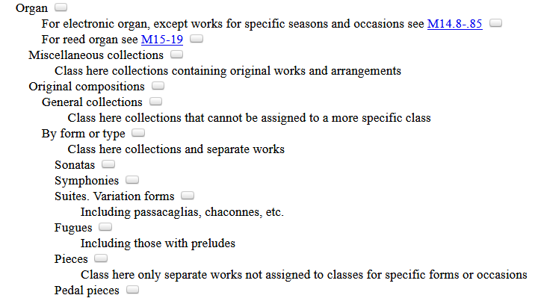
LC Genre/Form Terms
General principles
If the classification number reflects the genre/form of the resource, record that genre/form term first
050 _4 M10 $b .T289 2016
245 00 Ten preludes and fugues from the 19th and 20th centuries : $b for organ / $c compiled by
Esther Criscuola de Laix.
655 _7 Fugues. $2 lcgft
655 _7 Preludes (Music) $2 lcgft
655 _7 Scores. $2 lcgft
Notes:
Since this work has been classed in a number for fugues, the LCGFT term “Fugues” is given as the first 655 field.
"This volume features ten preludes, fugues, and prelude-fugue pairs from the early nineteenth through mid-twentieth centuries, by Charles Zeuner, Carl Czerny, Joseph Sulzer, and others. Included are pieces of a range of difficulties and lengths, with and without pedals, that are suitable for both service playing and concert use"--Back cover.

Slide 50
LC Genre/Form Terms
General principles
If no predominant genre/form and not classified in a number that reflects genre/form, then assign terms in any order considered to be most useful
If terms are assigned for the whole resource and for parts of the resource, assign terms for the whole before terms for the parts
100 1_ Shaw, Bernard, $d 1856-1950, $e author.
245 10 Three plays for Puritans / $c Bernard Shaw ; definitive text under the editorial
supervision of Dan H. Laurence ; with an introduction by Michael Billington.
505 0_ The devil's disciple -- Caesar and Cleopatra -- Captain Brassbound's conversion.
655 _7 Drama. $2 lcgft
655 _7 $3 The devil's disciple ; Captain Brassbound's conversion: $a Melodramas (Drama)
$2 lcgft
655 _7 $3 Caesar and Cleopatra: $a Historical drama. $2 lcgft
655 _7 $3 Caesar and Cleopatra: $a Biographical drama. $2 lcgft
655 _7 $3 Captain Brassbound's conversion: $a Problem plays. $2 lcgft
Notes:
The first genre/form term represents the compilation as a whole. Two of the plays are melodramas, one is both an historical drama and biographical drama, and one is a problem play (plays that dramatize contemporary social problems and are intended to change public opinion). The cataloger has opted to include $3 to indicate which plays are which genre/forms.

Slide 51
LC Genre/Form Terms
General principles
If no predominant genre/form and not classified in a number that reflects genre/form, then assign terms in any order considered to be most useful
If terms are assigned for the whole resource and for parts of the resource, assign terms for the whole before terms for the parts
245 10 Orchestral works / $c Henri Dutilleux.
505 0_ Symphony no. 1 -- Tout un monde lointain -- The shadows of time : for 3
children's voices and orchestra -- Métaboles -- Violin concerto : L'arbre des
songes -- Symphony no. 2 : Le double -- Sur le même accord : nocturne for
violin and orchestra -- Les citations : diptych for oboe, harpsichord, bass and
percussion -- Mystère de l'instant -- Timbres, espace, mouvement.
655 _7 Art music. $2 lcgft
655 _7 Symphonies. $2 lcgft
655 _7 Concertos. $2 lcgft
655 _7 Chamber music. $2 lcgft
Notes:
A sound recording of a number of kinds of orchestral works. The term Art music describes the contents as a whole. The cataloger opted not to include $3 to indicate which works are which genre/forms.

Slide 52
LCGFT Exercise - General Principles
You are cataloging Chelsea Quinn Yarbro’s Sins of Omission. Assign LCGFT for this work. Use appropriate MARC 21 coding and consult the PDF list of LCGFT terms.
Notes:
Answer:
655 _7 Paranormal fiction. $2 lcgft
655 _7 Thrillers (Fiction) $2 lcgft
655 _7 Novels. $2 lcgft

Slide 53
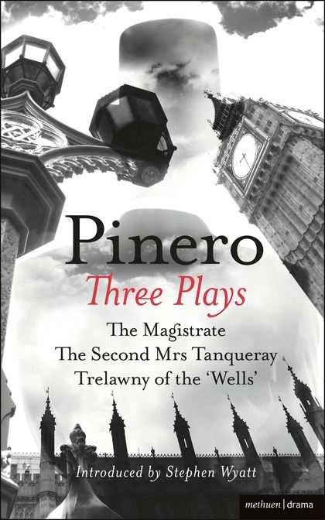
LCGFT Exercise - General Principles
You are cataloging the compilation Three Plays, by Arthur Wing Pinero. The plays are The Magistrate; The Second Mrs. Tanqueray; and Trelawny of the “Wells”. The first work is a farce, the second is a thesis play, and the third is a comedy. Assign LCGFT for this collection. Use appropriate MARC 21 coding and consult the PDF list of LCGFT terms.
Notes:
Answer:
655 _7 Drama. $2 lcgft
655 _7 $3 The magistrate: $a Farces. $2 lcgft
655 _7 $3 The second Mrs. Tanqueray: $a Problem plays. $2 lcgft
655 _7 $3 Trelawny of the "Wells": $a Comedy plays. $2 lcgft

Slide 54
LCGFT Exercise - General Principles
You are cataloging the compilation Bred Any Good Rooks Lately?: A Collection of Puns, Shaggy Dogs, Spoonerisms, Feghoots & Malappropriate Stories. Assign LCGFT for this collection. Use appropriate MARC 21 coding and consult the PDF list of LCGFT terms.
Notes:
Answer:
655 _7 Puns. $2 lcgft
655 _7 Shaggy dog stories. $2 lcgft
655 _7 Spoonerisms. $2 lcgft
655 _7 Humorous fiction. $2 lcgft
In LCGFT, Feghoots is a UF for Shaggy dog stories.
The rule of three does not apply, because there are more than three sub-genres of humor here.
“If a resource displays more than three of the narrower terms of a single broader term, assign the broader term unless the rule of four, described below, applies.”
The rule of four applies in this case, because the broader term Humor has many additional narrower terms besides the four above.
“Malappropriate stories” could indicate that there are malapropisms as well. If so then 655 _7 Malapropisms. $2 lcgft might also be needed. However, should that be the case, there would be five genre/form headings that had the BT Humor, and therefore one would assign “Humor” rather than five individual terms.

Slide 55
LCGFT
General Terms

Slide 56
LCGFT “General” Terms
Terms which are not specific to a particular discipline
Abridgments Almanacs Bibliographies Blogs
Conference papers and proceedings Diaries Dictionaries
FAQs Guidebooks Newsletters Picture books
Sayings Textbooks Yearbooks Zines
Terms for ephemera Calendars Menus Theater programs
Terms for some graphic materials Dance posters Postcards Paper dolls
Terms for puzzles and games Board games Sudoku puzzles
Terms for types of toy and movable books Flip books Pop-up books
Some nonfiction terms Autobiographies Biographies Diaries
Essays Travel writing True crime stories

Slide 57
LCGFT “General” Terms
Many have corresponding headings or form subdivisions in LCSH, but the LCGFT headings may not be identical. For example:
LCSH: $v Biography LCSH: $v Congresses
LCGFT: Biographies LCGFT: Conference papers and proceedings
LCSH: $v Handbooks, manuals, etc. LCSH: Imaginary histories
LCGFT: Handbooks and manuals LCGFT: Counterfactual histories
LCSH: Playbills LCSH: Sound effects books
LCGFT: Playbills (Posters) LCGFT: Sound books
LCSH: $v Tables LCSH: $v Exhibitions
LCGFT: Tables (Data) LCGFT: Exhibition catalogs
Notes:
All LCGFT terms are in the plural form, unlike some LCSH headings. Terms in LCSH with “etc.” were deemed undesirable, so you won’t find them in LCGFT. All terms were reevaluated to be sure that they reflected current and common usage and made sense as stand-alone genre/form terms.

Slide 58
LCGFT “General” Terms
Divided into 10 “top” terms: Commemorative works; Creative nonfiction; Derivative works; Discursive works; Ephemera; Illustrated works; Informational works; Instructional and educational works; Recreational works; Tactile works
These are mainly for gathering the general terms into broad categories; they will rarely be assigned in a bibliographic record because more specific terms are available
Some of the more specific terms may be in the hierarchies of multiple top terms. For example, Handbooks and manuals has two BTs, Instructional and educational works and Reference works, which is an NT of Informational works

Slide 59
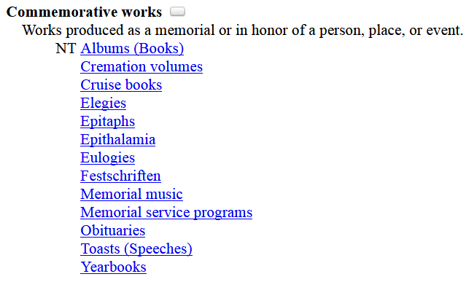
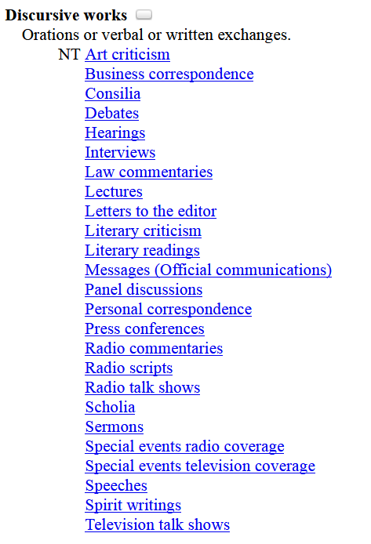
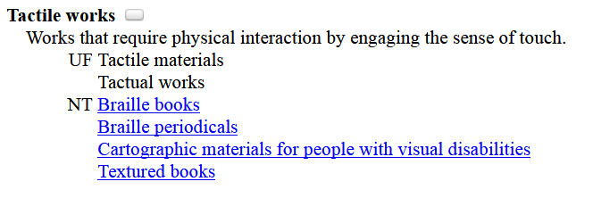
Notes:
Examples of some of the top-level general terms in Classification Web, showing their narrower terms.

Slide 60
General Term Examples
100 1_ Frank, Anne, $d 1929-1945, $e author.
240 10 Achterhuis. $l English
245 14 The diary of Anne Frank / $c prepared by the Netherlands Institute for
War Documentation …
600 10 Frank, Anne, $d 1929-1945 $v Diaries.
650 _0 Holocaust, Jewish (1939-1945) $z Netherlands
$z Amsterdam $v Personal narratives.
650 _0 Jewish girls $z Netherlands $z Amsterdam $v Diaries.
650 _0 Jews $z Netherlands $z Amsterdam $v Diaries.
655 _7 Diaries. $2 lcgft
655 _7 Personal narratives. $2 lcgft
Notes:
Note: I have not shown all of the subjects that were assigned to this work, just the ones that have corresponding LCGFT terms. In this case, the form subdivisions used in subject headings are identical to the LCGFT terms assigned.

Slide 61
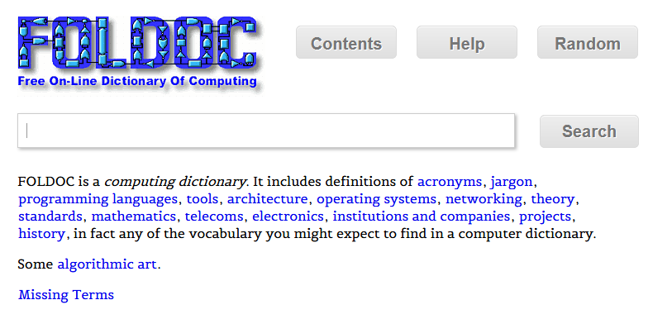
General Term Examples
245 00 FOLDOC : $b free on-line dictionary of computing / $c editor, Denis
Howe.
650 _0 Computer science $v Dictionaries.
650 _0 Computers $v Dictionaries.
650 _0 Microcomputers $v Dictionaries.
655 _7 Dictionaries. $2 lcgft
Notes:
Another example where the LCGFT term is identical to the LCSH form subdivision.

Slide 62
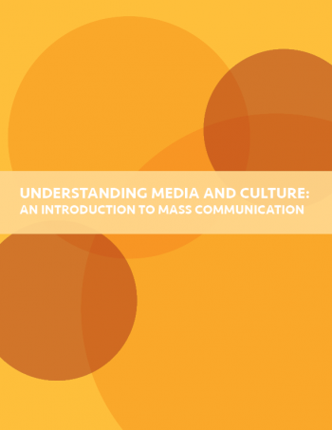
General Term Examples
245 00 Understanding media and culture : $b an
introduction to mass communication.
650 _0 Mass media $v Textbooks.
650 _0 Social media $v Textbooks.
650 _0 Culture $v Textbooks.
655 _7 Textbooks. $2 lcgft
Notes:
Another example where the LCGFT term is identical to the LCSH form subdivision. It won’t always be this simple, however!

Slide 63
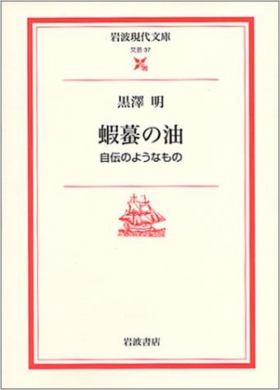
General Term Examples
100 1_ 黒澤明, $d 1910-1998, $e author.
100 1_ Kurosawa, Akira, $d 1910-1998, $e author.
245 10 蝦蟇の油 : $b 自伝のようなもの / $c 黒澤明.
245 10 Gama no abura : $b jiden no yō na mono / $c Kurosawa Akira.
600 14 黒澤明, $d 1910-1998.
600 10 Kurosawa, Akira, $d 1910-1998.
650 _0 Motion picture producers and directors $z Japan
$v Biography.
655 _7 Autobiographies. $2 lcgft
Notes:
An example where a more specific LCGFT term is assigned in 655 than the form subdivision used in the subject headings. Since this work is an autobiography, Autobiographies is the correct term to assign to this work.

Slide 64
General Term Examples
100 1_ Gross, John, $d 1935-2011, $e compiler.
245 14 The Oxford book of aphorisms / $c chosen by John Gross.
650 _0 Aphorisms and apothegms.
655 _7 Sayings. $2 lcgft
100 1_ Cordry, Harold V., $d 1943- $e compiler.
245 14 The multicultural dictionary of proverbs : $b over 20,000 adages from more than 120 languages, nationalities, and ethnic groups / $c Harold V. Cordry.
650 _0 Proverbs.
655 _7 Sayings. $2 lcgft
Notes:
In some cases, a single term has been chosen in LCGFT to represent a number of different terms in LCSH.

Slide 65
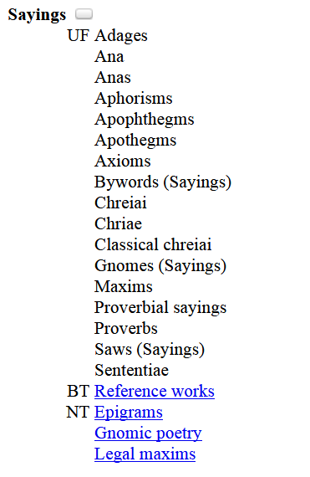
adage: a saying often in metaphorical form that typically embodies a common observation
aphorism: a terse formulation of a truth or sentiment : adage
apothegm: a short, pithy, and instructive saying or formulation : aphorism
axiom: a maxim widely accepted on its intrinsic merit
maxim: a proverbial saying
proverb: a brief popular epigram or maxim : adage
Definitions from Merriam-Webster dictionary online (https://www.merriam-webster.com)
Notes:
The differences in meaning of the terms “Adages”, “Aphorisms”, “Maxims”, “Proverbs”, etc. are so small and hard to discern, and often overlap. A single general term, “Sayings” was chosen for LCGFT.

Slide 66
General Term Examples
100 1_ Crowther, Robert, $e author.
245 10 Amazing pop-up trucks / $c Robert Crowther.
520 __ Text and pop-up illustrations introduce five different kinds of trucks from cement truck to garbage truck, and explain what they can do.
650 _0 Trucks $v Juvenile literature.
650 _1 Trucks.
650 _1 Pop-up books.
650 _1 Toy and movable books.
655 _7 Pop-up books. $2 lcgft

Slide 67
General Term Examples - Serials
245 00 Oregon historical quarterly.
310 __ Quarterly
651 _0 Oregon $x History $v Periodicals.
651 _0 Northwest, Pacific $x History $v
Periodicals.
655 _7 Periodicals. $2 lcgft
710 2_ Oregon Historical Society, $e issuing
body.

Slide 68
General Term Examples - Serials
110 2_ Seattle Parks Foundation, $e author.
245 10 Annual report.
246 13 Seattle Parks Foundation annual report
610 20 Seattle Parks Foundation $v Periodicals.
650 _0 Parks $z Washington (State) $z Seattle $v Periodicals.
655 _7 Annual reports. $2 lcgft
Notes:
Another situation in which the LCGFT term assigned does not correspond to the form subdivision used in the subject headings. Annual reports is the specific term appropriate to this work, it is assigned from LCGFT instead of Periodicals.
Note: just because something is issued annually does not make it an “Annual report”
The form subdivision $v Periodicals is used in a much broader sense than the actual definition of the term. Although one might assign the LCGFT term Periodicals, probably the broader term Serial publications is more appropriate for this publication.
From the Subject Headings Manual H 1927: “In subject cataloging practice the term periodical is defined as a publication other than a newspaper that is actually or purportedly issued according to a regular schedule (monthly, quarterly, biennially, etc.) in successive parts, each of which bears a numerical or chronological designation, and that is intended to be continued indefinitely. This definition is broader than the traditional definition, which states that a periodical is generally published more frequently than annually and normally contains separate articles. The term serial is frequently used in a broader sense to refer to any title cataloged as a serial, including periodicals, newspapers, monographic series, etc. The subdivision –Periodicals is used under headings assigned to serials that conform to the subject cataloging definition of periodicals.”

Slide 69
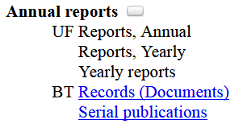
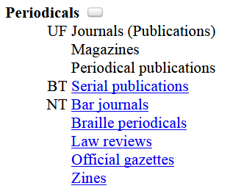
Notes:
As you can see from these terms in LCGFT, Annual reports is not considered a type of periodical.

Slide 70
General Term Examples - Serials
245 04 The Canada year book.
310 __ Annual (irregular)
362 0_ 1905-
362 1_ Ceased in print with 2012.
651 _0 Canada $v Statistics $v Periodicals.
655 _7 Statistics. $2 lcgft
655 _7 Yearbooks. $2 lcgft
Notes:
Another situation in which the LCGFT term assigned does not correspond to the form subdivision used in the subject headings. This annual publication is a yearbook, which is found in LCGFT as a particular type of serial publication. The ALA glossary of library and information science (1983) defines yearbook as: An annual compendium of facts and statistics of the preceding year, frequently limited to a special subject.
Note: just because something is issued annually does not make it an “Annual report” or a “Yearbook”
The form subdivision $v Periodicals is used in a much broader sense than the actual definition of the term. Although one might assign the LCGFT term Periodicals, probably the broader term Serial publications is more appropriate for this publication.
From the Subject Headings Manual H 1927: “In subject cataloging practice the term periodical is defined as a publication other than a newspaper that is actually or purportedly issued according to a regular schedule (monthly, quarterly, biennially, etc.) in successive parts, each of which bears a numerical or chronological designation, and that is intended to be continued indefinitely. This definition is broader than the traditional definition, which states that a periodical is generally published more frequently than annually and normally contains separate articles. The term serial is frequently used in a broader sense to refer to any title cataloged as a serial, including periodicals, newspapers, monographic series, etc. The subdivision –Periodicals is used under headings assigned to serials that conform to the subject cataloging definition of periodicals.”

Slide 71
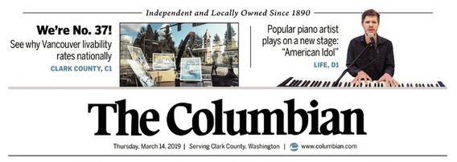
General Term Examples - Serials
130 0_ Columbian (Vancouver, Wash.)
245 14 The Columbian.
310 __ Daily (Mon.-Fri.), $b <Mar. 9, 1989->
321 __ Daily (except Saturdays), $b 1937-
651 _0 Vancouver (Wash.) $v Newspapers.
651 _0 Clark County (Wash.) $v Newspapers
655 _7 Newspapers. $2 lcgft

Slide 72
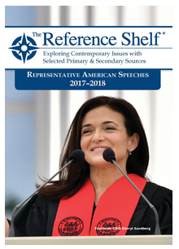
General Term Examples - Serials
130 _0 Representative American speeches (2015)
245 10 Representative American speeches.
310 __ Annual
362 1_ Began with 2014/2015.
386 __ Americans $2 lcdgt
490 1_ The reference shelf
650 _0 Speeches, addresses, etc., American
$y 21st century $v Periodicals.
655 _7 Speeches. $2 lcgft
655 _7 Serial publications. $2 lcgft
830 _0 Reference shelf.
Notes:
The form subdivision $v Periodicals is used in a much broader sense than the actual definition of the term. Although one might assign the LCGFT term Periodicals, probably the broader term Serial publications is more appropriate for this biennial publication.
From the Subject Headings Manual H 1927: “In subject cataloging practice the term periodical is defined as a publication other than a newspaper that is actually or purportedly issued according to a regular schedule (monthly, quarterly, biennially, etc.) in successive parts, each of which bears a numerical or chronological designation, and that is intended to be continued indefinitely. This definition is broader than the traditional definition, which states that a periodical is generally published more frequently than annually and normally contains separate articles. The term serial is frequently used in a broader sense to refer to any title cataloged as a serial, including periodicals, newspapers, monographic series, etc. The subdivision –Periodicals is used under headings assigned to serials that conform to the subject cataloging definition of periodicals.”

Slide 73
General Term Examples - Serials
245 00 Safety committees for the real world.
__ Annual
650 _0 Industrial safety $z Oregon $v
Handbooks, manuals, etc.
650 _0 Industrial hygiene $z Oregon $v
Handbooks, manuals, etc.
655 _7 Handbooks and manuals. $2 lcgft
655 _7 Serial publications. $2 lcgft
Notes:
Another example where the LCGFT term does not correspond exactly to the LCSH form subdivision. Catalogers must search the LCGFT genre/form authority records and use the headings found there. Don’t just copy LCSH form subdivisions into the 655 field.
Note: Although this is published annually, it is not an “Annual report.”
Note: $v Handbooks, manuals, etc. is one of the form subdivisions that the Subject Headings Manual (H 1927) says not to add $v Periodicals to:
Do not use –Periodicals as a further subdivision under the following form subdivisions:
–Amateurs' manuals –Atlases –Calendars –Cases –Congresses –Databases –Dictionaries –Digests –Directories –Encyclopedias –Gazetteers –Guidebooks
–Handbooks, manuals, etc. –Juvenile films –Juvenile literature –Juvenile sound recordings –Laboratory manuals –Maps –Newspapers –Observer's manuals –Outlines, syllabi, etc. –Photo maps –Registers –Telephone directories

Slide 74
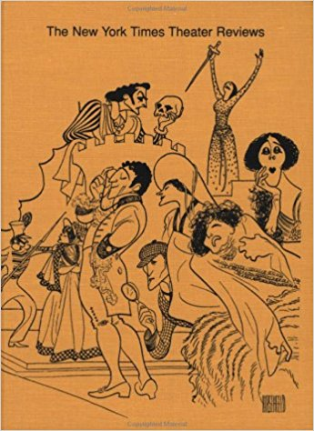
General Term Examples - Serials
245 00 The New York times theater reviews.
310 __ Biennial, $b 1971-72-
650 _0 Theater $z United States $v Reviews
$v Periodicals.
655 _7 Theater reviews. $2 lcgft
655 _7 Serial publications. $2 lcgft

Slide 75
General Term Examples - Serials
111 2_ Vancouver Queer Film & Video Festival, $e author.
245 14 The ... Annual Vancouver Queer Film & Video Festival : $b festival guide.
310 __ Annual
611 20 Vancouver Queer Film & Video Festival $v Periodicals.
650 _0 Gay and lesbian film festivals $z British Columbia $z Vancouver $v Periodicals.
655 _7 Film festival programs. $2 lcgft
655 _7 Serial publications. $2 lcgft
Notes:
Note: I have not shown all of the subjects that were assigned to this work, just the first two.

Slide 76
General Term Examples - Nontextual
100 1_ King, Coretta Scott, $d 1927-2006, $e author.
245 10 My life, my love, my legacy / $c Coretta Scott King as told to the Rev.
Dr. Barbara Reynolds.
250 __ Unabridged.
300 __ 1 online resource (1 sound file (14 hr., 30 min.)) : $b digital
600 10 King, Coretta Scott, $d 1927-2006.
600 10 King, Martin Luther, $c Jr., $d 1929-1968.
650 _0 Civil rights workers $z United States $v Biography.
…
655 _7 Autobiographies. $2 lcgft
655 _7 Audiobooks. $2 lcgft

Slide 77
General Term Examples - Nontextual
245 00 Travel writers / $c compilation, Steve Cleary.
300 __ 2 audio discs (150 min.) : $b digital, CD audio ; $c 4 3/4 in. + $e 1 booklet (13 unnumbered
pages : illustrations ; 12 cm).
500 __ "A mixture of radio broadcasts and live talks and readings"--Accompanying booklet.
505 0_ disc 1. Marooned on Elephant Island / Leonard D.A. Hussey (3:04). Speaking personally /
Rosita Forbes (7:48). The philosophy of exploration / Freya Stark (17:35). Nuptials of the
East and West / Sacheverell Sitwell (12:46). Interview at her home in Chandolin / Ella
Maillant ; interviewer, Bridget Carter (17:21). On the Bushmen of the Kalahari / Laurens
van der Post (19:10) -- disc 2. The time of my life / Peter Fleming (20:49). The empty
quarter / Wilfred Thesiger (16:02). The last fiesta / Laurie Lee (13:57). Turning points / Eric
Newby (11.28). Trieste and the meaning of nowhere / Jan Morris (6:02). By camel across
Sahara / Geoffrey Moorhouse ; interviewer, Robert Williams (4:55)..
655 _7 Travel writing. $2 lcgft
655 _7 Literary readings. $2 lcgft
655 _7 Nonfiction radio programs. $2 lcgft
655 _7 Interviews. $2 lcgft

Slide 78
General Term Examples - Nontextual
245 00 Stink bugs of Oregon.
264 1_ Salem, OR : $b Oregon Department of Agriculture, Plant Protection and Conservation Program, Insect Pest Prevention and Management, $c [2017]
300 __ 1 poster ; $b color ; $c 46 x 31 cm
650 _0 Stinkbugs $z Oregon $v Posters.
655 _7 Wildlife posters. $2 lcgft
Notes:
Another example where the form subdivision is more general than the LCGFT term that would be assigned.

Slide 79
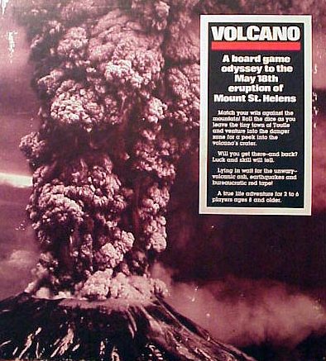
General Term Examples - Nontextual
245 00 Volcano : $b a board game odyssey to the May 18th eruption of Mount
St. Helens.
300 __ 1 game (1 board, 1 rules sheet, 6 colored move markers, 1 dice, 31
blue cards, 37 red cards, and 34 grey cards) : $b paper, cardboard, and
plastic ; $c 34 x 30 x 5 cm
655 _7 Board games. $2 lcgft

Slide 80
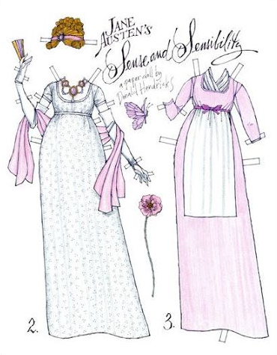
General Term Examples - Nontextual
100 1_ Hendricks, Donald, $e artist.
245 10 Elinor, Jane Austen's Sense and sensibility / $c a
paper doll by Donald Hendricks.
300 __ 6 unnumbered leaves : $b chiefly color illustrations ;
$c 28 cm
600 10 Dashwood, Elinor $x Clothing $v Pictorial works.
600 10 Austen, Jane, $d 1775-1817 $x Characters
$x Clothing $v Pictorial works.
650 _0 Costume $z England $x History $y 19th century
$v Pictorial works.
650 _0 Dresses $z England $x History $y 19th century
$v Pictorial works.
655 _7 Paper dolls. $2 lcgft
700 1_ $i Illustrations for (work): $a Austen, Jane, $d
1775-1817. $t Sense and sensibility.

Slide 81
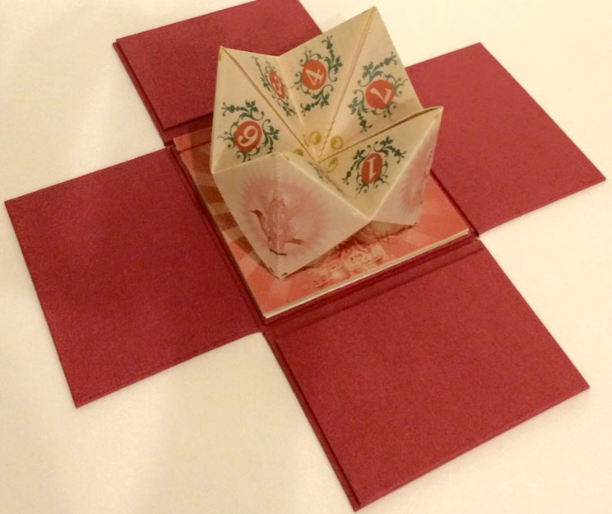
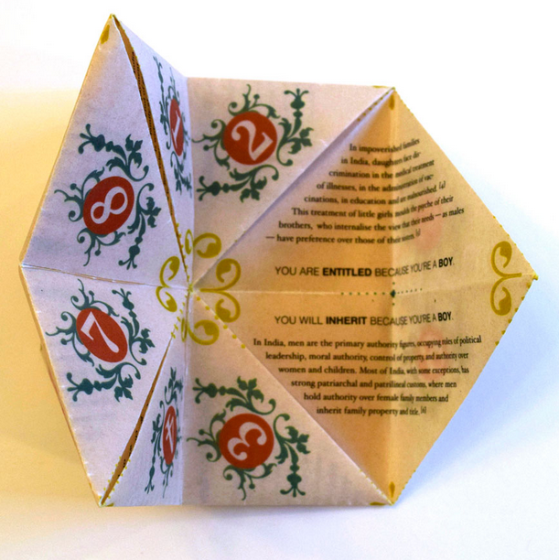
General Term Examples - Nontextual
100 1_ Gupta, Malini, $d 1972- $e book artist.
245 14 The fortune teller / $c designed and
digitally printed by Malini Gupta.
300 __ 17 unnumbered leaves : $b color
illustrations ; $c 14 cm, in box (10 x 15 x 15
cm) + $e 1 folded sheet (10 x 12 x 12 cm), 1
sheet (13 cm)
655 _7 Cootie catchers. $2 lcgft
655 _7 Toy and movable books. $2 lcgft
655 _7 Artists' books. $2 lcgft

Slide 82
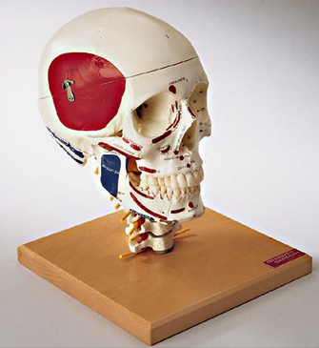
General Term Examples - Nontextual
245 00 Skull with muscle attachments.
300 __ 1 model (4 pieces) : $b vinyl plastic, color ;
$c 28 x 21 x 21 cm + $e 1
identification key booklet
650 _0 Skull $x Anatomy.
650 _0 Cervical vertebrae $x Anatomy.
655 _7 Anatomical models. $2 lcgft

Slide 83
LCGFT Exercises - General Terms
Assign LCGFT for the resources depicted. Use appropriate MARC 21 coding and consult the PDF list of LCGFT terms.

Slide 84
Notes:
Answer:
655 _7 Guidebooks. $2 lcgft
Subjects assigned:
650 _0 Popular music $z California $z San Francisco $x History and criticism.
650 _0 Musical landmarks $z California $z San Francisco $v Guidebooks.
651 _0 San Francisco (Calif.) $v Guidebooks.

Slide 85
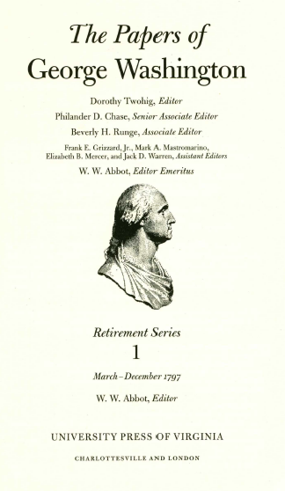
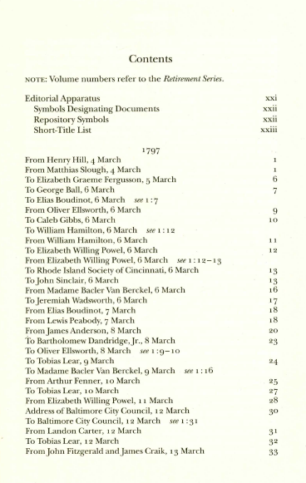
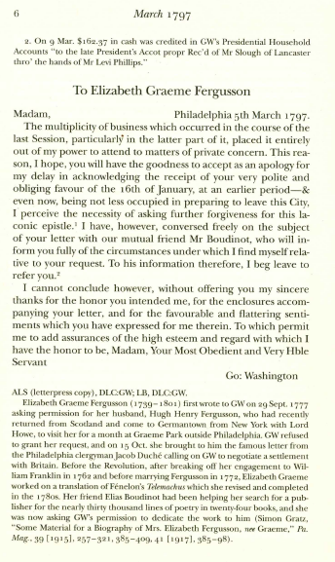
Notes:
ANSWER:
655 _7 Personal correspondence. $2 lcgft

Slide 86
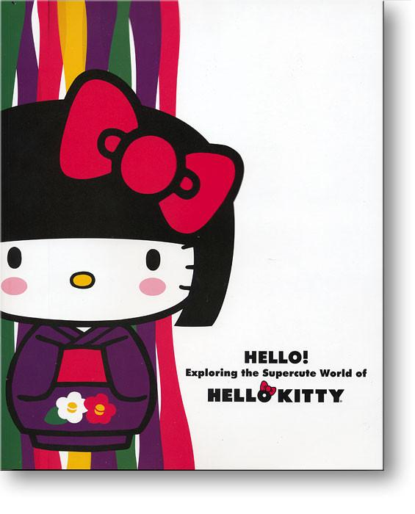
500 __ Published in conjunction with
the exhibition held October 11,
2014-May 31, 2015 at the
Japanese American National
Museum, Los Angeles, California.
600 00 Hello Kitty $c (Fictitious character)
$v Exhibitions.
600 00 Hello Kitty $c (Fictitious character)
$x Collectibles $v Exhibitions.
650 _0 Character toys $x Collectibles $z Japan $v Exhibitions.
650 _0 Licensed products $v Exhibitions.
Notes:
ANSWER:
655 _7 Exhibition catalogs. $2 lcgft
Perhaps also:
655 _7 Illustrated works. $2 lcgft

Slide 87
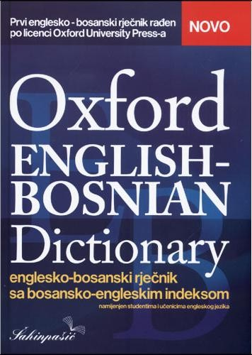
Notes:
ANSWER:
655 _7 Multilingual dictionaries. $2 lcgft

Slide 88
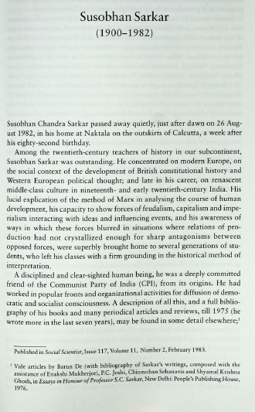
Foreword
To mark the completion of forty years of existence, we are bringing out collections of essays on some specific topics, culled from past numbers of the journal. The collection which follows is of obituary articles published in Social Scientist in the past. Oddly enough, for reasons which are not very clear, the journal published no obituaries until 1983, that is, for the first eleven years of its existence.
Notes:
ANSWER:
655 _7 Obituaries. $2 lcgft

Slide 89
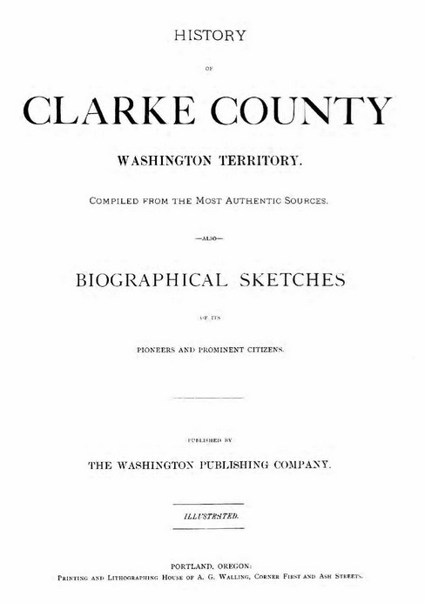
100 1_ Alley, B. F., $e author.
245 10 History of Clarke County, Washington
Territory : $b compiled from the most authentic
sources : also biographical sketches of its pioneers
and prominent citizens.
264 _1 Portland, Oregon : $b The Washington Publishing
Company, $c 1885
300 __ 399 pages, 86 unnumbered leaves of plates : $b
illustrations, portraits ; $c 30 cm
505 0_ Early history of the Pacific Coast -- Oregon's early
history -- Washington Territory -- Clarke County --
Biographical sketches.
651 _0 Clark County (Wash.) $x History.
651 _0 Clark County (Wash.) $v Biography.
651 _0 Washington Territory $x History.
651 _0 Oregon Territory $x History.
700 1_ Munro-Fraser, J. P., $e author.
Notes:
ANSWER:
655 _7 Local histories. $2 lcgft
655 _7 Biographies. $2 lcgft
655 _7 Portraits. $2 lcgft
655 _7 Illustrated works. $2 lcgft

Slide 90
Notes:
ANSWER:
655 _7 Conference papers and proceedings. $2 lcgft

Slide 91
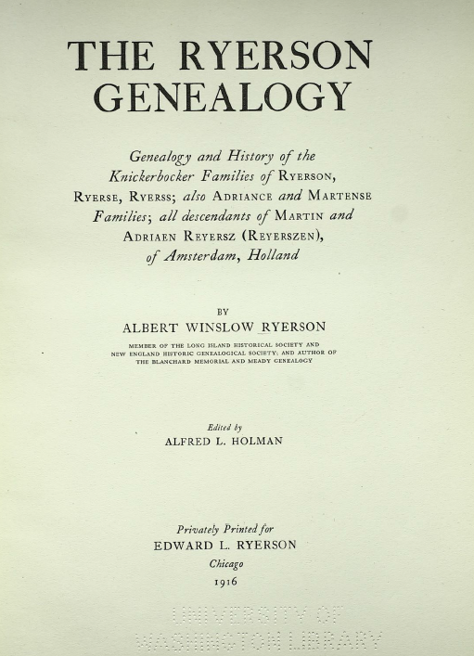
Notes:
ANSWER:
655 _7 Family histories. $2 lcgft

Slide 92
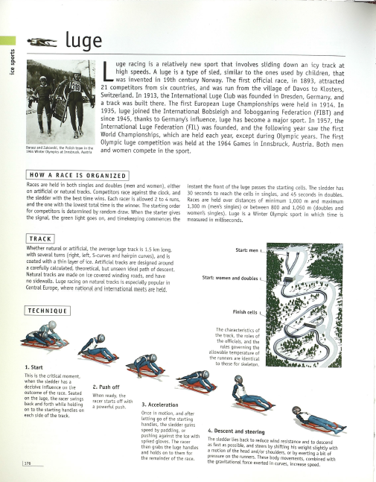
Notes:
ANSWER:
655 _7 Reference works. $2 lcgft
655 _7 Illustrated works. $2 lcgft
or perhaps
655 _7 Trivia and miscellanea. $2 lcgft
655 _7 Illustrated works. $2 lcgft

Slide 93
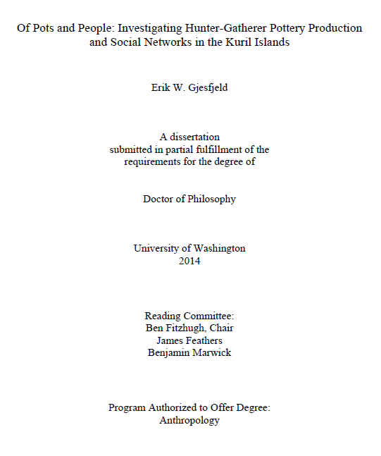
Notes:
ANSWER:
655 _7 Academic theses. $2 lcgft

Slide 94
Notes:
ANSWER:
655 _7 Self-help publications. $2 lcgft

Slide 95
100 1_ Santat, Dan, $e author, $e illustrator.
245 14 The adventures of Beekle : $b the unimaginary
friend / $c Dan Santat.
300 __ 1 volume (unpaged) : $b color illustrations ; $c 29 cm
520 __ "An imaginary friend waits a long time to be
imagined by a child and given a special name, and
finally does the unimaginable--he sets out on a
quest to find his perfect match in the real world."--$c
Provided by publisher.
521 __ Preschool.
521 8_ 480 $b Lexile.
526 0_ Accelerated Reader $c 2.3.
586 __ Caldecott Medal, 2015.
650 _0 Imaginary companions $v Juvenile fiction.
650 _0 Friendship $v Juvenile fiction.
650 _1 Imaginary playmates $v Fiction.
650 _1 Friendship $v Fiction.
Notes:
ANSWER:
655 _7 Picture books. $2 lcgft
655 _7 Fiction. $2 lcgft
For children’s picture books, neither Novels nor Short stories seems appropriate, so probably the best choice is Fiction.

Slide 96
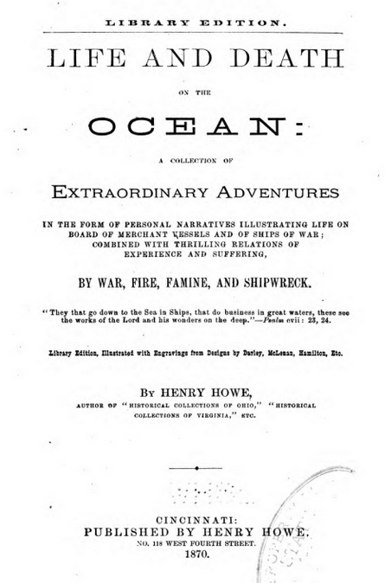
100 1_ Howe, Henry, $d 1816-1893, $e author.
245 10 Life and death on the ocean : $b a collection of extraordinary adventures in the form of personal narratives illustrating life on board of merchant vessels and of ships of war; combined with thrilling relations of experience and suffering, by war, fire, famine, and shipwreck / $c by Henry Howe.
650 _0 Voyages and travels.
650 _0 Seafaring life.
650 _0 Shipwrecks.
Notes:
ANSWER:
655 _7 True adventure stories. $2 lcgft
Perhaps also:
655 _7 Personal narratives. $2 lcgft

Slide 97
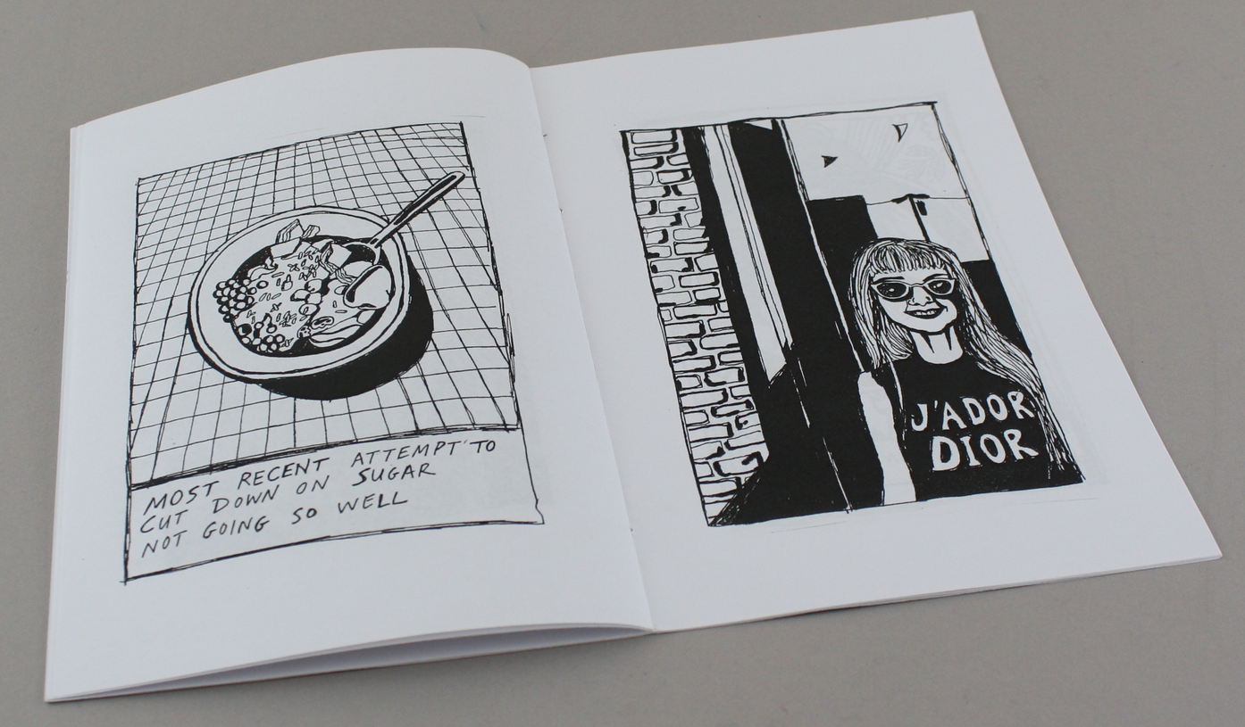
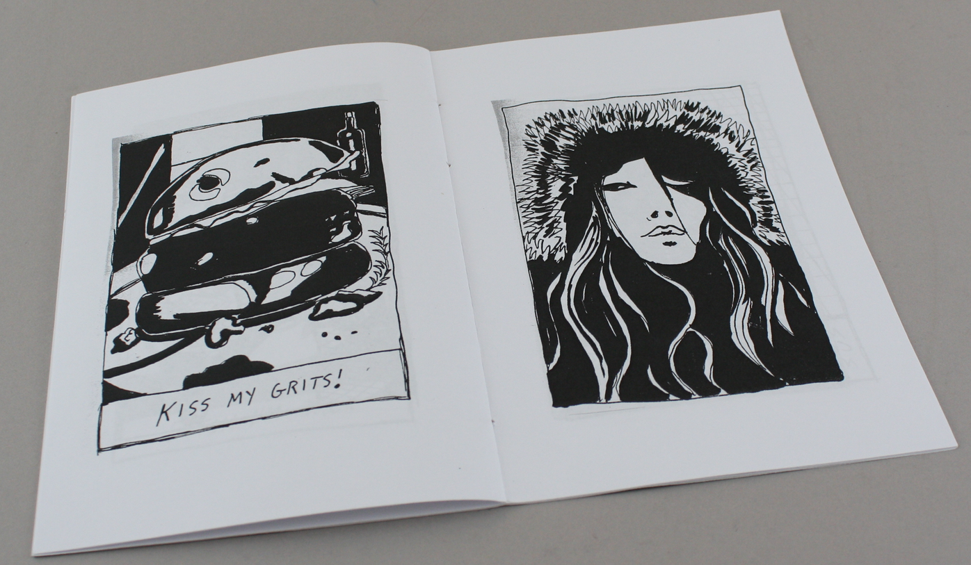
Notes:
ANSWER:
655 _7 Zines. $2 lcgft
655 _7 Illustrated works. $2 lcgft
or
655 _7 Zines. $2 lcgft
655 _7 Comics (Graphic works) $2 lcgft

Slide 98
https://www.greenkitchenstories.com/
Notes:
ANSWER:
655 _7 Recipes. $2 lcgft
655 _7 Blogs. $2 lcgft

Slide 99
Notes:
ANSWER:
655 _7 Periodicals. $2 lcgft

Slide 100
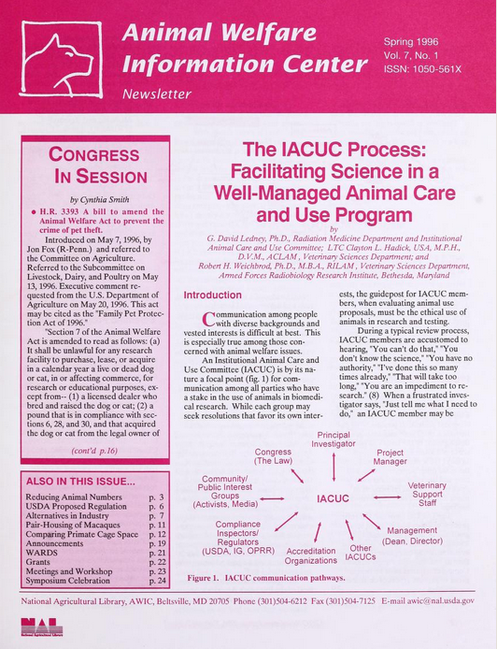
Notes:
ANSWER:
655 _7 Newsletters. $2 lcgft

Slide 101
All cataloged on a single record
Notes:
ANSWER:
655 _7 Guidebooks. $2 lcgft
655 _7 Serial publications. $2 lcgft

Slide 102
LCGFT
Literature Terms

Slide 103
LCGFT Literature Terms
Top term: Literature
Five high-level terms under Literature:
Comics (Graphic works)
Drama
Fiction
Folk literature
Poetry
Notes:
The top term Literature is unlikely to be used very much, since more specific terms will generally be available. It might be used for very general literary anthologies.
All of the terms below Literature may be used for both collections and individual works.

Slide 104
LCGFT Literature Terms
Many have corresponding headings in LCSH, but the LCGFT headings may not be identical. For example:
LCSH: Adventure stories LCSH: Motion picture plays LCSH: Horror comic books, strips, etc.
LCGFT: Action and adventure fiction LCGFT: Screenplays LCGFT: Horror comics
LCSH: Comic books, strips, etc. LCSH: Nonfiction novel LCSH: Gothic fiction (Literary genre)
LCGFT: Comics (Graphic works) LCGFT: Nonfiction novels LCGFT: Gothic fiction
LCSH: Horror tales LCSH: Moralities LCSH: Spy stories
LCGFT: Horror fiction LCGFT: Morality plays LCGFT: Spy fiction
LCSH: Plot-your-own stories LCSH: Comedy LCSH: Tragedy
LCGFT: Choose-your-own stories LCGFT: Comedy plays LCGFT: Tragedies (Drama)
LCSH: Mysteries and miracle-plays LCSH: Magic realism (Literature) LCSH: Suspense fiction
LCGFT: Mystery and miracle plays LCGFT: Magic realist fiction LCGFT: Suspense fiction and Thrillers (Fiction)
Notes:
All LCGFT terms are in the plural form, unlike some LCSH headings.

Slide 105
LCGFT Literature Terms
Explicit aspects like audience, creator characteristics, place of origin, language, and time period of creation that are often included in LCSH were out of scope for LCGFT if they are explicit in the term, so you will not find terms like these from LCSH:
Buddhist stories Byzantine literature Children’s poetry
Chinese drama Christian fiction College prose
Gay men’s writings Literature, Medieval Mexican periodicals

Slide 106
LCGFT Literature Terms
However, when those aspects are not explicit, terms may be in LCGFT, e.g.
Azharot Jewish liturgical poems on 613 commandments in the Torah
Bible plays specific religion is not explicit
Chansons de geste a medieval French genre
Comedies of humours an English 16th-17th century drama genre
Fabliaux bawdy medieval tales
Hyangga Korean poetry from Unified Silla (668-935) and Koryŏ dynasties (935-1392)
Jataka stories Buddhist tales about the previous births of the Buddha

Slide 107
LCGFT Literature Terms
Exclusions from LCGFT
Terms that require a value judgment on the part of catalogers and users are ineligible, e.g., Feminist fiction; Patriotic poetry
Terms for literary movements, e.g., Dadaist poetry; Expressionist drama; Beat literature
However, style and technique are eligible, e.g., Frame stories; Magic realist fiction; Metadramas; Parodies (Literature); Noir comics; Satirical literature; Stream of consciousness fiction
Notes:
Frame stories: stories that contain other stories
Metadramas: drama that self-consciously calls attention to its own fictional status as a theatrical pretense, often through the use of a play-within-a-play

Slide 108
LCGFT Literature Terms
LCGFT Manual J 235 Special provisions for literature:
Fiction: In addition to other genre/form terms, assign a term for length when it is readily apparent
Novels Novellas Short stories Flash fiction
Poetry: For both individual poems and collections of poetry, rely chiefly on the title, introduction, cover information, etc., to determine whether the poetry is of a specific genre or form. If after a superficial review a specific genre or form cannot be determined, assign the term Poetry
Poetry: If the genre or form of a poem or collection of poetry is known to the cataloger due to the cataloger’s academic or cultural background, etc., one or more genre/form terms may be assigned to represent the genre or form (e.g., you know that Homer’s Odyssey is Epic poetry even if the resource you’re cataloging doesn’t say it is)
Notes:
1. Fiction. In addition to terms assigned in accordance with the guidelines in J 110, assign a term that indicates the length of the resource when it is readily apparent (e.g., Novels; Novellas; Short stories; Flash fiction).
Flash fiction: very short fiction of just a page or two; short stories of extreme brevity.

Slide 109
Literature Examples - Fiction
245 00 Out of the blue : $b new short fiction
from Iceland / $c Helen Mitsios, editor
; foreword by Sigurjón Birgir Sigurðsson.
264 _1 Minneapolis : $b University of
Minnesota Press, $c 2017.
650 _0 Short stories, Icelandic $v Translations
into English.
650 _0 Icelandic fiction $y 21st century $v
Translations into English.
651 _0 Iceland $v Fiction.
655 _7 Short stories. $2 lcgft
Notes:
A collection of short stories by various authors. No specific literary genres/forms are identified other than the length of the fiction.

Slide 110
Literature Examples - Fiction
245 04 The future is female! : $b 25 classic science
fiction stories by women, from pulp pioneers
to Ursula K. Le Guin / $c Lisa Yaszek, editor.
264 _1 New York, NY : $b Library of America, $c
[2018]
650 _0 Science fiction, American.
650 _0 Short stories, American.
650 _0 American fiction ǂx Women authors.
655 _7 Short stories. $2 lcgft
655 _7 Science fiction. $2 lcgft
Notes:
A collection of short stories by various authors. In addition to the length of the fiction, a term for the genre can also be assigned.

Slide 111
Literature Examples - Fiction
100 1_ Proulx, Annie, $e author.
245 10 Brokeback Mountain / $c Annie Proulx.
260 __ New York : $b Scribner, $c 2005.
300 __ 55 pages ; $c 19 cm
650 _0 Cowboys $v Fiction.
650 _0 Ranch life $v Fiction.
650 _0 Gay men $v Fiction.
651 _0 Wyoming $v Fiction.
655 _7 Romance fiction. $2 lcgft
655 _7 Gay fiction. $2 lcgft
655 _7 Western fiction. $2 lcgft
655 _7 Short stories. $2 lcgft
Notes:
An individually published short story.

Slide 112
Literature Examples - Fiction
100 1_ Tartt, Donna, $e author.
245 14 The goldfinch / $c Donna Tartt.
650 _0 Young men $v Fiction.
650 _0 Loss (Psychology) $v Fiction.
650 _0 Artists $v Fiction.
650 _0 Self-realization $v Fiction.
651 _0 New York (N.Y.) $v Fiction.
655 _7 Novels. $2 lcgft
655 _7 Bildungsromans. $2 lcgft
655 _7 Fictional autobiographies. $2 lcgft

Slide 113
Literature Examples - Fiction
245 04 The pearl jacket and other stories : $b flash fiction from contemporary China / $c edited and translated by Shouhua Qi.
650 _0 Flash fiction, Chinese $v Translations into English.
650 _0 Chinese fiction $y 21st century $v Translations into English.
650 _0 Chinese fiction $y 20th century $v Translations into English.
655 _7 Flash fiction. $2 lcgft
Notes:
A compilation of flash fiction by Chinese authors. Flash fiction are stories that are very short, no more than a page or two in length. It is also known as microfiction, short-short stories, and sudden fiction.

Slide 114
Literature Examples - Fiction
245 00 한국 공포 문학 단편선.
245 00 Han'guk kongp'o munhak tanp'yŏnsŏn.
310 Annual
362 1_ Began in 2006.
650 _0 Horror tales, Korean $v Periodicals.
650 _0 Short stories, Korean $v Periodicals.
650 _0 Korean fiction $y 21st century $v Periodicals.
655 _7 Horror fiction. $2 lcgft
655 _7 Short stories. $2 lcgft
655 _7 Serial publications. $2 lcgft
Notes:
This is a compilation of works by different authors, issued as an annual publication, so here we have literature genre/form terms and a general term. For the fiction aspect, two terms are given, one for the genre (horror) and one for the length (short stories).
Genre/Form Terms Manual J 235 Literature
1. Fiction. In addition to terms assigned in accordance with the guidelines in J 110, assign a term that indicates the length of the resource when it is readily apparent (e.g., Novels; Novellas; Short stories; Flash fiction).

Slide 115
Literature Examples - Poetry
100 1_ Tolmie, Sarah, $e author.
245 10 Trio / $c Sarah Tolmie.
490 1_ The Hugh MacLennan poetry series
500 __ "A collection of 120 sonnets in eight parts,
Trio reveals, frame by frame, a married
fortysomething female narrator in love
with two younger men … and torn between
the claims of body and mind”--Page 4 of cover.
650 _0 Love poetry, Canadian.
650 _0 Sonnets, Canadian.
655 _7 Love poetry. $2 lcgft
655 _7 Sonnets. $2 lcgft
Notes:
A collection by one author.

Slide 116
Literature Examples - Poetry
100 1_ Pope, Alexander, $d 1688-1744, $e author.
245 14 The rape of the lock / $c Alexander Pope ;
edited by Elizabeth Gurr.
650 _0 Young women $v Poetry.
650 _0 Catholics $z England $v Poetry.
650 _0 Aristocracy (Social class) $z England $v Poetry.
650 _0 Pride and vanity $v Poetry.
655 _7 Mock-heroic poetry. $2 lcgft
655 _7 Narrative poetry. $2 lcgft
Notes:
An individually published poem.
LCGFT Manual J 235: “If the genre or form of a poem or collection of poetry is known to the cataloger due to the cataloger’s academic or cultural background, etc., one or more genre/form terms may be assigned to represent the genre or form.”

Slide 117
Literature Examples - Poetry
245 00 White lotus : $b a journal of haiku & senryu poetry.
310 __ Semiannual
362 0_ Issue #1 (fall/winter 2005)-
650 _0 Haiku, American $v Periodicals.
650 _0 Senryu, American $v Periodicals.
655 _7 Haiku. $2 lcgft
655 _7 Senryu. $2 lcgft
655 _7 Periodicals. $2 lcgft
Notes:
A journal that publishes two kinds of poetry.

Slide 118
Literature Examples - Poetry
245 04 The best American poetry.
260 New York, N.Y. : $b Collier Books, $c c1988-
260 3_ $3 <2011->: $a New York : $b Scribner Poetry
310 Annual
362 0_ 1988-
650 _0 American poetry $y 20th century $v Periodicals.
650 _0 American poetry $y 21st century $v Periodicals.
655 _7 Poetry. $2 lcgft
655 _7 Serial publications. $2 lcgft
Notes:
Here we have both a literature genre/form term and a general term. The broad term Poetry is used, as the collection contains a large variety of different types of poems.

Slide 119
Literature Examples - Comics
100 1_ Feiffer, Jules, $e author, $e artist.
245 10 Kill my mother : $b a graphic novel / $c Jules Feiffer.
650 _0 Private investigators $v Comic books, strips, etc.
650 _0 Murder $v Comic books, strips, etc.
655 _7 Graphic novels. $2 lcgft
655 _7 Noir comics. $2 lcgft

Slide 120
Literature Examples - Comics
100 1_ Limke, Jeff, $e author.
245 10 Isis & Osiris : $b to the ends of the Earth : an
Egyptian myth / $c story by Jeff Limke ; pencils
and inks by David Witt.
600 00 Isis $c (Egyptian deity) $v Comic books, strips, etc.
600 00 Osiris $c (Egyptian deity) $v Comic books, strips,
etc.
650 _0 Mythology, Egyptian $v Comic books, strips, etc.
655 _7 Mythological comics. $2 lcgft
655 _7 Graphic novels. $2 lcgft

Slide 121
Literature Examples - Comics
100 0_ Chii $c (Mangaka), $e author, $e artist.
240 10 Hanayome wa moto danshi. $l English
245 14 The bride was a boy / $c (true) story and art by Chii ;
translation, Beni Axia Conrad ; adaptation, Shanti
Whitesides ; lettering and retouch, Karis Page.
600 00 Chii $c (Mangaka) $v Comic books, strips, etc.
650 _0 Male-to-female transsexuals $z Japan $v Biography $v
Comic books, strips, etc.
650 _0 Transgender people $z Japan $v Biography $v Comic
books, strips, etc.
650 _0 Sex change $z Japan $v Comic books, strips, etc.
650 _0 Gender identity $z Japan $v Comic books, strips, etc.
655 _7 Autobiographical comics. $2 lcgft
655 _7 Transgender comics. $2 lcgft
655 _7 Graphic novels. $2 lcgft

Slide 122
Literature Examples - Drama
245 00 Plays and performance texts by women 1880-
1930 : $b an anthology of plays by British and
American women from the modernist period
/ $c edited by Maggie B. Gale and Gilli Bush-
Bailey.
650 _0 English drama $x Women authors.
650 _0 English drama $y 19th century.
650 _0 English drama $y 20th century.
650 _0 American drama $x Women authors.
650 _0 American drama $y 19th century.
650 _0 American drama $y 20th century.
655 _7 Drama. $2 lcgft
Notes:
Collection of drama by various authors. No specific genres or forms to bring out.

Slide 123
Literature Examples - Drama
245 00 Christmas on stage : $b an anthology of royalty-free
Christmas plays for all ages / $c edited by Theodore O.
Zapel.
520 __ Contains twenty-seven royalty-free one-act plays and
readings for Christmas programs.
650 _0 Christmas plays, American.
650 _0 Children's plays, American.
650 _0 Young adult drama, American.
650 _0 One-act plays, American.
655 _7 Christmas plays. $2 lcgft
655 _7 One-act plays. $2 lcgft
655 _7 Theatrical adaptations. $2 lcgft
655 _7 Literary readings. $2 lcgft
655 _0 Non-royalty plays.
Notes:
Collection of drama by various authors, with specific genres or forms that can be brought out. The last 655 is taken from LCSH, as it is the type of term ineligible for inclusion in LCGFT.

Slide 124
Literature Examples - Drama
100 1_ Hanreddy, Joseph, $e author.
245 10 Pride & prejudice / $c by Jane Austen ; adapted
for the stage by Joseph Hanreddy & J.R. Sullivan.
600 10 Bennet, Elizabeth $c (Fictitious character) $v
Drama.
600 10 Darcy, Fitzwilliam $c (Fictitious character) $v
Drama.
650 _0 Young women $z England $v Drama.
650 _0 Courtship $v Drama.
650 _0 Sisters $z England $v Drama.
655 _7 Domestic drama. $2 lcgft
655 _7 Romantic plays. $2 lcgft
655 _7 Historical drama. $2 lcgft
655 _7 Theatrical adaptations. $2 lcgft
Notes:
A single play.

Slide 125
Literature Examples - Folk Literature
245 00 Long ago and far away : $b eight traditional fairy tales
/ $c foreword by Marina Warner ; translated by
Nigel Bryant, David Carter and Ann Lawson Lucas.
505 0_ Sleeping beauty from Perceforest -- Cinderella from
La gatta Cennerentola -- Snow White from La
Schiavottella -- Little Red Riding Hood from Le petit
chaperon rouge -- Little Red Riding Hood from Le
conte de la mère-grand -- Hansel and Gretel from Le
petit poucet -- Jack and the beanstalk -- Beauty and
the Beast from La belle et la bête -- The Little Mermaid
from Undine.
650 _0 Fairy tales.
655 _7 Fairy tales. $2 lcgft

Slide 126
Literature Examples - Folk Literature
100 0_ Gui de Cambrai, $d active 13th century, $e author.
240 10 Barlaam et Josaphat. $l English
245 10 Barlaam and Josaphat : $b a Christian tale of the
Buddha / $c Gui de Cambrai ; translated with notes
by Peggy McCracken ; Introduction by Donald S.
Lopez Jr.
600 00 Gautama Buddha $v Legends.
600 00 Barlaam, $c Saint (Legendary character) $v Legends.
600 00 Josaphat, $c Saint (Legendary character) $v Legends.
655 _7 Legends. $2 lcgft

Slide 127
Literature Examples - Folk Literature/Poetry
100 1_ Agee, Jon, $e author.
245 10 Orangutan tongs : $b poems to tangle your tongue / $c by
Jon Agee.
650 _0 Tongue twisters.
650 _0 Humorous poetry, American.
650 _0 Children's poetry, American.
655 _7 Tongue twisters. $2 lcgft
655 _7 Humorous poetry. $2 lcgft

Slide 128
LCGFT Exercises - Literature Terms
Assign LCGFT for the resources depicted. Use appropriate MARC 21 coding and consult the PDF list of LCGFT terms.

Slide 129
100 1_ Duffy, Damian, $e author, $e artist.
245 10 Kindred : $b a graphic novel adaptation /
$c by Damian Duffy and John Jennings.
650 _0 African American women $v Comic books,
strips, etc.
651 _0 Los Angeles (Calif.) $v Comic books, strips, etc.
651 _0 Southern States $v Comic books, strips, etc.
650 _0 Slaves $v Comic books, strips, etc.
650 _0 Slavery $v Comic books, strips, etc.
650 _0 Slaveholders $v Comic books, strips, etc.
650 _0 Time travel $v Comic books, strips, etc.
700 1_ $i Graphic novelization of (work): $a Butler,
Octavia E. $t Kindred.
Notes:
ANSWER:
655 _7 Science fiction comics. $2 lcgft
655 _7 Graphic novel adaptations. $2 lcgft
LCGFT has Time-travel fiction, but this may only be used for fiction (novels, short stories, etc.). Based on that term as a pattern, a SACO proposal could probably be made to establish Time-travel comics.

Slide 130
100 1_ Atwood, Margaret, $d 1939- $e author.
245 14 The handmaid's tale / $c Margaret Atwood.
250 __ Large print edition.
264 1_ Waterville, Maine : $b Thorndike Press,
a part of Gale, Cengage Learning, $c 2017.
300 __ 531 pages (large print) ; $c 23 cm.
340 __ $n large print $2 rdafs
490 1_ Thorndike Press large print core 650 _0 Theocracy $v Fiction.
650 _0 Misogyny $v Fiction.
650 _0 Dystopias $v Fiction.
650 _0 Pregnancy $x Social aspects $v Fiction.
650 _0 Man-woman relationships $v Fiction.
650 _0 Women $v Fiction.
830 _0 Thorndike Press large print core series.
Notes:
ANSWER:
655 _7 Dystopian fiction. $2 lcgft
655 _7 Political fiction. $2 lcgft
655 _7 Novels. $2 lcgft
Note: large print is a manifestation element, so it is not eligible to be in LCGFT. If a cataloger wanted, they could assign:
655 _0 Large type books.

Slide 131
Notes:
ANSWER:
655 _7 Poetry. $2 lcgft
There is nothing to indicate that the poems are of specific types and catalogers are not required to examine each poem and try to determine what kind(s) they are.

Slide 132
245 00 Brewing : $b 20 Milwaukee poets / $c edited by Martin J. Rosenblum ;
photographs by G. Reed.
246 30 20 Milwaukee poets
246 3_ Twenty Milwaukee poets
490 1_ The city anthology series of American
poetry
650 _0 American poetry $z Wisconsin $z
Milwaukee.
650 _0 American poetry $y 20th century.
651 _0 Milwaukee (Wis.) $v Poetry.
Notes:
ANSWER:
655 _7 Topographical poetry. $2 lcgft
655 _7 Poetry. $2 lcgft

Slide 133
245 00 Horniman's choice : $b four one act
plays from the "Manchester School“
of playwrights.
264 _1 London : $b Oberon Books, $c 2015.
505 0_ The price of coal / by Harold Brighouse
-- Night watches / by Allan Monkhouse
-- The Old Testament and the New / by
Stanley Houghton -- Lonesome like /
by Harold Brighouse.
651 _0 England, North West $x Social life and
customs $y 20th century $v Drama.
650 _0 One-act plays, English.
650 _0 English drama $y 20th century.
Notes:
ANSWER:
655 _7 One-act plays. $2 lcgft

Slide 134
100 1_ Mead, Richelle, $e author.
245 10 Shadow kiss / $c Richelle Mead.
490 1_ A Vampire Academy novel
650 _0 Vampires $v Juvenile fiction.
650 _0 High schools $v Juvenile fiction.
650 _0 Schools $v Juvenile fiction.
650 _0 Magic $v Juvenile fiction.
650 _0 Social classes $v Juvenile fiction.
650 _1 Vampires $v Fiction.
650 _1 High schools $v Fiction.
650 _1 Schools $v Fiction.
650 _1 Magic $v Fiction.
650 _1 Social classes $v Fiction.
800 1_ Mead, Richelle. $t Vampire
Academy novel.
"Is Rose's fate to kill the person she loves most? It's springtime at St. Vladimir's Academy, and Rose Hathaway is this close to graduation. Since Mason's death, Rose hasn't been feeling quite right. She has dark flashbacks in the middle of practice, can't concentrate in class, and has terrifying dreams about Lissa. But Rose has an even bigger secret .... She's in love with Dimitri. And this time, it's way more than a crush. Then Strigoi target the academy in the deadliest attack in Moroi history, and Dimitri is taken. Rose must protect Lissa at all costs, but keeping her best friend safe could mean losing Dimitri forever...“ --Amazon.com
Notes:
ANSWER:
655 _7 Novels. $2 lcgft
655 _7 Vampire fiction. $2 lcgft
655 _7 Fantasy fiction. $2 lcgft
655 _7 Romance fiction. $2 lcgft
Not also Paranormal fiction. $2 lcgft because that is a BT for Vampire fiction.

Slide 135
100 1_ Tempest, Kate, $e author.
245 10 Let them eat chaos / $c Kate Tempest.
500 __ “This poem was written to be read aloud”--Page opposite title page verso.
On back cover:
"Let Them Eat Chaos, Kate Tempest's new long poem written
for live performance and heard on the album release of the
same name, is both a powerful sermon and a moving play for
voices. Seven neighbours inhabit the same London street, but
are all unknown to each other. The clock freezes in the small
hours, and, one by one, we see directly into their lives: lives
that are damaged, disenfranchised, lonely, broken, addicted.
Then a great storm breaks over London, and brings them out
into the night to face each other--and offers them a chance
to connect.”
Notes:
ANSWER:
655 _7 Spoken word poetry. $2 lcgft
Possibly also: 655 _7 Narrative poetry. $2 lcgft

Slide 136
An annual cataloged as a serial
Notes:
ANSWER:
655 _7 Short stories. $2 lcgft
655 _7 Serial publications. $2 lcgft

Slide 137
SEE ALSO NEXT TWO SLIDES
Notes:
ANSWER:
655 _7 $3 The rape of the lock: $a Mock-heroic poetry. $2 lcgft
655 _7 $3 The rape of the lock: $a Narrative poetry. $2 lcgft
655 _7 $3 An essay on man: $a Didactic poetry. $2 lcgft
655 _7 $3 An essay on man: $a Epistolary poetry. $2 lcgft
Note: Philosophical poetry is not yet established in LCGFT, but it could be proposed through SACO. LCGFT already has Philosophical fiction.

Slide 138
Source: CliffsNotes website
https://www.cliffsnotes.com/literature/c/candide/critical-essays/alexander-popes-essay-on-man
The work that more than any other popularized the optimistic philosophy, not only in England but throughout Europe, was Alexander Pope's Essay on Man (1733-34), a rationalistic effort to justify the ways of God to man philosophically. As has been stated in the introduction, Voltaire had become well acquainted with the English poet during his stay of more than two years in England, and the two had corresponded with each other with a fair degree of regularity when Voltaire returned to the Continent.
Voltaire could have been called a fervent admirer of Pope. ... Even as late as 1756, the year in which he published his poem on the destruction of Lisbon, he lauded the author of Essay on Man. In the edition of Lettres philosophiques published in that year, he wrote: “The Essay on Man appears to me to be the most beautiful didactic poem, the most useful, the most sublime that has ever been composed in any language.” …
Pope denied that he was indebted to Leibnitz for the ideas that inform his poem, and his word may be accepted. Those ideas were first set forth in England by Anthony Ashley Cowper, Earl of Shaftesbury (1671-1731). They pervade all his works but especially the Moralist. Indeed, several lines in the Essay on Man, particularly in the first Epistle, are simply statements from the Moralist done in verse. Although the question is unsettled and probably will remain so, it is generally believed that Pope was indoctrinated by having read the letters that were prepared for him by Bolingbroke and that provided an exegesis of Shaftesbury's philosophy. The main tenet of this system of natural theology was that one God, all-wise and all-merciful, governed the world providentially for the best.
Notes:
Source: CliffsNotes website: https://www.cliffsnotes.com/literature/c/candide/critical-essays/alexander-popes-essay-on-man
ANSWER:
655 _7 $3 The rape of the lock: $a Mock-heroic poetry. $2 lcgft
655 _7 $3 The rape of the lock: $a Narrative poetry. $2 lcgft
655 _7 $3 An essay on man: $a Didactic poetry. $2 lcgft
655 _7 $3 An essay on man: $a Epistolary poetry. $2 lcgft
Note: Philosophical poetry is not yet established in LCGFT, but it could be proposed through SACO. LCGFT already has Philosophical fiction.

Slide 139
Source: The Victorian Web
http://www.victorianweb.org/previctorian/pope/man.html
Notes:
Source: The Victorian Web: http://www.victorianweb.org/previctorian/pope/man.html
ANSWER:
655 _7 $3 The rape of the lock: $a Mock-heroic poetry. $2 lcgft
655 _7 $3 The rape of the lock: $a Narrative poetry. $2 lcgft
655 _7 $3 An essay on man: $a Didactic poetry. $2 lcgft
655 _7 $3 An essay on man: $a Epistolary poetry. $2 lcgft
Note: Philosophical poetry is not yet established in LCGFT, but it could be proposed through SACO. LCGFT already has Philosophical fiction.

Slide 140
Annual cataloged on one record. Includes both graphic narrative stories and comic strips. Some are excerpted.
Notes:
ANSWER:
655 _7 Comics (Graphic works) $2 lcgft
655 _7 Excerpts. $2 lcgft
655 _7 Serial publications. $2 lcgft

Slide 141
Issued bimonthly. Includes fiction and nonfiction.
Notes:
ANSWER:
655 _7 Sports fiction. $2 lcgft
655 _7 Short stories. $2 lcgft
655 _7 Novellas. $2 lcgft
655 _7 Sports writing. $2 lcgft
655 _7 Periodicals. $2 lcgft

Slide 142
Moving Image Terms
Top terms: Motion pictures, Television programs, and Video recordings *
LCGFT Manual Instruction Sheet J 240:
The word films refers to resources that are originally recorded and released on motion picture film, on video, or digitally. The phrase television programs refers to those resources that were intended to be telecast.
Assign one of these terms: Fiction films; Nonfiction films; Fiction television programs; Nonfiction television programs
For films, assign either Short films (< 40 min.) or Feature films (40 min. or longer) as appropriate
* actually, Visual works is the top term for moving images and other visual works
Notes:
Note: with the addition artistic and visual works terms, Visual works is now actually the top term over Motion pictures, Television programs, and Videorecordings

Slide 143
Moving Image Terms
LCGFT Manual Instruction Sheet J 240:
For moving image resources produced with captions or sign language for viewing by the hearing impaired assign: Films for the hearing impaired or Television programs for the hearing impaired
For moving image resources with additional audio description provided for people with visual disabilities assign: Films for people with visual disabilities or Television programs for people with visual disabilities.
Local policy decision: instead of or in addition to above, may assign Video recordings for the hearing impaired and/or Video recordings for people with visual disabilities
Notes:
First and second subbullets: Note: The terms describe audiences, not genres or forms, and are provided in LCGFT as exceptions.
The terms Video recordings for the hearing impaired and Video recordings for people with visual disabilities, which likewise refer to audiences, are also provided as exceptions. Individual libraries may choose to develop local policies to assign them instead of, or in addition to, the above required terms.

Slide 144
Moving Image Terms
OLAC’s Library of Congress Genre-Form Thesaurus (LCGFT) for Moving Images: Best Practices (http://www.olacinc.org/sites/capc_files/LCGFTbestpractices.pdf)
Terms may be assigned from different levels of the same hierarchy if desired (e.g., Slasher films as well as Horror films; Sex comedy films as well as Comedy films)
Fiction vs. nonfiction: useful for limiting/faceting; guidelines for borderline cases
When to assign Short films and Feature films: films or videos that have been or are likely to have been originally exhibited theatrically or otherwise shown publicly and for films and videos similar in structure and style to films shown in theatrical venues where users may find these categories useful
Accessibility terms: base accessibility form terms on the format in hand, normally video recordings, rather than the original format. Films for the hearing impaired and Films for people with visual disabilities should thus only be used when cataloging moving images in film format. Television programs for [. . .] terms would not be used at all
Notes:
OLAC’s Library of Congress Genre-Form Thesaurus (LCGFT) for Moving Images: Best Practices (December 13, 2011)
Terms may be assigned from the same hierarchy: “First, OPACs, generally, neither do a good job of guiding the user through the syndetic structure nor make it easy to search both the larger category (e.g., Comedy films) and all
of its subcategories (e.g., Screwball comedy films, Parody films) at one time. Assigning terms at different levels would make it easier for users to do comprehensive searches.”
“Secondly, with topical headings, some specificity is lost by using broader headings in addition to headings that are specific to the item because it becomes impossible to retrieve items solely on the general, broader topic (e.g., if a library used Psychology as a subject heading on all psychology-related works as opposed to only general overviews). Genre terms are not specific in this same way. Specialized types of comedies are not lesser members of the general category of comedy.”
Fiction films/Nonfiction films and Fiction television programs/Nonfiction television programs: Though these terms may not seem useful for direct searching, they have great potential as search limits or in faceted interfaces, particularly when combined with genres that are not inherently either fiction or nonfiction, such as Biographical films.
Filmed or televised performances are considered recordings of events, and, therefore, nonfiction. For unclear cases, use cataloger judgment, taking into consideration the intent of the filmmakers and the likely perception of the audience.
Short films vs. Feature films: Do not apply to film serials, materials that were originally made for television, recordings of events such as lectures or conferences, instructional materials, live performances, unedited footage, or materials intended primarily as visual or conceptual art. When in doubt, apply the term.

Slide 145
Moving Image Terms
OLAC’s Library of Congress Genre-Form Thesaurus (LCGFT) for Moving Images: Best Practices (http://www.olacinc.org/sites/capc_files/LCGFTbestpractices.pdf)
Recommends order of genre/form terms: from specific terms to broader terms, followed by terms relating to intended audience, technique, derivation, duration, fiction/nonfiction element, form of distribution, and accessibility. Any local terms should follow the authorized LCGFT terms
Guidance on when to use Internet videos, Podcasts, and Webisodes
Internet videos: only when the piece in hand is on the Internet
Podcasts and Webisodes: for resources in their original format online as well as for DVDs containing them

Slide 146
Moving Image Examples
245 00 Monsters, Inc. / $c Walt Disney Pictures presents ; Pixar Animation Studios film ; producer, Darla K.
Anderson ; written by Andrew Stanton, Daniel Gerson ; directors, Pete Docter, David Silverman, Lee Unkrich.
650 _0 Monsters $v Juvenile drama.
650 _0 Factories $v Juvenile drama.
650 _0 Monsters, Inc. (Imaginary organization) $v Juvenile drama.
650 _0 Girls $v Juvenile drama.
650 _0 Toddlers $v Juvenile drama.
650 _0 Male friendship $v Juvenile drama.
650 _0 Nightmares $v Juvenile drama.
655 _7 Comedy films. $2 lcgft
655 _7 Monster films. $2 lcgft
655 _7 Children's films. $2 lcgft
655 _7 Computer animation films. $2 lcgft
655 _7 Animated films. $2 lcgft
655 _7 Feature films. $2 lcgft
655 _7 Fiction films. $2 lcgft
655 _7 Video recordings for the hearing impaired. $2 lcgft
655 _7 Video recordings for people with visual disabilities. $2 lcgft

Slide 147
Moving Image Examples
130 0_ Modern family (Television program). $n Season 6.
245 10 Modern family. $n The complete sixth season / $c Levitan Lloyd ; 20th Century Fox
Television ; created by Christopher Lloyd & Steven Levitan.
650 _0 Families $z United States $v Drama.
650 _0 Man-woman relationships $z United States $v Drama.
650 _0 Stepfamilies $v Drama.
650 _0 Gay fathers $v Drama.
650 _0 Adopted children $v Drama.
650 _0 Suburban life $v Drama.
651 _0 Los Angeles (Calif.) $v Drama.
655 _7 Domestic comedy television programs. $2 lcgft
655 _7 Documentary-style television programs. $2 lcgft
655 _7 Gay television programs. $2 lcgft
655 _7 Fiction television programs. $2 lcgft
655 _7 Television series. $2 lcgft
655 _7 Video recordings for the hearing impaired. $2 lcgft

Slide 148
Music Terms
Use for both sound recordings and notated music
For notated music, there are additional terms that are assigned to bring out the notated aspect (e.g., Chorus scores; Fakebooks (Music); Musical sketches; Parts (Music); Piano scores; Scores; Songbooks; Vocal scores)
LCGFT Manual J 250 Music – “coming soon”
Until J 250 comes out, use: Music Library Association’s Best Practices for Using LCGFT for Music Resources

Slide 149
Music Terms
Music Library Association’s Best Practices for Using LCGFT for Music Resources (https://cdn.ymaws.com/www.musiclibraryassoc.org/resource/resmgr/BCC_Resources/BPsForUsingLCGFT_Music.pdf)
Generally choose the most specific appropriate term available (e.g., Rock music instead of Popular music)
If work combines aspects of two genres/forms that are in different hierarchies, or exemplifies more than one genre/form, give multiple terms (e.g., for an art song, assign both Songs and Art music)
For notated music, give terms for the notated format in addition to any genre/form terms describing the musical work (e.g., for the score and set of parts for a string quartet, assign Chamber music, Scores, and Parts (Music))

Slide 150
Music Terms
Music Library Association’s Best Practices for Using LCGFT for Music Resources
For sound recordings, do not assign Sound recordings*, but assign terms for particular types of sound recordings if appropriate (e.g., Film soundtracks, Live sound recordings, Original cast recordings, Remixes (Music), Visual albums)
Guidance on some specific terms (Art music and Folk music; Chamber music; Arrangements (Music); Excerpts)
LCGFT terms should be used in conjunction with LCMPT terms
For now, continue to use LCSH in field 650 according to the guidelines in the Subject Headings Manual
* This practice was based on an earlier version of the authority record that had a scope note
limiting the use of Sound recordings to collections. That scope note was removed in 2019.

Slide 151
Music Examples - Sound Recordings
100 1_ Martin, Steve, $d 1945- $e composer, $e librettist.
245 10 Bright star : $b a new musical : original Broadway cast recording /
$c music, book & story by Steve Martin ; music, lyrics & story by
Edie Brickell.
300 __ 1 audio disc (61 min.) : $b digital ; $c 4 3/4 in.
650 _0 Musicals.
655 _7 Musicals. $2 lcgft
655 _7 Original cast recordings. $2 lcgft

Slide 152
Music Examples - Sound Recordings
245 00 Bellydance reggaeton / $c Tres Mundos.
300 __ 1 audio disc : $b digital ; $c 4 3/4 in.
511 0_ Tres Mundos (Viviana Pintado, vocals, piano ;
Douglas Little, vocals, saxophone, flute ;
Eliezer Freitas-Santos, vocals, percussion) ;
with additional musicians.
546 __ Sung in Spanish, English, and Arabic.
650 _0 Reggaetón.
650 _0 Popular music $z Latin America $y 2001-2010.
650 _0 Songs, Spanish $z Latin America.
650 _0 Songs, Arabic $z Latin America.
655 _7 Reggaeton. $2 lcgft
655 _7 Bellydance music. $2 lcgft
655 _7 Songs. $2 lcgft
Notes:
To bring out the fact that this is vocal music, Songs is included in the LCGFT terms assigned.

Slide 153
Music Examples - Sound Recordings
100 1_ Dutilleux, Henri, $d 1916-2013, $e composer.
240 10 Orchestra music. $k Selections
245 10 Métaboles ; $b L'arbre des songes ; Symphony no. 2 : Le double / $c Dutilleux.
300 __ 1 audio disc (73:02) ; $c 4 3/4 in.
382 01 $3 Métaboles ; Symphony no. 2: $a orchestra $e 1
$t 1 $2 lcmpt
382 01 $3 L'arbre des songes: $b violin $n 1 $a orchestra
$e 1 $r 1 $t 1 $2 lcmpt
650 _0 Orchestral music.
650 _0 Concertos (Violin)
650 _0 Symphonies.
655 _7 Art music. $2 lcgft
655 _7 Concertos. $2 lcgft
655 _7 Symphonies. $2 lcgft
655 _7 Live sound recordings. $2 lcgft
Notes:
A collection of orchestral works by one composer. The first 655 assigned, Art music, reflects the contents as a whole.

Slide 154
Music Examples - Scores
100 1_ Zwilich, Ellen Taaffe, $d 1939-
$e composer.
245 10 Lament : $b for piano / $c Ellen Taaffe
Zwilich.
300 __ 1 score (4 pages) ; $c 31 cm
348 __ score $2 rdafnm
382 01 piano $n 1 $s 1 $2 lcmpt
650 _0 Piano music.
655 _7 Art music. $2 lcgft
655 _7 Scores. $2 lcgft
Notes:
A score for a piano work. The first 655 assigned, Art music is the most specific music genre/form term available in this situation.

Slide 155
Music Examples - Scores
100 1_ Bolcom, William, $e composer.
245 10 Variations on a theme by George Rochberg :
$b for piano solo / $c William Bolcom.
300 __ 1 score (15 pages) ; $c 31 cm
348 __ score $2 rdafnm
382 01 piano $n 1 $s 1 $2 lcmpt
650 _0 Variations (Piano)
650 _0 Piano music.
655 _7 Variations (Music) $2 lcgft
655 _7 Scores. $2 lcgft
Notes:
Another score for a piano work. For this work, a more specific term other than Art music is available.

Slide 156
Music Examples - Scores
100 1_ Lowry, Todd, $e composer, $e author.
245 10 New Orleans piano styles : $b a guide to the keyboard licks of Crescent City
greats / $c by Todd Lowry.
__ 1 score (77 pages) : $b illustrations ; $c 31 cm + $e 1 audio disc (4 3/4 in.)
348 __ score $2 rdafnm
500 __ Accompanying CD contains demonstrations of all the musical examples in the book
as recorded by Brent Edstrom.
500 __ "Learn to play the piano styles of Jelly Roll Morton, James Booker, Fats Domino,
Professor Longhair, Allen Toussaint, Harry Connick Jr., Dr. John, and more"--Page 4
of cover.
650 _0 Piano $v Methods (Jazz)
650 _0 Piano $v Methods (Jazz) $v Self-instruction.
650 _0 Jazz $z Louisiana $z New Orleans.
655 _7 Jazz. $2 lcgft
655 _7 Methods (Music) $2 lcgft
655 _7 Scores. $2 lcgft

Slide 157
Music Examples - Scores
100 1_ Fauré, Gabriel, $d 1845-1924, $e composer.
240 10 Instrumental music. $k Selections
245 10 Berceuse pour violon et orchestre, op. 16, N 50b ; $b Ballade pour piano et orchestre, op. 19, N 56b ; Élégie pour violoncelle et
orchestre, op 24, N 66b ; Romance pour violon et orchestre, op. 28, N 71b ; Fantaisie pour piano et orchestre, op. 111, N 184b ;
Concerto pour violon et orchestre, op. 14, N 47 / $c Gabriel Fauré ; éditées par Peter Jost.
500 __ The 1st and 4th works originally for violin and piano; the 3rd work originally for cello and piano.
650 _0 Violin with orchestra, Arranged $v Scores.
650 _0 Ballades (Instrumental music) $v Scores.
650 _0 Piano with orchestra $v Scores.
650 _0 Cello with orchestra, Arranged $v Scores.
650 _0 Concertos (Violin) $v Scores.
655 _7 Art music. $2 lcgft
655 _7 $3 1st, 3rd-4th works: $a Arrangements (Music) $2 lcgft
655 _7 $3 2nd work: $a Ballades (Instrumental music) $2 lcgft
655 _7 $3 4th work: $a Romances (Music) $2 lcgft
655 _7 $3 5th work: $a Fantasias (Music) $2 lcgft
655 _7 $3 6th work: $a Concertos. $2 lcgft
655 _7 Scores. $2 lcgft

Slide 158
Music Examples - Scores
245 00 Lady Gaga saga : $b bassoon quartet medley.
300 __ 1 score (8 pages) + 4 parts ; $c 28 cm.
348 __ score $a part $2 rdafnm
500 __ A medley of songs made famous by Lady Gaga, including "Telephone,”
"Poker face," and "Bad romance," arranged for bassoon quartet.
650 _0 Woodwind quartets (Bassoons (4)), Arranged $v Scores and parts.
655 _7 Popular music. $2 lcgft
655 _7 Chamber music. $2 lcgft
655 _7 Medleys (Music) $2 lcgft
655 _7 Arrangements (Music) $2 lcgft
655 _7 Scores. $2 lcgft
655 _7 Parts (Music) $2 lcgft

Slide 159
Cartographic Materials
LCGFT Manual: No separate instruction sheet for these materials
Cartographic Resources Manual (2016) available through Cataloger’s Desktop
Replaces LC’s Map Cataloging Manual
Chapter 4. Subject Access:
Assign at least one genre form heading for all cartographic materials. Assign a more specific applicable heading or headings in preference to a general one, that is, Road maps rather than Maps.
There is no set order for genre form headings for maps.
However, for other cartographic materials, the first heading should be specific to the medium, such as Atlases, World atlases, Globes, or Relief models. This heading can then be followed, in no set order, by any another headings that apply, such as Physical maps or Road maps.

Slide 160
Cartographic Materials
Cartographic Resources Manual (2016) available through Cataloger’s Desktop
Chapter 4. Subject Access:
A subsidiary map mentioned in a title, subtitle, or cover, even if not indexed, frequently receives a subject or genre/form tracing depending on prominence, detail, typography, or other factors.
Subsidiary maps, especially insets, which portray a specific subject frequently receive subject or genre/form tracings, whether or not they are indexed.
The genre/form headings Maps, Tourist maps, and Road maps are all considered general headings, and the maps to which they apply are considered general maps. The use of two of the three general headings on the same work should be explained by the title, alternate title, series, or overall publishers’ intent, often clarified by a shows note.
Title: Tourist map of Britain. Title: Tourist road map of Britain.
Subject heading: Great Britain--Maps. Subject headings: Great Britain--Maps.
Genre/form heading: Tourist maps. Roads--Great Britain--Maps.
Genre/form headings: Tourist maps; Road maps
Notes:
See the Special Applications and Instructions section of chapter 4 of Cartographic Resources Manual for additional instructions on special kinds of cartographic resources.

Slide 161
Cartographic Examples
110 2_ Replogle Globes, $e cartographer.
245 10 Replogle world nation series 12 inch diameter globe / $c LeRoy
M. Tolman, chief cartographer ; Terrence E. Donovan, cartographer.
255 __ Scale 1:41,849,600. 660 miles per in. $c (W 180°--E 180°/N 90°--S
90°).
__ 1 globe : $b color, plastic coated paper gores over plastic core,
mounted on spindle crowned by a plastic clockface, in a metal
meridian half circle, on metal base ; $c 31 cm in diameter
500 __ Raised relief globe.
651 _0 Earth (Planet) $v Maps.
655 _7 Globes. $2 lcgft
655 _7 Relief models. $2 lcgft
655 _7 World maps. $2 lcgft

Slide 162
Cartographic Examples
110 2_ Real World Globes, $e cartographer.
245 10 Geological globe of the world = $b Globe géologique du monde / $c Real
World Globes.
246 31 Globe géologique du monde
255 __ Scale 1:27,900,000. 1 cm to 279 km.
300 __ 1 globe : $b color plastic-coated paper over foam core, mounted on
separate ring stand ; $c 46 cm in diameter + $e legend sheet (31 x 61 cm)
and measuring tape
650 _0 Geology $v Maps.
651 _0 Earth (Planet) $v Maps.
655 _7 Globes. $2 lcgft
655 _7 Geological maps. $2 lcgft
655 _7 World maps. $2 lcgft

Slide 163
Cartographic Examples
110 2_ GeoLand Ltd., $e cartographer.
245 10 Georgia--topographical map 1:50 000 / $c GeoLand.
255 __ Scale 1:50,000 $c (E 39°52ʹ--E 46°45ʹ/N 43°51ʹ--N 41°17ʹ).
300 __ 100 maps : $b color ; $c 58 x 69 cm
500 __ General-content topographic quadrangle maps of the Republic of
Georgia also showing points-of-interest and foreign occupation zones.
__ Relief shown by contours and spot heights; relief shown by contours,
shading, spot heights, and rock drawings on some sheets.
651 _0 Georgia (Republic) $v Maps.
650 _0 Military occupation $v Maps.
655 _7 Topographic maps. $2 lcgft
655 _7 Quadrangle maps. $2 lcgft

Slide 164
Cartographic Examples
110 2_ Oxford University Press. $b Cartographic
Department, $e cartographer.
245 10 Oxford school atlas for Pakistan / $c all maps
drawn by the Cartographic Unit, Oxford University
Press, UK ; editorial advisor, Dr. Fazle Karim Khan.
__ Scales differ.
264 _1 Karachi, Pakistan : $b Oxford University Press, $c [2013]
300 __ 1 atlas (112 pages) : $b color illustrations, color maps ; $c 29 cm
651 _0 Pakistan $v Maps.
650 _0 Atlases $z Pakistan.
655 _7 Children's atlases. $2 lcgft
655 _7 World atlases. $2 lcgft

Slide 165
100 1_ Wiedel, Joseph W., $e cartographer.
245 10 Capitol Hill and the Mall / $c J.W.
Wiedel, Univ. of Md. ; produced for and
funded by the United States Department
of Education, Office of Special Education
and Rehabilitative Services.
500 __ Tactile map for the blind.
500 __ Covers the Mall west of the
Washington Monument.
500 __ Place-names in braille and lower-
case type.
500 __ Streets and government buildings in
raised relief.
651 _0 Capitol Hill (Washington, D.C.) $v
Maps.
651 _0 Mall, The (Washington, D.C.) $v
Maps.
650 _0 Public buildings $z Washington
(D.C.) $v Maps.
655 _7 Maps. $2 lcgft
655 _7 Cartographic materials for people
with visual disabilities. $2 lcgft
Cartographic Examples
Notes:
The LCGFT term Cartographic materials for people with visual disabilities is one of those exceptional terms that includes an audience. It’s possible that in the future these will be cancelled or changed to some other form, such as Tactile cartographic materials.

Slide 166
Artistic and Visual Works
LCGFT Manual: No separate instruction sheet for these materials (yet)
Broad categories of artistic and visual works for use in general libraries that need to provide high-level genre/form access to their collections of visual works
Not intended to replicate the breadth and depth of specialized vocabularies such as the Thesaurus for Graphic Materials and the Art & Architecture Thesaurus
Top term: Visual works
SACO proposals not yet being accepted

Slide 167
Artistic/Visual Examples
100 1_ Kardashian, Kim, $d 1980- $e author, $e photographer.
245 10 Selfish / $c Kim.
520 __ The reality television star and wife of Kanye West presents a
collection of her favorite "selfies," which offer a behind-the-scenes
look into her glamorous life.
600 10 Kardashian, Kim, $d 1980- $v Self-portraits.
650 _0 Television personalities $z United States $v Portraits.
650 _0 Celebrities $z United States $v Portraits.
650 _0 Portrait photography.
655 _7 Selfies. $2 lcgft
655 _7 Photobooks. $2 lcgft

Slide 168
Artistic/Visual Examples
245 00 Kitchen & bathroom planning guidelines with access standards / $c
National Kitchen & Bath Association.
520 __ "NKBA Kitchen & Bathroom Planning Guidelines with Access Standards
is a collection of illustrations and planning suggestions to aid professionals
in the safe and effective planning of kitchens and bathrooms"-- $c Provided
by publisher.
650 _0 Kitchens $x Design and construction.
650 _0 Bathrooms $x Design and construction.
650 _0 Kitchens $v Designs and plans.
650 _0 Bathrooms $v Designs and plans.
650 _0 Kitchens $x Standards.
650 _0 Bathrooms $x Standards.
655 _7 Architectural drawings. $2 lcgft

Slide 169
Artistic/Visual Examples
100 1_ Banks, Alisa C. $q (Alisa Christophe), $e book artist.
245 10 Cotton heritage / $c Alisa Banks.
300 __ 1 volume (6 unnumbered pages) : $b illustrations ; $c 15 x 18 cm, in
box 26 x 22 x 7 cm
650 _0 Cotton in art.
650 _0 Cotton $z Southern States.
650 _0 Cotton $v Poetry.
650 _0 Artists' books $z United States $v Specimens.
655 _7 Poetry. $2 lcgft
655 _7 Artists' books. $2 lcgft

Slide 170
Artistic/Visual Examples
245 00 Georgia 2001 state flag.
246 3_ Georgia state flag
300 __ 1 flag : $b nylon, color ; $c 91 x 152 cm
500 __ 3 x 5 foot dyed nylon Georgia state flag (2001-2003). Reverse image
is seen on back. Can be used on standard flagpoles or banner poles.
650 _0 Flags $z Georgia $v Specimens.
655 _7 Flags. $2 lcgft

Slide 171
LCDGT
Library of Congress Demographic Group Terms

Slide 172
Audience and Creator/Contributor Characteristics
Explicit indications of audience and creators/contributors of works and expressions are out of scope for LCGFT (although currently there are a few exceptions)
Introduction to Library of Congress Demographic Group Terms:
“When LCGFT is fully implemented, LCSH form headings – including those that include both form and audience, or form and creator/contributor characteristics – will no longer be assigned to resources that are for particular audiences, or by members of a particular demographic group. Those headings will be reserved for topical resources about those resources. Since the demographic characteristics of audiences, creators, and contributors are out of scope for LCGFT, another method had to be devised for describing those aspects of resources, or vital information would be lost.”

Slide 173
Audience and Creator/Contributor Characteristics
If we stop using LCSH to describe what resources are, information about audience and creators/contributors needs to be retained somewhere
LCSH: Almanacs, Children’s LCSH: Young adult fiction, Korean
LCGFT: Almanacs LCGFT: Fiction (or Novels, Short stories, etc.)
LCSH: Jazz $z Lithuania LCSH: Music by African American composers
LCGFT: Jazz LCGFT: Music (or more specific terms)
LCSH: Music for the blind LCSH: Canadian poetry $x Women authors
LCGFT: Music (or more specific terms) LCGFT: Poetry

Slide 174
Audience and Creator/Contributor Characteristics
MARC fields 385 and 386 were developed to have a place to record audience and creator/contributor characteristics
Library of Congress Demographic Group Terms (LCDGT) is a controlled vocabulary specific to demographic groups and was developed for use in 385 and 386 fields
Initial group of 387 terms were approved in 2015, and there were 1,177 approved terms as of April 2019
SACO proposals may be made for additional needed terms (although there is currently a moratorium while LC evaluates LCDGT’s structure and principles)
LCDGT should be used with the Demographic Group Terms Manual (https://www.loc.gov/aba/publications/FreeLCDGT/freelcdgt.html)

Slide 175
MARC 385 – Audience Characteristics
Indicators both blank
Subfields:
$a – Audience term (R)
$b – Audience code (R)
$m – Demographic group term (NR)
$n – Demographic group code (NR)
$0 – Authority record control number or standard number (R)
$2 – Source (NR)
$3 – Materials specified (NR)
Notes:
Field Definition and Scope
A category of persons for which a resource is intended or a category of persons representing the intellectual level for which the content of a resource is considered appropriate.
If a demographic group is not specified then multiple audience characteristics from the same source vocabulary or code list may be recorded in the same field in separate occurrences of subfield $a and subfield $b. If a demographic group is specified then the characteristics in the field must all come from the same group. Terms from different source vocabularies are recorded in separate occurrences of the field.

Slide 176
MARC 386 – Creator/Contributor Characteristics
Indicators both blank
Subfields:
$a – Creator/contributor term (R)
$b – Creator/contributor term code (R)
$i – Relationship information (R)
$m – Demographic group term (NR)
$n – Demographic group code (NR)
$0 – Authority record control number or standard number (R)
$2 – Source (NR)
$3 – Materials specified (NR)
$4 – Relationship (R)
Notes:
Field Definition and Scope
A group category to which the creator(s) of a work or compilation of works, or the contributor(s) to an expression or compilation of expressions, belongs.
If a demographic group is not specified then multiple creator/contributor group categories from the same source vocabulary or code list may be recorded in the same field in separate occurrences of subfield $a and subfield $b. If a demographic group is specified then the categories in the field must all come from the same group. Terms from different source vocabularies are recorded in separate occurrences of the field.

Slide 177
MARC 385/386 $m and $n
$m – Demographic group term (NR)
$n – Demographic group code (NR)
During the development of the 385 and 386 fields, some commented that many class of persons headings belong to broader group categories that users might want to search or limit by. For example, children, tweens, teenagers, young adults, middle-aged persons, and senior citizens are all examples of age groups. Catholics, Baptists, Jews, Buddhists, Mormons, Muslims, Hindus, and Wiccans are all examples of religious groups.
LC PSD maintains the list of group terms and codes: http://www.loc.gov/standards/valuelist/lcdgt.html

Slide 178
http://www.loc.gov/standards/valuelist/lcdgt.html

Slide 179
385/386 Fields
$m and $n are optional
$2 is optional, but recommended if terms recorded are from a controlled vocabulary. Use lcdgt for terms from LCDGT
May repeat $a when terms are from the same vocabulary:
386 __ Catholics $a Canadians $a Librarians $2 lcdgt
A work or works created by Catholic Canadian librarians
Must repeat the field if $m or $n is used and terms belong to different demographic categories:
386 __ $n rel $a Catholics $2 lcdgt
386 __ $n nat $a Canadians $2 lcdgt
386 __ $n occ $a Librarians $2 lcdgt

Slide 180
385/386 Fields
Must repeat field if terms are from different controlled vocabularies:
385 __ $a Teenagers $2 lcdgt
385 __ $a Adolescents $2 ericd
A work or works for teenagers
386 __ $a Indians, North American $2 mesh
386 __ $a American Indians $2 ericd
386 __ $a Indians of North America $2 lcsh
A work or works created by Native Americans
Notes:
Note: There currently is no collective term in LCDGT for Native Americans

Slide 181
385/386 Fields
Generally, break up compound terms into their components. For example:
386 __ Japanese American women teachers $2 lcsh
use instead:
386 __ Japanese Americans $a Women $a Teachers $2 lcdgt
or
386 __ $a Japanese Americans $2 lcdgt
386 __ $a Women $2 lcdgt
386 __ $a Teachers $2 lcdgt
A work or works created by Japanese American women teachers

Slide 182
Use $3 for parts of resource to which the field applies.
245 00 Contemporary African plays / $c edited and introduced by Martin Banham and Jane Plastow.
386 __ Africans $2 lcdgt
386 __ $3 The chattering and the song ; Death and the king’s horseman $a Nigerians $2 lcdgt
386 __ $3 The rise and shine of Comrade Fiasco $a Zimbabweans $2 lcdgt
386 __ $3 Anowa $a Ghanaians $2 lcdgt
386 __ $3 Woza Albert! $a South Africans $2 lcdgt
386 __ $3 The other war $a Eritreans $2 lcdgt
386 __ $3 The chattering and the song ; The rise and shine of Comrade Fiasco ; Woza Albert! ; The
other war ; Death and the king’s horseman $a Men $2 lcdgt
386 __ $3 Anowa $a Women $2 lcdgt
505 0_ The chattering and the song / Femi Osofisan -- The rise and shine of Comrade Fiasco /
Andrew Whaley -- Anowa / Ama Ata Aidoo -- Woza Albert! / Percy Mtwa, Mbongeni Ngema,
and Barney Simon -- The other war / Alemseged Tesfai ; translated by Paul Warwick, Samson
Gebregzhier, and Alemseged Tesfai -- Death and the king's horseman / Wole Soyinka.
650 _0 African drama (English) $y 20th century.
655 _7 Drama. $2 lcgft
Notes:
$3 - Materials specified
Part of the described materials to which the field applies.
The first 386 applies to all of the works in this collection, so no $3 is necessary.

Slide 183
Use $i and/or $4 to record relationship between the term(s) recorded and the resource being described.
100 1_ Rylant, Cynthia, $e author.
245 10 Herbert's first Halloween / $c by Cynthia Rylant ; illustrated by Steven Henry.
386 __ $i Author: $a Oregonians $a Women $2 lcdgt
386 __ $i Illustrator: $a Washingtonians (Washington State) $a Men $2 lcdgt
650 _0 Halloween $v Juvenile fiction.
650 _0 Father and child $v Juvenile fiction.
650 _0 Costume $v Juvenile fiction.
650 _1 Halloween $v Fiction.
650 _1 Father and child $v Fiction.
655 _7 Fiction. $2 lcgft
655 _7 Picture books. $2 lcgft
700 1_ Henry, Steven, $d 1962- $e illustrator.
Notes:
$i - Relationship information (R)
Designation of a relationship between one or more members of the demographic group recorded in the 386 field and the resource described in the 1XX/245 of the record. This may be an uncontrolled textual phrase or a controlled textual value from a list of relationships between bibliographic resources.
$4 - Relationship
Code or URI that specifies the relationship from the entity described in the record to the entity referenced in the field.

Slide 184
$i and $4 are repeatable
100 1_ Bizet, Georges, $d 1838-1875, $e composer.
245 10 Carmen / $c Georges Bizet.
386 __ $i Composer, $i Librettist: $a French $2 lcdgt $4 cmp $4 lbt
__ $i Composer, $i Librettist, $i Conductor: $a Men $2 lcdgt $4 cmp $4 lbt $a cnd
386 __ $i Conductor: $a Americans $2 lcdgt $4 cnd
500 __ Libretto by Henri Meilhac and Ludovic Halévy, based on the novella by Prosper
Mérimée.
511 0_ Adriana Maliponte, soprano ; Marilyn Horne, mezzo-soprano ; James McCracken,
tenor ; Tom Krause, baritone ; Donald Gramm, bass ; Colette Boky, Marcia Baldwin,
Russell Christopher, Andrea Velis, Raymond Gibbs, supporting soloists ; Manhattan
Opera Chorus ; Metropolitan Opera Orchestra and Children's Chorus ; Leonard
Bernstein, conductor.
700 1_ Meilhac, Henri, $d 1831-1897, $e librettist.
700 1_ Halévy, Ludovic, $d 1834-1908, $e librettist.
Notes:
$i - Relationship information (R)
Designation of a relationship between one or more members of the demographic group recorded in the 386 field and the resource described in the 1XX/245 of the record. This may be an uncontrolled textual phrase or a controlled textual value from a list of relationships between bibliographic resources.
$4 - Relationship
Code or URI that specifies the relationship from the entity described in the record to the entity referenced in the field.

Slide 185
386 Field
$4 can hold a code and/or URI for the relationship
130 0_ Gravity (Motion picture : 2013)
245 10 Gravity / $c directed by Alfonso Cuarón ; written by Alfonso
Cuarón & Jonás Cuarón ; produced by Alfonso Cuarón ; produced
by David Heyman ; executive producers, Nikki Penny, Chris
DeFaria, Stephen Jones ; a Warner Bros. Pictures presentation ; an
Esperanto Filmoj produktado ; a Heyday Films production ; an
Alfonso Cuarón film.
257 __ United States $a Great Britain $2 naf
386 __ $i Film director: $a Mexicans $a Men $2 lcdgt $4 fmd $4
http://id.loc.gov/vocabulary/relators/fmd
Notes:
$4 - Relationship
Code or URI that specifies the relationship from the entity described in the record to the entity referenced in the field.

Slide 186
386 Field
Example showing both $3 and $i
245 00 Three contemporary European plays.
386 __ $3 Escalation: obscene $i Author: $a Austrians $a Men $2 lcdgt
386 __ $3 The propsmaster $i Author: $a Serbs $a Men $2 lcdgt
386 __ $3 Hand in hand $i Author: $a Swedes $a Women $2 lcdgt
505 0_ Escalation: obscene / by Werner Schwab ; translated by David
Barnett -- The propsmaster / by Uglješa Šajtinac ; translated by
Duška Radosavljević Heaney -- Hand in hand / by Sofia Fredén ;
translated by Mark Batty.
655 _7 Drama. $2 lcgft
Notes:
$3 - Materials specified
Part of the described materials to which the field applies.
There are other ways to record the gender. For example (shown on the next slide):
386 __ $3 Escalation: obscene $i Author: $a Austrians $2 lcdgt
386 __ $3 The propsmaster $i Author: $a Serbs $2 lcdgt
386 __ $3 Hand in hand $i Author: $a Swedes $2 lcdgt
386 __ $3 Escalation: obscene ; The propsmaster $i Author: $a Men $2 lcdgt
386 __ $3 Hand in hand $i Author: $a Women $2 lcdgt
$i is used here because statements are only being made about the authors of the plays, not the translators.

Slide 187
386 Field
Example showing both $3 and $i
Alternative to the previous slide:
386 __ $3 Escalation: obscene $i Author: $a Austrians $2 lcdgt
386 __ $3 The propsmaster $i Author: $a Serbs $2 lcdgt
386 __ $3 Hand in hand $i Author: $a Swedes $2 lcdgt
386 __ $3 Escalation: obscene ; The propsmaster $i Author: $a Men $2 lcdgt
386 __ $3 Hand in hand $i Author: $a Women $2 lcdgt
Notes:
An alternative way to record the same characteristics. There is no one correct way, and there is presently no best practice, although LC practice is to use only one demographic group term per field.
$i is used here because statements are only being made about the authors of the plays, not the translators.

Slide 188
386 Field
$3 will commonly be used for sound recordings of works by various composers
245 00 Cello sonata ; $b Polonaise brillante / $c Chopin. Variations
concertantes / Mendelssohn. Variations on a theme of Rossini /
Martinů. Cello sonata / Debussy. Rhapsody no. 1 / Bartók.
Hungarian wedding dance / Weiner.
386 __ $3 Cello sonata (Chopin) ; Polonaise brillante $i Composer: $a Poles $2 lcdgt
386 __ $3 Variations concertantes $i Composer: $a Germans $2 lcdgt
386 __ $3 Variations on a theme of Rossini $i Composer: $a Czechs $2 lcdgt
386 __ $3 Cello sonata (Debussy) $i Composer: $a French $2 lcdgt
386 __ $3 Rhapsody no. 1 ; Hungarian wedding dance $i Composer: $a Hungarians $2
lcdgt
386 __ $i Composer: Men $2 lcdgt
Notes:
$3 - Materials specified
Part of the described materials to which the field applies.
Will commonly be used for music by composers with different characteristics.
No subfield $3 necessary for the final 386, because all of the compositions are by men.
$i is used here because statements are only being made about the composers of the music on the sound recording, not the performers or others involved.

Slide 189
Which Vocabularies to Use?
Any vocabularies that are on the Subject Heading and Term Source Codes list or other appropriate specialized lists such as Occupation Term Source Codes
LCDGT is being developed as a preferred vocabulary to use in these fields
My advice:
1) use LCDGT as first choice
2) propose needed new terms through SACO whenever possible
3) use other vocabularies (LCSH, MeSH, AAT, etc.) as third resort
4) use an uncontrolled/local term as last resort
http://www.loc.gov/standards/sourcelist/subject.html

Slide 190
Where Can You Find LCDGT Terms?
Available in Classification Web and through LC’s Linked Data Service (id.loc.gov)
Now also searchable through Cataloger’s Desktop (if you have a Class Web subscription)
Annually created PDF file at https://www.loc.gov/aba/publications/FreeLCDGT/DEMOGRAPHIC.pdf
Netanel Ganin’s list at http://www.netanelganin.com/projects/lcdgt/lcdgt.html
New and changed terms are posted in the monthly lists at http://www.loc.gov/aba/cataloging/subject/weeklylists; free subscriptions to the monthly lists, via e-mail or RSS feed, can be arranged at http://www.loc.gov/rss
Full MARC 21 authority records in MARC UTF-8 format are free to download from http://classificationweb.net/LCDGT/ and in a variety of formats from the Linked Data Service
Authority records not available in OCLC Connexion or SkyRiver
Notes:
The primary source for access to the approved LCDGT terms is Classification Web. The terms can now also be searched in Cataloger’s Desktop if you also have a Classification Web subscription. There is a PDF file compiled annually posted on the LCDGT Manual web page. Authority records in MARC UTF-8 format may be freely downloaded from http://classificationweb.net/LCDGT/, and they are also available for download in a variety of formats from LC’s Linked Data Service, http://id.loc.gov. Hopefully, with enough interest, people will convince OCLC to make the terms available through Connexion, so you can search the authorities there.

Slide 191
LCDGT Authority Record
Authorized terms are tagged 150 even though they are used in 3XX fields
010 has prefix “dg” and 040 $f “lcdgt”
072 field contains code(s) for the demographic group categories a term falls into
072 code “eth” indicates that the established term Bosnian Swedes is an ethnic/cultural group

Slide 192
Why Use LCDGT?
LCDGT includes many terms that are not in LCSH:
language speakers Chinese speakers Korean speakers
demonyms for persons from states, provinces, regions, etc.
Wisconsinites Newfoundlanders Tuscans
non-U.S. ethnic groups formed as compound terms
Japanese Canadians Asian Australians Bosnian Swedes
members of named religious denominations and political parties
Church of Scotland members Fianna Fáil members (Ireland)
LCDGT terms may be different from LCSH:
phrase headings instead of [Main heading]--[Subdivision] strings
Breast cancer patients Bookstore employees
Native American tribal groups formed differently
Cherokee (North American people) vs. Cherokee Indians
new authority research might lead to choice of different authorized form
Notes:
In LCSH some class of persons headings are formed by adding subdivisions to a main heading:
Breast $x Cancer $x Patients
Bookstores $x Employees
There are no subdivided terms in LCDGT. All terms are formed in direct order as plural nouns.
Terms for Native American tribes are formed the same way in LCDGT as they are for other groups around the world. The term for the tribe or ethnic group is qualified by a qualifier in the form “([demonym] people)”. Hence “Cherokee (North American people)” and “Basques (European people)” and “Bengali (South Asian people)”. This provides consistency throughout the vocabulary and is less North American-centric.

Slide 193
Notes:
LCDGT via Classification Web

Slide 194
Searching by “Subject heading” will result in a browsable list beginning with the term searched
Use the established demographic group codes in the “Subject category code” search and you will get a list of all of the established terms that are members of that demographic group
Notes:
LCDGT via Classification Web

Slide 195
Click on bubble to view MARC record

Slide 196
072 code indicates that the established term Academic librarians is an occupational group
Notes:
Authority record for LCDGT term Academic librarians viewed in Classification Web

Slide 197
Notes:
If you have a subscription to both Classification Web and Cataloger’s Desktop, you can now search LCDGT terms through Cataloger’s Desktop.
In this screenshot, I am searching for the term “Academic librarians”.

Slide 198
Notes:
If you have a subscription to both Classification Web and Cataloger’s Desktop, you can now search LCDGT terms through Cataloger’s Desktop.

Slide 200
Notes:
LCDGT via the LC Linked Data Service

Slide 204
PDF file of terms on the LCDGT web page:
https://www.loc.gov/aba/publications/FreeLCDGT/freelcdgt.html
Caution: only updated annually
Notes:
PDF file of LCDGT on the LCDGT Manual website. This is only updated annually.

Slide 205
Netanel Ganin generates an up-to-date list of LCDGT monthly:
http://www.netanelganin.com/projects/lcdgt/lcdgt.html
Notes:
Netanel Ganin (former of Brandeis University, now at Library of Congress National Audio-Visual Conservation Center) is generating an alphabetical list of the terms for those who don’t have access to Classification Web.

Slide 206
Notes:
New and changed demographic terms are published on the LC Subject Headings Monthly Lists at http://www.loc.gov/aba/cataloging/subject/weeklylists/ or https://classificationweb.net/approved-subjects/

Slide 207
Assigning LCDGT
https://www.loc.gov/aba/publications/FreeLCDGT/freelcdgt.html
Notes:
The LCDGT Manual, currently in a draft edition, is the source for guidelines and principles for assigning and establishing LCDGT terms. The manual is available in PDF form online. The final version will probably also be available through Cataloger’s Desktop.

Slide 208
Notes:
LCDGT Manual web page.

Slide 209
Assigning LCDGT - Key Points
May add Audience Characteristics (field 385) and Creator/Contributor Characteristics (field 386) to bibliographic and authority records
LC practice: one term per field. Repeat field if recording multiple terms. Optionally include $n code.
385 __ Lawyers $2 lcdgt
385 __ Japanese speakers $2 lcdgt
or
385 __ $n occ $a Lawyers $2 lcdgt
385 __ $n lng $a Japanese speakers $2 lcdgt
Notes:
The Program for Cooperative Cataloging has not yet announced a particular practice or best practice.

Slide 210
Assigning LCDGT - Key Points
LCDGT Manual L 480 (Audience) and L 485 (Creators/Contributors)
Audience may be explicitly stated or implicit. Infer audience through examination of the resource (subject matter, format, etc.).
Liberally assign inferred audiences for juvenile resources, both fiction and nonfiction. Not restricted to age and educational level terms. For example, for a picture book on intercountry adoption for ages 5-9, you could assign both School children and Adoptees, if considered useful for those wishing to find a resource to help explain adoption to young children
No limit to number of terms that can be assigned
Notes:
L 480
1. b. Implicit indication of intended Audience.
Assign one or more terms that describe the intended audience and that come readily to mind from a superficial review of the resource, including the subject matter, format, etc. Assign such terms with caution, since even resources that seem to have a relatively narrow inferred audience may be useful to a wide variety of readers, depending on the viewpoints of the readers. In case of doubt, do not include terms for audiences that are only inferred.

Slide 211
Assigning LCDGT - Key Points
LCDGT Manual L 480 (Audience) and L 485 (Creators/Contributors)
Generally, all editions of a resource should get the same audience terms assigned, unless the audience has changed significantly. Generally, all editions of a resource by the same creator should get the same creator terms.
You may assign terms that overlap in meaning if they are in different group categories (e.g., Teenagers and High school students; Asian Americans and Americans)
Creator/contributor terms should be based on self-identification as a member of a particular demographic group
Avoid assigning terms based solely on a photograph or a person’s name. Gendered titles (Ms., Mr., Madame, contessa) and pronouns (he, she, elle, er, etc.) may be used, with caution, to choose terms describing a person’s gender
Notes:
Avoid assigning terms based on a photograph or picture of the creator, or based on the creator’s name, because they can be misleading regarding age, ethnicity, gender, etc. Gendered titles such as Ms., Mr., or Dottoressa (i.e., an Italian title for a female university graduate) may be useful in assigning terms describing gender, but they must be used with caution, as must pronouns such as he, she, and their equivalents in other languages.

Slide 212
What do each of these people have in common?
Notes:
They are all named Michael.
Michael Learned, actress from the TV show The Waltons
Michael Steele, bassist and guitarist in bands such as The Bangles and The Runaways
Michael Burnham, fictional character on Star Trek: Discovery, portrayed by American actress Sonequa Martin-Green

Slide 213
Assigning LCDGT - Key Points
LCDGT Manual L 480 (Audience) and L 485 (Creators/Contributors)
Demographic terms assigned to one of a creator’s resources generally can be used on other resources created by the same person
Assign a term that is broader or more general than the group it is intended to cover only when it is not possible to establish a precise term, or when an array of terms is needed
Assign a separate term for each discrete element rather than compound terms (e.g., Japanese Americans and Women and Teachers, rather than the LCSH term Japanese American women teachers)
L 487 gives guidance on the order of the terms
If classification number does not reflect either the audience or creator/contributor characteristics, the order doesn’t matter

Slide 214
Assigning LCDGT - Key Points
Follow special instructions in L 510-L 560 if there are any
Age level and Educational level terms can both be assigned
385 __ Teenagers $2 lcdgt
385 __ Junior high school students $2 lcdgt
385 __ High school students $2 lcdgt
Assign Adults only when resource specifically states that as the audience. This can include statements found on a resource such as “Ages 10 and up”:
385 __ Preteens $2 lcdgt
385 __ Teenagers $2 lcdgt
385 __ Adults $2 lcdgt
Many resources may not have a specific audience and that’s OK. Resources with a general audience do not get any audience terms assigned.

Slide 215
Assigning LCDGT - Key Points
Follow special instructions in L 510-L 560 if there are any
Ethnic/cultural terms and nationality/regional terms may both be assigned, even if they share wording (e.g., Korean Americans and Americans)
Assign demonyms based on statements that indicate current or former residence in a place
Do not attempt to distinguish between people who were born and/or grew up in a place and those who moved to that place later in their lives. Do not attempt to discern immigration and naturalization status, except as explicitly indicated on the resource itself.
“… was born and raised in Australia and currently lives in Spain”
386 __ Australians $a Spaniards $2 lcdgt

Slide 216
Assigning LCDGT - Key Points
Follow special instructions in L 510-L 560 if there are any
When the audience or creator/contributor resides below the first-level administrative subdivisions of countries (e.g., a state, a province), assign terms for the first-level administrative subdivision (e.g., for a resident of San Francisco or someone who grew up in San Francisco, assign Californians)
Note: LC is still deciding whether and how to establish demonyms for places below the first-level administrative subdivision of a country
Possible interim practice:
If there is an well known demonym for the local place, assign it without a subfield $2 or with $2 local if you keep your own list of locally assigned terms
For creator/contributors, could also add 370 $g for the place of origin of work
For example: A collection of poetry written by people from Portland, Oregon
370 __ $g Portland (Or.) $2 naf
386 __ Portlanders or Portlanders $2 local
386 __ Oregonians $2 lcdgt

Slide 217
Assigning LCDGT - Key Points
Follow special instructions in L 510-L 560 if there are any
Do not assign language terms just to reflect the language of a resource (e.g., don’t assign audience German speakers to every resource in German). Language terms for audience are usually assigned for resources that instruct speakers of one language who are learning another language.
Bilingual dictionaries may have two audience speaker terms assigned if speakers of both languages would find it useful
245 00 Collins English-Italian, Italian-English dictionary …
385 __ English speakers $2 lcdgt
385 __ Italian speakers $2 lcdgt
Monolingual language dictionaries would not be assigned a language audience term, e.g., don’t assign English speakers to the OED or to A Dictionary of Economics

Slide 218
Assigning LCDGT - Key Points
Do not assign a term from the Occupation/Field of Activity category when the term is redundant with the format of resource being cataloged. That is, don’t assign Composers as a creator characteristic of a score. It’s a score, so its creator must be a composer! Similarly, don’t assign Poets to every book of poetry. However, if you have a novel or non-fiction work written by a composer, then assigning Composers as a creator characteristic is useful.
Consider SACO proposals for new LCDGT terms needed in new cataloging (once moratorium has been lifted)
Continue to follow current subject cataloging policies and procedures as found the Subject Headings Manual. That is, assignment of LCDGT in fields 385 and 386 is in addition to what you assign in 6XX fields.
Notes:
Does anyone ever come to the reference/information desk and ask “do you have any music by composers?” or “do you have any novels by authors?”? Of course not, so adding a creator characteristic that is identical to the format of the resource being cataloged seems redundant and unnecessary. On the other hand, a user might ask if we have any novels written by composers, or music composed by poets. So in those kinds of situations, by all means add the characteristic for which the person is better known.

Slide 219
Examples - Audience
245 00 Monsters, Inc. / $c Walt Disney Pictures presents ; Pixar Animation
Studios film ; producer, Darla K. Anderson ; written by Andrew
Stanton, Daniel Gerson ; directors, Pete Docter, David Silverman, Lee
Unkrich.
385 __ Children $2 lcdgt
650 _0 Monsters $v Juvenile drama.
650 _0 Factories $v Juvenile drama.
650 _0 Monsters, Inc. (Imaginary organization)
$v Juvenile drama.
650 _0 Girls $v Juvenile drama.
650 _0 Toddlers $v Juvenile drama.
650 _0 Male friendship $v Juvenile drama.
650 _0 Nightmares $v Juvenile drama.
Notes:
Another possible 385 that could be useful here, especially since LCGFT does not have the term Family films:
385 Families $2 lcdgt

Slide 220
Examples - Audience
Audn c
100 1_ Maciejewski, Mark, $e author.
245 10 I am Fartacus / $c by Mark Maciejewski.
385 __ Preteens $2 lcdgt
521 1_ 9-13.
650 _0 Middle school boys $v Juvenile fiction.
650 _0 Middle school students $v Juvenile fiction.
650 _0 Antiheroes $v Juvenile fiction.
650 _0 Outcasts $v Juvenile fiction.
650 _0 Practical jokes $v Juvenile fiction.
655 _7 Novels. $2 lcgft
655 _7 Humorous fiction. $2 lcgft
Notes:
Audn (008-22): c = Pre-adolescent
[You can’t have a presentation without a fart joke, right? ;-)]

Slide 221
Examples - Audience
100 1_ Lowry, Todd, $e composer, $e author.
245 10 New Orleans piano styles : $b a guide to the keyboard licks of Crescent City
greats / $c by Todd Lowry.
__ 1 score (77 pages) : $b illustrations ; $c 31 cm + $e 1 audio disc (4 3/4 in.)
385 __ Piano students $2 lcdgt
500 __ Accompanying CD contains demonstrations of all the musical examples in the book
as recorded by Brent Edstrom.
500 __ "Learn to play the piano styles of Jelly Roll Morton, James Booker, Fats Domino,
Professor Longhair, Allen Toussaint, Harry Connick Jr., Dr. John, and more"--Page 4 of
cover.
650 _0 Piano $v Methods (Jazz)
650 _0 Piano $v Methods (Jazz) $v Self-instruction.
650 _0 Jazz $z Louisiana $z New Orleans.
655 _7 Jazz. $2 lcgft
655 _7 Methods (Music) $2 lcgft
655 _7 Scores. $2 lcgft

Slide 222
Examples - Audience
110 2_ Oxford University Press. $b Cartographic
Department, $e cartographer.
245 10 Oxford school atlas for Pakistan / $c all maps
drawn by the Cartographic Unit, Oxford University
Press, UK ; editorial advisor, Dr. Fazle Karim Khan.
__ Scales differ.
264 _1 Karachi, Pakistan : $b Oxford University Press, $c [2013]
300 __ 1 atlas (112 pages) : $b color illustrations, color maps ; $c 29 cm
385 __ High school students $2 lcdgt
651 _0 Pakistan $v Maps.
650 _0 Atlases $z Pakistan.
655 _7 Children's atlases. $2 lcgft
655 _7 World atlases. $2 lcgft

Slide 223
Examples - Audience
100 1_ Tassone, Giuseppe, $d 1964- $e author.
245 13 Un buon affare : $b Italian for business / $c Giuseppe Tassone.
385 __ English speakers $2 lcdgt
385 __ Businesspeople $2 lcdgt
650 _0 Italian language $v Conversation and phrase books
(for businesspeople)
650 _0 Italian language $v Conversation and phrase books
$x English.
650 _0 Italian language $x Business Italian.
650 _0 Italian language $v Textbooks for foreign speakers
$x English.
650 _0 Italian language $x Spoken Italian.
655 _7 Phrase books. $2 lcgft
655 _7 Textbooks. $2 lcgft

Slide 224
Examples - Audience
100 1_ Wiedel, Joseph W., $e cartographer.
245 14 The tactile and large print atlas of the state of Maryland / $c editor,
Margaret Rockwell Pfanstiehl, Ed.D. ; cartographers, Joseph W. Wiedel
and Mary L. Helmsen.
340 __ $n large print $2 rdafs
346 __ $b Braille code.
385 __ Blind $2 lcdgt
385 __ People with visual disabilities $2 lcsh
651 _0 Maryland $v Maps.
655 _7 Atlases. $2 lcgft
655 _7 Braille books. $2 lcgft
655 _7 Cartographic materials for people with visual disabilities. $2 lcgft
655 _0 Large type books.
Notes:
The second 385 field contains a term taken from LCSH, because the needed term was not found in LCDGT. It could be proposed for LCDGT through SACO. This atlas contains both large print and braille, so its audience is both blind persons and people with limited sight.

Slide 225
Examples - Audience
100 1_ Binetti, Marianne, $d 1956- $e author.
245 10 Edible gardening for Washington and Oregon
/ $c Marianne Binetti and Alison Beck.
385 __ Gardeners $2 lcdgt
385 __ Oregonians $2 lcdgt
385 __ Washingtonians (Washington State) $2 lcdgt
650 _0 Gardening $z Oregon.
650 _0 Gardening $z Washington (State)
650 _0 Plants, Edible $z Oregon.
650 _0 Plants, Edible $z Washington (State)
700 1_ Beck, Alison, $d 1971- $e author.

Slide 226
Examples – Creator/Contributor Characteristics
100 1_ King, Coretta Scott, $d 1927-2006, $e author.
245 10 My life, my love, my legacy / $c Coretta Scott King as told to the
Rev. Dr. Barbara Reynolds.
386 __ African Americans $2 lcdgt
386 __ Americans $2 lcdgt
386 __ Civil rights workers $2 lcsh
386 __ Activists $2 lcdgt
386 __ Baptists $2 lcdgt
386 __ Widows $2 lcdgt
__ Women $2 lcdgt
655 _7 Autobiographies. $2 lcgft
655 _7 Audiobooks. $2 lcgft
Notes:
An individual work.
Note: the third 386, Civil rights workers, is not yet in LCDGT. The LCSH term has been recorded, but it could be proposed through SACO to be added to LCDGT.

Slide 227
Examples – Creator/Contributor Characteristics
245 00 Women on the edge : $b writing from Los Angeles / $c edited by
Samantha Dunn and Julianne Ortale ; foreword by Janet Fitch.
386 __ Californians $2 lcdgt
386 __ Women $2 lcdgt
650 _0 Short stories, American $z California $z Los
Angeles.
650 _0 American fiction $x Women authors.
651 _0 Los Angeles (Calif.) $v Fiction.
655 _7 Short stories. $2 lcgft
Also consider including:
386 __ Angelenos [without $2 or with $2 local]
370 __ $g Los Angeles (Calif.) $2 naf
Notes:
This is a compilation of short stories by Californian women. Currently, LC does not accept proposals for demonyms below the level of a state or province, that is, demonyms for local places like cities. There’s nothing that prevents you, however, from recording an uncontrolled term, should you decide that is important for access. Simply record the term without a subfield $2. Another option is to record the local place in the 370 subfield $g (place of origin of work or expression).
Since users looking for American short stories would probably also want to retrieve this collection, it might also be beneficial to include a 386 for Americans as well.

Slide 228
Examples – Creator/Contributor Characteristics
245 00 Shivering in a paper gown : $b breast cancer and its aftermath : an anthology /
$c edited by Meaghan Calcari Campbell, Laurie Hessen Pomeranz, and Doreenda Ziba.
386 __ Breast cancer patients $2 lcdgt
386 __ Women $2 lcdgt
386 __ Californians $2 lcdgt
520 __ The thirty authors who tell their stories are breast cancer
survivors in the San Francisco Bay Area who were diagnosed
with the disease before the age of 45. They are all members
of BAYS, the Bay Area Young Survivors support and action group.
650 _0 Breast cancer patients' writings, American $z California
$z San Francisco Bay Area.
655 _7 Essays. $2 lcgft
655 _7 Autobiographies. $2 lcgft
655 _7 Poetry. $2 lcgft

Slide 229
Examples – Creator/Contributor Characteristics
245 00 Russian music from the 1920s.
505 0_ Nocturne / Nikolai Roslavets (7:18) -- Rails : op. 16 / Vladimir Deshevov (1:05) -- Suite for 2
pianos. March ; Waltz ; Humoresque / Leonid Polovinkin (9:58) -- Concerto for bassoon and
strings / Lev Knipper (17:47) -- Fragments : for nonet, op. 2 / Alexei Zhivotov (7:43) –
Chamber symphony in C major, op. 2 / Gavril Popov (32:32).
386 __ $i Composer: $a Russians $2 lcdgt
386 __ $i Composer: $a Men $2 lcdgt
650 _0 Music $z Russia $y 20th century.
655 _7 Art music. $2 lcgft
655 _7 Chamber music. $2 lcgft
655 _7 Suites. $2 lcgft
655 _7 Concertos. $2 lcgft
655 _7 Symphonies. $2 lcgft
Notes:
A collection of Russian music by different male composers. The optional use of subfield $i is shown.

Slide 230
Examples – Creator/Contributor Characteristics
100 1_ Greenberg, Jay, $d 1991- $e composer.
240 10 Symphonies, $n no. 5
245 10 Symphony no. 5 ; $b Quintet for strings / $c Jay Greenberg.
__ New York, N.Y. : $b Sony Classical, $c ℗2006.
300 __ 1 audio disc : $b digital, SACD ; $c 4 3/4 in.
386 __ $3 Symphony no. 5 $i Composer: $a Teenagers $2 lcdgt
386 __ $3 Quintet for strings $i Composer: $a Preteens $2 lcdgt
386 __ $i Composer: $a Boys $2 lcdgt
__ $i Composer: $a Americans $2 lcdgt
650 _0 Symphonies.
650 _0 String quintets (Violins (2), viola, cellos (2))
650 _0 Music by child composers.
655 _7 Symphonies. $2 lcgft
655 _7 Chamber music. $2 lcgft
700 12 Greenberg, Jay, $d 1991- $t Quintets, $m violins (2), viola, cellos (2)
Notes:
The symphony was written when the composer was 13. The quintet when he was 12. The slide illustrates the application of both subfields $3 and $i.

Slide 231
Examples - Creator/Contributor Characteristics
245 00 Sonata no. 4 / $c Eugene Ysaÿe. Prelude and fugue in B minor / Max Reger.
Recitativo and scherzo / Fritz Kreisler. Sonata no. 3, BWV 1005 / Johann
Sebastian Bach. Tango etudes / Astor Piazzolla.
246 1_ Title from container: $a Violin solo
386 __ $3 Sonata no. 4 $i Composer: $a Belgians $2 lcdgt
386 __ $3 Prelude and fugue in B minor ; Sonata no. 3, BWV 1005 $i Composer: $a Germans
$2 lcdgt
386 __ $3 Recitativo and scherzo $i Composer: $a Austrian Americans $a Americans $2 lcdgt
386 __ $3 Tango etudes $i Composer: $a Argentines $2 lcdgt
386 __ $i Composer: $a Men $2 lcdgt
386 __ $i Instrumentalist: $a Coloradans $a Chinese Americans $a Americans $a Women $a
University and college faculty members $a Violin teachers $2 lcdgt
511 0_ Linda Wang, violin.
700 1_ Wang, Linda $c (Violinist), $e instrumentalist, $e audio producer.
Notes:
Another slide showing how $i and $3 may be combined if necessary.
Linda Wang is String Chair and Professor of Violin at University of Denver's Lamont School of Music
I’ve included both Coloradans and Americans in the last 386 because users might just be looking for any American regardless of state.

Slide 232
Examples - Audience and Creator
100 1_ Lindgren, Astrid, $d 1907-2002, $e author.
240 10 Pippi Långstrump i Humlegården. $l English
245 10 Pippi Longstocking in the park / $c by Astrid Lindgren ;
with pictures by Ingrid Nyman.
385 __ Children $2 lcdgt
386 __ Swedes $2 lcdgt
386 __ Women $2 lcdgt
600 10 Longstocking, Pippi $v Juvenile fiction.
650 _0 Parks $v Juvenile fiction.
650 _0 Criminals $z Sweden $v Juvenile fiction.
650 _0 Girls $z Sweden $v Juvenile fiction.
651 _0 Sweden $v Juvenile fiction.
655 _7 Fiction. $2 lcgft
Notes:
Another individual work. In this example, the cataloger has chose to record the demographic group codes in subfield $n in addition to the LCDGT terms. Both audience (385) and creator/contributor characteristics (386) have been recorded. In this example the creator (Lindgren) and the contributor (Nyman) are both Swedish women. The translator (another contributor) is unnamed.

Slide 233
Examples – Audience and Creator
100 1_ Labrecque, Ellen, $e author.
245 14 The science of a triple axel / $c Ellen Labrecque.
385 __ Preteens $2 lcdgt
385 __ Fourth grade students $2 lcdgt
385 __ Fifth grade students $2 lcdgt
__ Sixth grade students $2 lcdgt
386 __ Pennsylvanians $2 lcdgt
386 __ Women $2 lcdgt
521 1_ 8-12.
521 2_ 4-6.
650 _0 Axel jump $v Juvenile literature.
650 _0 Figure skating $v Juvenile literature.
650 _0 Physics $v Juvenile literature.
650 _0 Sports sciences $v Juvenile literature.
Notes:
Although there is some meaning in overlap between the age group “Preteens” and the educational level groups recorded here, because the terms are from different categories, they can all be recorded.

Slide 234
Examples – Audience and Creator
100 1_ Reale, Michelle, $e author.
245 14 The indispensable academic librarian : $b teaching
and collaborating for change / $c Michelle Reale.
385 __ Academic librarians $2 lcdgt
386 __ Women $2 lcdgt
386 __ Pennsylvanians $2 lcdgt
386 __ Academic librarians $2 lcdgt
386 __ University and college faculty
members $2 lcdgt
Notes:
Although there is some meaning in overlap between the age group “Preteens” and the educational level groups recorded here, because the terms are from different categories, they can all be recorded.

Slide 235
Examples – Audience and Creator
130 0_ Young American (New York, N.Y.)
245 14 The young American.
__ New York : $b Frank Leslie, $c 1874-1876.
385 __ Teenagers $2 lcdgt
__ Americans $2 lcdgt
650 _0 Adventure stories, American $v Periodicals.
650 _0 American fiction $y 19th century $v Periodicals.
650 _0 Young adult fiction, American $v Periodicals.
655 _7 Action and adventure fiction. $2 lcgft
655 _7 Short stories. $2 lcgft
655 _7 Periodicals. $2 lcgft
Notes:
A serial for teenagers, written by Americans.

Slide 236
Examples - Authority Records
046 __ $k 2008 $2 edtf
100 1_ Collins, Suzanne. $t Hunger Games (Novel)
370 __ $g United States $2 naf
380 __ Novels $a Dystopian fiction $a Apocalyptic fiction $a Science
fiction $a Action and adventure fiction $2 lcgft
380 __ Young adult fiction $2 lcsh
385 __ Teenagers $2 lcdgt
386 __ Americans $2 lcdgt
386 __ Women $2 lcdgt
500 1_ $w r $i Author: $a Collins, Suzanne
500 1_ $w r $i Sequel: $a Collins, Suzanne. $t Catching fire
530 _0 $w r $i Adapted as motion picture (work): $a Hunger Games
(Motion picture)
Notes:
Fields 385 and 386 are also authorized in work and expression authority records. They can be included in authority records for individual works, such as this one.

Slide 237
Examples - Authority Records
100 1_ Benjamin, Martin, $d 1968- $t Swahili phrasebook
380 __ Phrase books $a Dictionaries $2 lcgft
385 __ English speakers $2 lcdgt
400 1_ Benjamin, Martin, $d 1968- $t Swahili phrasebook & dictionary
400 1_ Benjamin, Martin, $d 1968- $t Swahili phrasebook and dictionary
500 1_ $w r $i Author: $a Benjamin, Martin, $d 1968-
Notes:
First subject heading assigned to this work:
650 _0 Swahili language $v Conversation and phrase books $x English.

Slide 238
Examples - Authority Records
130 _0 Compañeras (Ramos)
380 __ Lesbians' writings, American--Hispanic American authors
$a Lesbians' writings, Hispanic American (Spanish) $2 lcsh
380 __ Oral histories $a Essays $a Poetry $a Short stories $a Art $2 lcgft
381 __ Ramos
386 __ Hispanic American lesbians $2 lcsh
386 __ Lesbians $a Hispanic Americans $a Americans $a Women $2 lcdgt
430 _0 Compañeras: Latina lesbians
500 1_ $w r $i Editor: $a Ramos, Juanita, $d 1953-
670 __ Compañeras : Latina lesbians : (an anthology), 1987: $b title page
(compiled and edited by Juanita Ramos)
Notes:
An anthology

Slide 239
Examples - Authority Records
130 _0 World's best plays by celebrated European authors
370 __ $g New York (N.Y.) $2 naf
380 __ Monographic series $2 lcsh
380 __ Drama $2 lcgft
386 __ Europeans $2 lcdgt
643 __ New York $a London $b S. French
644 __ f $5 ICU
645 __ t $5 DPCC $5 ICU
646 __ s $5 ICU
670 __ Everyman, a morality play, ©1925: $b series title page (The
world's best plays by celebrated European authors)
Notes:
Example of a series authority record with a creator characteristic added

Slide 240
Examples - Authority Records
130 _0 Gallaudet deaf literature series
380 __ Monographic series $a Series (Publications) $2 lcsh
380 __ Literature $2 lcgft
386 __ $n mpd $a Deaf $2 lcdgt
386 __ $n mpd $a Persons With Hearing Impairments $2 mesh
670 __ Deaf American prose 1980-2010, c2012: $b t.p. (The Gallaudet deaf literature series)
Notes:
Another illustration of using different controlled vocabularies for creators. The inclusion of $n is optional.

Slide 241
Examples - Authority Records
Potential use of $i and $4. Neither has yet to be implemented in NACO authority records.
046 __ $k 2013 $2 edtf
100 1_ Steinbeck, John, $d 1902-1968. $t Grapes of wrath. $l Italian $s (Perroni)
373 __ Bompiani (Firm)
377 __ ita
__ Perroni
386 __ $i Translator: $a Italians $a Men $2 lcdgt $4
http://id.loc.gov/vocabulary/relators/trl
400 1_ Steinbeck, John, $d 1902-1968. $t Furore
500 1_ $w r $i Translator: $a Perroni, Sergio Claudio
670 __ Furore, 2014: $b title page (translation by Sergio Claudio Perroni) title
page verso (Bompiani; original title: The grapes of wrath)
670 __ OCLC, March 8, 2016 $b (Furore; translated by Sergio Claudio Perroni;
2013)
Notes:
Example showing the use of 386 $i and $4 (subfields not yet implemented by NACO) to indicate the nationality and gender of the translator.

Slide 242
LCDGT in Other Authority Fields
LCDGT also authorized for use in some other authority fields: 368 $c, 374, 375
Notes:
Note: 385 and 386 are only valid in work and expression authority records. For attributes of persons that don’t fit in any of the other MARC 3XX fields in the authority format, field 368 $c (Other Attributes of Person or Corporate Body) can be used in a personal name authority record. In the example shown in the slide, this person’s nationality has been recorded in 368 $c.
374 - Profession/Occupation
375 - Gender

Slide 243
LCDGT Exercises

Slide 244
Exercise 1
Here are some established terms found in LCDGT:
Americans | High school students | Library employees
British Columbians | Hotel employees | Librarians
Buddhists | Japanese | Males
Calligraphers | Japanese Canadians | Men
Children | Japanese speakers | Monks
Chinese | Journalists | Restaurant employees
Chinese Americans | Junior high school students | Teenagers
Chinese speakers | Korean speakers | Travelers
Chosŏnjok | Koreans | Tourism industry employees
English speakers | Lamas | Women
Females | Lawyers | Zen Buddhists

Slide 245
Assign audience and creator/contributor characteristics for the following resources based on these subject headings assigned:
Children’s poetry, Chinese.
Korean language $v Textbooks for foreign speakers $x Japanese.
Japanese language $v Conversation and phrase books (for restaurant and hotel personnel)
Japanese language $v Conversation and phrase books $x Korean.
4. Sermons, Korean $x Women authors.
5. Mishima, Yukio, $d 1925-1970 $v Translations into English.
6. American drama $x Chinese American authors.
American drama $x Buddhist authors.
Young adult drama, American.
Monks’ writings, Japanese $z British Columbia $z Vancouver.
Zen literature, Japanese $z British Columbia $z Vancouver.
Gautama Buddha $v Juvenile literature.
Notes:
1. 385 Children $2 lcdgt
386 Chinese $2 lcdgt
2. 385 Japanese speakers $2 lcdgt
3. 385 Restaurant employees $2 lcdgt
385 Hotel employees $2 lcdgt
385 Korean speakers $2 lcdgt
4. 386 Koreans $2 lcdgt
386 Women $2 lcdgt
5. 386 Japanese $2 lcdgt
386 Men $2 lcdgt
6. 385 Teenagers $2 lcdgt
386 Americans $2 lcdgt
386 Chinese Americans $2 lcdgt
386 Buddhists $2 lcdgt
7. 385 Children $2 lcdgt
386 Monks $2 lcdgt
386 Zen Buddhists $2 lcdgt
386 Japanese Canadians $2 lcdgt
386 British Columbians $2 lcdgt

Slide 246
Exercise 2 Assign audience and/or creator/contributor characteristics using the PDF list of LCDGT terms and the information provided for the following resources.

Slide 247
245 00 Out of the dump : $b writings
and photographs by children
from Guatemala / $c edited by
Kristine L. Franklin & Nancy
McGirr ; translated from the
Spanish by Kristine L. Franklin.
520 __ A compilation of poems with
photographs by children who
live in the municipal dump in
Guatemala City.
Notes:
ANSWER:
386 __ $n age $a Children $2 lcdgt
386 __ $n nat $a Guatemalans $2 lcdgt
Note: Including $n is optional. The remaining answers do not show it.

Slide 248
Information found on preliminary pages:
Huw Powell is the author of the adult novel Rush Hour Rules, which was shortlisted for the International Thriller Awards’ Best First Novel. Spacejackers is his first book for children. He lives in Somerset, England with his wife and two children.
FORMAT: middle-grade novel
AGES: 8-12
GRADES: 3-6
Notes:
ANSWER:
385 Preteens $2 lcdgt
385 Third grade students $a Fourth grade students $a Fifth grade students $a Sixth grade students $2 lcdgt
386 Men $2 lcdgt
386 English $a Britons $2 lcdgt
Note: Somerset is a county in England and a SACO proposal has been made to establish the demonym for it, Somersetonians, in LCDGT. In the meantime, English would be sufficient.
Contrary to what it says in the draft LCGFT Manual, I think it may be desirable in some cases to record two demonyms from the same hierarchy. English and Britons is one of those. Having both terms allows a user to limit to either. We don’t yet know how users will want to search and limit, so providing both is, I think, helpful and prudent. Another similar example could be a region within a country and the country itself (e.g., Californians and Americans; Ontarians and Canadians).

Slide 249
245 04 The Faber book of gay short fiction / $c edited by Edmund White.
260 London ; $a Boston : $b Faber and Faber, $c 1991.
650 _0 Gay men $v Fiction.
650 _0 Gay men's writings, English.
650 _0 Gay men's writings, American.
650 _0 Short stories, American.
650 _0 Short stories, English.
655 _7 Gay fiction. $2 lcgft
655 _7 Short stories. $2 lcgft
An anthology by 32 American and British male authors
Notes:
ANSWER:
386 Gay men $2 lcdgt
386 Britons $2 lcdgt
386 Americans $2 lcdgt
386 Men $2 lcdgt

Slide 250
100 1_ Lowry, Todd, $e composer, $e author.
245 10 New Orleans piano styles : $b a guide to the keyboard licks of Crescent City
greats / $c by Todd Lowry.
__ 1 score (77 pages) : $b illustrations ; $c 31 cm + $e 1 audio disc (4 3/4 in.)
348 __ score $2 rdafnm
500 __ Accompanying CD contains demonstrations of all the musical examples in the book
as recorded by Brent Edstrom.
500 __ "Learn to play the piano styles of Jelly Roll Morton, James Booker, Fats Domino,
Professor Longhair, Allen Toussaint, Harry Connick Jr., Dr. John, and more"--Page 4
of cover.
650 _0 Piano $v Methods (Jazz)
650 _0 Piano $v Methods (Jazz) $v Self-instruction.
650 _0 Jazz $z Louisiana $z New Orleans.
655 _7 Jazz. $2 lcgft
655 _7 Methods (Music) $2 lcgft
655 _7 Scores. $2 lcgft
Notes:
ANSWER:
385 Piano students $2 lcdgt
There isn’t any information about the author, so you can’t provide any 386 fields. Perhaps: 386 Men $2 lcdgt

Slide 251
On back cover:
010-014 RL: 3.2
GUIDED READING LEVEL: L
On page 64:
ABOUT THE AUTHOR
Jonathan Swift was born on November 30, 1667, in Dublin, Ireland. … In 1726, he published Gulliver’s Travels, a story that is still popular today.
ABOUT THE RETELLING AUTHOR
Growing up in a small Minnesota town, Donald Lemke kept himself busy reading comics, as well as classic novels. Today, Lemke works as a children’s book editor and pursues a master’s degree in publishing from Hamline University in St. Paul. In his spare time, Lemke has written several graphic novels for kids.
ABOUT THE ILLUSTRATOR
Cynthia Martin has worked in comics and animation since 1983. … She lives in Omaha, Nebraska.
Notes:
ANSWER:
385 Preteens $2 lcdgt
385 Teenagers $2 lcdgt
385 Middle school students $2 lcdgt
Could possibly also add: Fifth grade students, Sixth grade students, Seventh grade students, Eighth grade students
386 $i Author: $a Minnesotans $a Men $2 lcdgt
386 $i Illustrator: $a Nebraskans $a Women $2 lcdgt
Perhaps: $i Author, $i Illustrator: $a Midwesterners and/or $a Americans $2 lcdgt

Slide 252
Found on UMKC Conservatory website: Dr. Zhou has been a United States citizen since 1999
Notes:
ANSWER:
386 Chinese Americans $2 lcdgt
386 Americans $2 lcdgt
386 Men $2 lcdgt
386 Music teachers $2 lcdgt
386 University and college faculty members $2 lcdgt
A more specific term instead of Music teachers would be one that’s already in LCSH: Composition teachers (Music). This has been proposed through SACO but is not yet approved.
Note: Dr. Zhou has been a United States citizen since 1999. Cf. https://conservatory.umkc.edu/faculty.cfm?r=152C

Slide 253
245 00 Brewing : $b 20 Milwaukee poets / $c edited by Martin J. Rosenblum ;
photographs by G. Reed.
246 30 20 Milwaukee poets
246 3_ Twenty Milwaukee poets
490 1_ The city anthology series of American
poetry
650 _0 American poetry $z Wisconsin $z
Milwaukee.
650 _0 American poetry $y 20th century.
651 _0 Milwaukee (Wis.) $v Poetry.
Notes:
ANSWER:
386 Wisconsinites $2 lcdgt
perhaps also 386 Americans $2 lcdgt
Could also add an uncontrolled term:
386 Milwaukeeans or Milwaukeeans $2 local
and/or:
370 $g Milwaukee (Wis.) $2 naf

Slide 254
100 0_ Jahri Jah Jah, $d 1968- $e author.
245 10 Tongan for kids / $c by Jahri Jah Jah!.
246 1_ $i Subtitle on cover: $a Words and
phrases in Tongan
246 1_ $i Subtitle on back cover: $a Learn to
speak words and phrases in Tongan
650 _0 Tongan language $v Terms and phrases
$v Juvenile literature.
650 _0 Tongan language $v Conversation and
phrase books $x English $v Juvenile
literature.
650 _0 Tongan language $v Glossaries,
vocabularies, etc. $v Juvenile literature.
650 _0 Picture dictionaries, Tongan $v Juvenile
literature.
655 _7 Picture dictionaries. $2 lcgft
655 _7 Phrase books. $2 lcgft
Notes:
ANSWER:
385 Children $2 lcdgt
385 English speakers $2 lcdgt

Slide 255
Back cover:
PATRICK MODIANO was awarded the 2014 Nobel Prize in Literature and is one of the most celebrated French novelists of his generation. Dora Bruder has been translated worldwide into twenty languages.
Notes:
ANSWER:
386 French $2 lcdgt
386 Nobel Prize winners $2 lcdgt
386 Men $2 lcdgt

Slide 256
Notes:
ANSWER:
385 Asian Americans $2 lcdgt
385 Pacific Islander Americans $2 lcdgt
385 Pacific Northwesterners $2 lcdgt
Perhaps also creator/contributors:
386 Asian Americans $2 lcdgt
386 Pacific Islander Americans $2 lcdgt
386 Washingtonians (Washington State) $2 lcdgt

Slide 257
An annual cataloged as a serial
Most authors are from either the Republic of Ireland or Northern Ireland; others are of Irish heritage living in other countries.
Notes:
ANSWER:
386 Irish $2 lcdgt
386 Irish (Republic of Ireland) $2 lcdgt
386 Northern Irish $2 lcdgt
Note: Irish (Republic of Ireland) and Northern Irish are not in the same hierarchy as Irish, so all three terms are permissible:
Irish BT Europeans
Irish (Republic of Ireland) BT Europeans
Northern Irish BT Britons

Slide 258
Notes:
ANSWER:
385 Blind $2 lcdgt
385 Middle school students $2 lcdgt
385 High school students $2 lcdgt
385 Preteens $2 lcdgt
385 Teenagers $2 lcdgt
385 Adults $2 lcdgt
Also possibly:
385 History students $2 lcdgt
385 Americans $2 lcdgt
385 Canadians $2 lcdgt
Geography students and Social studies students could be possible terms as well, but they would have to be proposed through SACO. Another term that could be helpful, People with visual disabilities, has already been proposed, but not yet added to LCDGT.

Slide 259
Preliminary page: “Susan Frohlick is Associate Professor of Cultural Anthropology at the University of Manitoba, Canada.”
Page xv: “like most anthropologists, I cherish being in the field above all”
Page xvii: “Many students in both undergraduate and graduate courses over the past few years have allowed me to discuss my work …”
Page 3: “These observations of mine as a cultural anthropologist …”
Page 10: “familiar to me as a white heterosexual Euro-Canadian woman … My own history of traveling to Europe and other countries abroad as a young woman in the late 1970s …”
Notes:
ANSWER:
386 Anthropology teachers $2 lcdgt
386 Cultural anthropologists $2 lcdgt
386 University and college faculty members $2 lcdgt
386 Women $2 lcdgt
386 Manitobans $2 lcdgt
and maybe also 386 Canadians $2 lcdgt

Slide 260
Back cover:
“Arthur Braverman is an American author and translator, primarily translating from Japanese to English. A Zen Buddhist practitioner, Bravermen lived in Japan for seven years and studied at Antai-ji temple in 1969 training under Kosho Uchiyama. He lives in Ojai, California.”
Notes:
ANSWER:
386 Zen Buddhists $2 lcdgt
386 Californians $2 lcdgt
386 Men $2 lcdgt
Perhaps also uncontrolled 386 Ojaians or Ojaians $2 local
Perhaps also 386 Americans $2 lcdgt

Slide 261
245 00 The sorcerer's apprentice / $c Paul Dukas. Danse macabre, op. 40 /
Camille Saint-Saëns. La boutique fantasque / Gioacchino Rossini-
Ottorino Respighi.
511 0_ Scottish National Orchestra, Sir Alexander Gibson, conductor.
518 __ Recorded at the City Hall, Glasgow, 31 October 1972.
505 00 $t L'apprenti sorcier / $r Paul Dukas $r (Alexander Gibson,
conductor ; Royal Scottish National Orchestra) -- $t Danse macabre,
op. 40 / $r Camille Saint-Saens $r (Alexander Gibson, conductor ;
Royal Scottish National Orchestra) -- $t La boutique fantasque, P. 120
/ $r Ottorino Respighi $r (Alexander Gibson, conductor ; Royal
Scottish National Orchestra).
655 _7 Symphonic poems. $2 lcgft
655 _7 Ballets (Music) $2 lcgft
700 1_ Gibson, Alexander, $d 1926-1995, $e conductor.
700 12 $i Container of (work): $a Dukas, Paul, $d 1865-1935. $t Apprenti
sorcier.
700 12 $i Container of (work): $a Saint-Saëns, Camille, $d 1835-1921. $t
Danse macabre (Symphonic poem)
700 12 $i Container of (work): $a Respighi, Ottorino, $d 1879-1936. $t
Boutique fantasque.
710 2_ Scottish National Orchestra, $e performer.
Dukas and Saint-Saëns are from France
Rossini and Respighi are from Italy
Gibson is Scottish
Notes:
386 $3 The sorcerer's apprentice ; Danse macabre $i Composer: $a French $2 lcdgt
386 $3 La boutique fantasque $i Composer: $a Italians $2 lcdgt
386 $i Composer: $a Men $2 lcdgt
Also possible:
386 $i Conductor, $i Performer: $a Scots $2 lcdgt
And instead of the third 386 above: 386 $i Composer, $i Conductor: $a Men $2 lcdgt

Slide 262
A children’s book about HIV with a First Nations storyline
Includes study material for students, teachers, parents, health educators and others
Author Larry Loyie was born in Slave Lake, Alberta. He spent his early years living a traditional Cree life and treasures the lessons he learned from the elders. He went to residential school from the age of 10 to 14, then began his working life. Larry returned to school later in life to fulfill his childhood dream of becoming a writer. He received the 2001 Canada Post Literacy Award for Individual Achievement (British Columbia). In 2003, Larry was the first First Nations writer to win the Norma Fleck Award for Canadian Children’s Non-Fiction for his first children’s book As Long as the Rivers Flow.
Co-author Constance Brissenden BA, MA is a freelance writer and editor. She is the author of 14 books of travel and history. In 1993, Constance and Larry formed Living Traditions Writers Group (www.firstnationswriter.com) to encourage First Nations people to write about their traditions and stories.
Illustrator Heather D. Holmlund has roots in the northern town of Fort Frances, Ontario, where she grew up. Her source of artistic vision has always been the spiritual essence of the Canadian landscape and its people. Heather attended York University in the visual arts program, before making her home in Pickering, Ontario. She is the award-winning illustrator of As Long as the Rivers Flow.
Notes:
ANSWER:
385 Children $2 lcdgt
386 Canadians $2 lcdgt
386 $i First author: $a Cree (North American people) $a Men $2 lcdgt
386 $i Second author: $a Women $2 lcdgt
386 $i Illustrator: $a Ontarians $a Women $2 lcdgt
Constance Brissenden and Larry Loyie are described as “partners” in online sources, and lived in British Columbia (Loyie died in 2016). If that information were available to the cataloger, they could add:
386 $i Author: $a British Columbians $2 lcdgt

Slide 263
Notes:
ANSWER:
385 Medical personnel $2 lcdgt
385 English speakers $2 lcdgt
386 $i First author: $a Social workers $2 lcdgt
386 Dominican Americans $2 lcdgt
386 Connecticut residents $2 lcdgt
perhaps also 386 Americans $2 lcdgt
Also possible would be to record the genders of the authors in one or more 386, e.g. 386 Men $a Women $2 lcdgt
Other characteristics not yet in LCDGT: pretrial competency examiners; Spanish teachers (this has been proposed but isn’t yet approved), rehabilitation therapists (LCDGT has Physical therapists but that is just one kind of rehabilitation therapist, and we don’t know if she is a physical therapist. Allied health personnel is the BT of Physical therapists, but it seems to broad to be useful. Rehabilitation therapists could possibly be proposed through SACO).
http://study.com/articles/Rehabilitation_Therapist_Education_Requirements.html: “Physical therapists, occupational therapists and substance abuse and behavior disorder counselors are all considered rehabilitation therapists. The educational requirements for these careers vary, with substance abuse and behavior disorder counselors needing a bachelor's or master's degree, while physical therapists are required to have a doctoral degree.”

Slide 264
Back cover: “Tailored specifically for undergraduate students, this Companion offers uniquely comprehensive coverage of the topics necessary for successful communication in psychology, making it a valuable resource for research methods and introductory psychology courses.”
Introduction:
“Most students and even faculty in psychology and related disciplines receive little or no formal training in how to communicate effectively. …
The purpose of this book is to provide the basic information that students and professionals alike need to communicate well and succeed in psychology and related disciplines. …
Chapter 1 is on getting started. It discusses how you can learn about and communicate effectively in psychology and related fields. It contains tips for ensuring that you will make the very best use possible of your college experiences in psychology and related fields.
Chapter 2 presents and discusses eight common misconceptions that students hold about psychology papers. …”
SEE ALSO NEXT SLIDE
Notes:
ANSWER:
385 Undergraduates $2 lcdgt
385 Psychology students $2 lcsh
NOTE: There are terms in LCDGT like Anthropology students, Chemistry students, Law students, etc., but Psychology students is not yet established. It is established in LCSH, however, so it could be recorded with $2 lcsh, or better yet, a SACO proposal could be made to get it into LCDGT.
386 Psychologists $2 lcdgt
386 Psychology teachers $2 lcdgt
386 University and college faculty members $2 lcdgt
386 New Yorkers (New York State) $2 lcdgt
perhaps also 386 Americans $2 lcdgt

Slide 265
Back cover:
Robert J. Sternberg is Professor of Human Development at Cornell University
Karin Sternberg is Research Associate in the Department of Human Development at Cornell University
SEE ALSO NEXT SLIDE
Notes:
ANSWER:
385 Undergraduates $2 lcdgt
385 Psychology students $2 lcsh
NOTE: There are terms in LCDGT like Anthropology students, Chemistry students, Law students, etc., but Psychology students is not yet established. It is established in LCSH, however, so it could be recorded with $2 lcsh, or better yet, a SACO proposal could be made to get it into LCDGT.
386 Psychologists $2 lcdgt
386 Psychology teachers $2 lcdgt
386 University and college faculty members $2 lcdgt
386 New Yorkers (New York State) $2 lcdgt
perhaps also 386 Americans $2 lcdgt

Slide 266
SEE ALSO NEXT SLIDE
Notes:
ANSWER:
385 Undergraduates $2 lcdgt
385 Psychology students $2 lcsh
NOTE: There are terms in LCDGT like Anthropology students, Chemistry students, Law students, etc., but Psychology students is not yet established. It is established in LCSH, however, so it could be recorded with $2 lcsh, or better yet, a SACO proposal could be made to get it into LCDGT.
386 Psychologists $2 lcdgt
386 Psychology teachers $2 lcdgt
386 University and college faculty members $2 lcdgt
386 New Yorkers (New York State) $2 lcdgt
perhaps also 386 Americans $2 lcdgt

Slide 267
Notes:
ANSWER:
385 Undergraduates $2 lcdgt
385 Psychology students $2 lcsh
NOTE: There are terms in LCDGT like Anthropology students, Chemistry students, Law students, etc., but Psychology students is not yet established. It is established in LCSH, however, so it could be recorded with $2 lcsh, or better yet, a SACO proposal could be made to get it into LCDGT.
386 Psychologists $2 lcdgt
386 Psychology teachers $2 lcdgt
386 University and college faculty members $2 lcdgt
386 New Yorkers (New York State) $2 lcdgt
perhaps also 386 Americans $2 lcdgt

Slide 268
Notes:
ANSWER:
The first author is a school principal. That term is not yet in LCDGT. It could and should be proposed. School principals is established in LCSH, so you could use that:
386 $i First author: $a School principals $2 lcsh
If sticking with just what is in LCDGT, the best you can probably do right now is: 386 $i First author: $a Teachers $2 lcdgt
386 $i Second author: $a University and college faculty members $2 lcdgt
386 Washingtonians (Washington State) $2 lcdgt
perhaps also 386 Americans $2 lcdgt
Gender could also be included if judged important, e.g. one way would be:
386 $i First author: $a School principals $2 lcsh
386 $i First author: $a Men $2 lcdgt
386 $i Second author: $a University and college faculty members $a Women $2 lcdgt
386 Washingtonians (Washington State) $2 lcdgt
The need to add terms to LCDGT leads us into the next section, which deals with formulating and proposing new LCDGT terms.

Slide 269
Other Facets (Briefly)
Music Medium of Performance
Time Period of Creation
Language
Place of Creation
Country of Producing Entity
Notes:
We’ll take a quick look at some other facets that can be coded in records.

Slide 270
Music - Medium of Performance
Medium of performance: instruments, voices, and/or other things needed to perform a musical work or expression.
382 - Medium of Performance (R)
First indicator: Second indicator:
Display constant controller Access control
# - No information provided # - No information provided 0 - Medium of performance 0 - Not intended for access 1 - Partial medium of performance 1 - Intended for access
Notes:
382 - Medium of Performance
For manifestations: the instrumental, vocal, and/or other medium of performance embodied in the manifestation.
For works and expressions: the instrumental, vocal, and/or other medium of performance for which a musical work was originally conceived or for which a musical expression is written or performed. May be used to differentiate a musical work or expression from another with the same title.

Slide 271
Music - Medium of Performance
382 - Medium of Performance (R)
$a - Medium of performance (R) | $t - Total number of ensembles (NR)
$b - Soloist (R) | $v - Note (R)
$d - Doubling instrument (R) | $0 - Authority record control number or standard number (R)
$e - Number of ensembles of the same type (R) | $1 - Real World Object URI (R)
$n - Number of performers of the same medium (R) | $2 - Source of term (NR)
$p - Alternative medium of performance (R) | $3 - Materials specified (NR)
$r - Total number of individuals performing alongside ensembles (NR) | $6 - Linkage (NR)
$s - Total number of performers (NR) | $8 - Field link and sequence number (R)

Slide 272
Music - Medium of Performance
Library of Congress Medium of Performance Terms for Music (LCMPT) was developed by LC and the Music Library Association as the controlled vocabulary to use in field 382
872 terms as of March 30, 2019
Best Practices for Using LCMPT at MLA Best Practices website: https://www.musiclibraryassoc.org/mpage/cmc_mlabestpractices
Terms searchable in Classification Web and id.loc.gov (but not in OCLC)
Annual cumulation of terms and draft LCMPT manual at https://www.loc.gov/aba/publications/FreeLCMPT/freelcmpt.html

Slide 273
Music - Medium of Performance
LCSH (650) terms that include medium of performance only (Piano music) or genre/form combined with medium (Concertos (Violin)) will eventually be limited to use on works about that medium/genre/form. For all other works, the genre/form aspect goes to field 655 and the medium of performance aspect goes to 382. So, for example, for a score or sound recording:
650 _0 Sonatas (Cello) becomes
382 01 cello $n 1 $s 1 $2 lcmpt
655 _7 Sonatas. $2 lcgft
650 _0 Quartets (Oboe, violin, viola, cello) becomes
382 01 oboe $n 1 $a violin $n 1 $a viola $n 1 $a cello $n 1 $s 4 $2 lcmpt 655 _7 Chamber music. $2 lcgft
and for notated music appropriate LCGFT term(s), e.g. Scores; Parts (Music)

Slide 274
Time Period of Creation
If we stop using LCSH terms to describe what something is, we now know where to put genre/form, audience, and creator characteristics. But what about LCSH strings that include chronological information?
Rock music $y 1971-1980
Orchestral music $y 18th century
American poetry $y 20th century
European drama $y Renaissance, 1450-1600
Fiction, Medieval
Notes:
LCSH strings describing what something is may include a chronological aspect, either as part of a main heading (Poetry, Medieval) or as a chronological subdivision. If we limit LCSH to works about something, we know how to deal with the genre/form, audience, and creator/contributor characteristics, but what about the chronological aspect? For that, we have two options in MARC.

Slide 275
MARC 046 - Special Coded Dates (R)
$k - Beginning or single date created (NR)
$l - Ending date created (NR)
$2 - Source of date (NR)
Use EDTF (Extended Date/Time Format) as the source of the date scheme: https://www.loc.gov/standards/datetime/edtf.html
$2 code for EDTF is edtf
yyyy or yyyy-mm or yyyy-mm-dd are the most commonly used dates
Notes:
MARC 045 - Time Period of Content (NR) has also been used to record creation dates for some types of resources, specifically, for printed music and sound recordings.
For books and continuing resources, this field indicates the period depicted by the content of the item (e.g., history of the 16th century would be coded as 045 ##$at-t- or 045 2#$bd1500$bd1599).
For collections of mixed materials, this field indicates the time period covered by the collection.
For computer files, this field indicates the period covered by the data in the file (e.g., a data file containing statistics for the period 1950-1960 would be coded 045 ##$ax5x6).
For cartographic material, this field indicates the date portrayed on the item, that is, the situation date. A currently prepared map of Rome in 50 B.C. would be coded for the B.C. date. A remote-sensing map which depicts the time the satellite recorded the image would be coded for that time.
For printed music and sound recordings, this field indicates the period of the composition, and will usually relate to the date of the composition. If the precise date of composition cannot be determined, an approximate date (or range of dates) or the dates of the composer are used.
For motion pictures and videorecordings, this field indicates the time period depicted in the film (e.g., a videorecording documentary of the history of the brewing industry in Wisconsin for the period 1900-1986 would be coded 045 2#$bd1900$bd1986).
For two-dimensional nonprojectable graphic representations, this field indicates the time period depicted in the graphic (e.g., a collection of photographs from 1870 to 1930 would be coded 045 ##$aw7x3).
For artifacts, this field indicates the time period covered by the content of the artifact (e.g., a model of an automobile repair shop of the 1920-1930 period would be coded 045 ##$ax2x3).
For naturally occurring objects, this field indicates the time period of the content, that is, the time period that the item originated (e.g., a geode would be coded for the time period when it was formed).

Slide 276
MARC 046 - Special Coded Dates (R)
046 __ $k 1932 $2 edtf
Work created in 1932
046 __ $k 2013 $l 2015 $2 edtf
Work started in 2013 and finished in 2015
046 __ $k 184X $2 edtf
Work created in the 1840s; specific year not known
046 __ $k 1972? $2 edtf
Work possibly created in 1972, but date not certain
046 __ $k 1972~ $2 edtf
Work created in approximately 1972

Slide 277
MARC 046 - Special Coded Dates (R)
$o - Single or starting date for aggregated content (NR)
$p - Ending date for aggregated content (NR)
046 __ $o 1920 $2 edtf
Compilation of works all created in 1920
046 __ $k 2017 $o 1800 $p 1899 $2 edtf
Compilation of 19th century works published in 2017
046 __ $k 2006 $o 1932 $p 1940 $2 edtf
Compilation of works originally released 1932-1940 and issued as a
collection in 2006
Notes:
$o - Single or starting date of original release of the contents of a collection/aggregation.
$p - Ending date of original release of the contents of a collection/aggregation.

Slide 278
046 __ $k 1938 $2 edtf
100 1_ Enright, Elizabeth, $d 1909-1968, $e author, $e illustrator.
245 10 Thimble summer / $c written and illustrated by Elizabeth Enright.
250 __ First Square Fish edition.
264 _1 New York, NY : $b Square Fish / Henry Holt, $c 2008.
264 _4 $c ©2008
385 __ Children $2 lcdgt
386 __ Americans $a Women $2 lcdgt
586 __ Newbery Medal, 1939.
650 _0 Farm life $v Juvenile fiction.
651 _0 Wisconsin $v Juvenile fiction.
655 _7 Novels. $2 lcdgt
Notes:
046 can also be used for individual works.

Slide 279
046 __ $k 1995 $2 edtf
130 0_ Mr. Holland's opus (Motion picture)
245 10 Mr. Holland's opus / $c Hollywood Pictures presents an Interscope
Communications Polygram Filmed Entertainment Production ; in
association with the Charlie Mopic Company ; a Stephen Herek film ;
written by Patrick Sheane Duncan ; produced by Ted Field, Michael
Nolin and Robert W. Cort ; directed by Stephen Herek.
257 __ United States $2 naf
500 __ Originally produced as a motion picture in
1995.
650 _0 Music teachers $v Drama.
651 _0 Portland (Or.) $v Drama.
655 _7 Fiction films. $2 lcgft
655 _7 Feature films. $2 lcgft
Notes:
046 can also be used for individual works.

Slide 280
046 __ $o 1787 $p 1900 $2 edtf
245 00 An American anthology, 1787-1900 :
$b selections illustrating the editor's
critical review of American poetry in the
nineteenth century / $c edited by Edmund
Clarence Stedman.
386 __ Americans $2 lcdgt
386 __ Men $a Women $2 lcdgt
650 _0 American poetry $y 19th century.
650 _0 American poetry $y 1783-1850.
655 _7 Poetry. $2 lcgft

Slide 281
MARC 388 - Time Period of Creation (R)
First indicator - Type of time period Second indicator - Undefined
# - No information provided
1 - Creation of work
2 - Creation of aggregate work
Subfields: $a - Time period of creation term
$0 - Authority record control number or standard number (R)
$2 - Source of term
$3 - Materials specified
Notes:
While 046 is used for coded dates of creation, field 388 was created to record controlled vocabulary for time period of creation.
First indicator:
1 - The time period of creation or origin of the work/expression, or of the components of an aggregate work/expression considered collectively.
2 - The time period of creation or origin of an aggregate work/expression.
First indicator value 1 is probably what will be used most of the time, unless you consider it important to bring out the time of creation of an aggregate (e.g. a compilation created in the 21st century of 19th century poetry).

Slide 282
What Vocabulary To Use in 388
LC maintains a list called Temporal Term Source Codes (https://www.loc.gov/standards/sourcelist/temporal.html). But there is nothing currently on the list!
“Many general subject lists and thesauri also contain controlled vocabularies for specifying time periods. Thus those general sources may also be used in usage elements identified for temporal terms, with the appropriate source code (see Subject Heading and Term Source Codes)”
Maybe some day LC will decide it needs to create the LCTTT (LC Temporal Terms Thesaurus). Or some other group might create a temporal terms list.
For now, use terms from other general lists, e.g., LCSH, FAST
Notes:
First bullet: in other words, LC has not yet identified any sources for terms that are limited to just time periods.
“Temporal Term Sources contains a list of sources of terms used to record time periods in bibliographic records and assigns a code to each source. The purpose of this list is to identify the vocabulary used in records. For code assignment, general structure, usage, and maintenance guidelines see Source Codes for Vocabularies, Rules, and Schemes. Many general subject lists and thesauri also contain controlled vocabularies for specifying time periods. Thus those general sources may also be used in usage elements identified for temporal terms, with the appropriate source code (see Subject Heading and Term Source Codes). Only sources that are specific for time periods are listed here.”

Slide 283
Rock music $y 1961-1970
046 __ $k 1969 $2 edtf
110 2_ Moody Blues (Musical group), $e performer. $4 prf
245 10 To our children's children's children / $c the Moody Blues.
260 __ New York, NY : $b Threshold, $c ℗2008.
300 __ 1 audio disc : $b digital ; $c 4 3/4 in.
388 1_ Nineteen sixties $2 lcsh
and/or
388 1_ Nineteen sixty-nine, A.D. $2 lcsh
and/or
388 1_ 1961-1970 $2 fast
and/or
388 1_ 1969 $2 fast
500 __ Originally released November 1969.
650 _0 Rock music $y 1961-1970.
650 _0 Progressive rock music.
655 _7 Progressive rock (Music) $2 lcgft
655 _7 Songs. $2 lcgft
Notes:
As you can see from this slide, there are a variety of possibilities that could be used to record time period of creation. As far as I am aware, there are no best practices yet developed for this. There is also no purpose-built controlled vocabulary for time periods. LCSH and FAST are typically being used at this time. Perhaps at some point LC will decide it needs to create the LCTTT - LC Temporal Terms Thesaurus.

Slide 284
European drama $y Renaissance, 1450-1600
046 __ $k 2012 $o 1450~ $p 1560 $2 edtf
245 00 Comic drama in the Low Countries, c.1450-1560 : $b a critical
anthology / $c edited and translated by Ben Parsons and Bas Jongenelen.
__ Cambridge ; $a New York : $b D.S. Brewer, $c 2012.
386 __ Dutch $a Flemings $2 lcdgt
388 1_ Renaissance $2 lcsh
388 1_ 1450-1560 $2 fast
650 _0 Dutch drama (Comedy)
650 _0 Dutch drama (Comedy) $v Translations into English.
650 _0 Dutch drama $y Early modern, 1500-1700.
650 _0 Dutch drama $y Early modern, 1500-1700 $v Translations into English.
650 _0 European drama $y Renaissance, 1450-1600.
650 _0 European drama $y Renaissance, 1450-1600 $v Translations into English.
655 _7 Farces. $2 lcgft
655 _7 Humorous monologues. $2 lcgft

Slide 285
Orchestral music $y 19th century Orchestral music $y 20th century
045 1_ $b d1891 $b d1892 $b d1903 $b d1900 $b d1916 $b d1901 $b d1906
046 __ $o 1890 $p 1916 $2 edtf
245 00 American orchestral compositions (1890-1916).
264 _1 New Rochelle, NY : $b Bridge Records, Inc., $c [2003]
382 01 orchestra $e 1 $t 1 $2 lcmpt
386 __ $i Composer: $a Americans $a Men $2 lcdgt
388 1_ Nineteenth century $a Twentieth century $2 lcsh
650 _0 Orchestral music $z United States $y 19th century.
650 _0 Orchestral music $z United States $y 20th century.
650 _0 Suites (Orchestra)
650 _0 Symphonic poems.
650 _0 Symphonies.
655 _7 Suites. $2 lcgft
655 _7 Symphonic poems. $2 lcgft
655 _7 Symphonies. $2 lcgft
Notes:
Two 388 fields could be used instead of a single one with repeated subfield $a’s.
300 __ 3 audio discs : $b digital ; $c 4 3/4 in.
511 0_ The Royal Philharmonic Orchestra ; Karl Krueger, conductor.
500 __ Recordings originally issued as analog discs: CD 1, as MIA 119 (1965) & MIA 137 (1967); CD 2, as MIA 138 (1963), MIA 121 (1965), & MIA 128 (1965); CD 3, as MIA 145 (1969) & MIA 138 (1963).
500 __ Compact discs.
505 0_ Suite no. 1 in D minor, op. 42 (21:32). Legend ; Love song ; In war-time ; Dirge ; Village festival / Edward MacDowell -- Suite no. 2, 'Indian'," op. 48 (36:20). In a haunted forest ; Summer idyll ; In October ; The sheperdess' song / Edward MacDowell -- Vathek : symphonic poem (1903) (14:54) / Horatio Parker -- Hero and Leander : symphonic poem, op. 33 (29:11) / Victor Herbert -- The gods of the mountains : suite, op. 52 (19:04) / Arthur Farwell -- Symphony no. 2 in F minor, 'The four seasons' op. 30 (45:15) ; Salome, op. 55 : symphonic poem (31:18) / Henry Hadley.

Slide 286
Language
Code language in 008/35-37 and 041 and record notes in 546
Give nationality/demonym for place of residence and other creator characteristics in 386
008/35-37 fre 008/35-37 fre
650 _0 French poetry. 650 _0 French poetry $z Brazil.
386 __ French $2 lcdgt 386 __ Brazilians $2 lcdgt
008/35-37 fre
650 _0 Short stories, French $z Ghana.
386 __ Ghanaians $2 lcdgt
Notes:
First example: the 386 refers to the nationality or residence of the creators, not the language.
Second example: title of book: Poèmes français d'écrivains brésiliens.
Third example: title of book: La belle Fleure et d'autres histoires = "Beautiful Fleure" and other stories : 20 stories for your reading pleasure, with comprehension texts / J.N.D. Dodoo. J.N.D. Dodoo is a professor at the University of Ghana.

Slide 287
Place of Creation
In addition to recording demonyms for the place where a creator is from in 386, consider giving place of creation in 370 $g. It’s possible they might not be the same place, however (e.g., a musical work created by an American composer while living in Italy).
245 00 Short stories from Mozambique / $c edited by Richard Bartlett.
370 __ $g Mozambique $2 naf
386 __ Mozambicans $2 lcdgt
546 __ Translated from the Portuguese.
650 _0 Short stories, Mozambican (Portuguese) $v Translations into English.
655 _7 Short stories. $2 lcgft

Slide 288
Country of Producing Entity
Field 257 in bibliographic records
Field 370 $c or $g in bibliographic and authority records
Subfield $i in 370 and/or 386 could be used to explain the relationship
245 00 Monsters, Inc. / $c Walt Disney Pictures presents ; Pixar Animation
Studios film ; producer, Darla K. Anderson ; written by Andrew
Stanton, Daniel Gerson ; directors, Pete Docter, David Silverman, Lee
Unkrich.
257 __ United States $2 naf
370 __ $i Production company: $c United States $2 naf
386 __ $i Production company: $a Americans $2 lcdgt
Notes:
MARC 257 - Country of Producing Entity. Name or abbreviation of the name of the country(s), area(s), etc. where the principal offices of the producing entity(s) of a resource are located. Entity(s) in this instance is the production company(s) or individual that is named in the statement of responsibility (subfield $c) of field 245 (Title Statement). The inclusion of countries, areas, etc. in this field does not express any opinion concerning the legal status of the entity.
MARC 370 Bibliographic
$c - Associated country
A country with which the work is identified. Dates that pertain to the country are recorded in subfields $s (Start period) and $t (End period).
$g - Place of origin of work or expression
The place(s) from which a work or expression originated. Dates associated with place of origin of work or expression are recorded in subfields $s (Start period) and $t (End period).
$i - Relationship information
Designation of a relationship between the associated place recorded in the 370 field and the resource described in the 1XX/245 of the record. This may be an uncontrolled textual phrase or a controlled textual value from a list of relationships between bibliographic resources.
MARC 370 Authority
$c - Associated country
A country with which the person, corporate body, family, or work is identified. Dates that pertain to the country are recorded in subfields $s (Start period) and $t (End period).
$g - Place of origin of work or expression
The place(s) from which a work or expression originated. Dates associated with place of origin of work or expression are recorded in subfields $s (Start period) and $t (End period).
$i - Relationship information
Designation of a relationship between the associated place recorded in the 370 field and the 1XX entity in the record. This may be an uncontrolled textual phrase or a controlled textual value from a list of relationships.
The 370 field shown in the slide is redundant with the 257 field. In the authority format however, there is no field specifically for country of production. The use of the subfield $i could help explain the relationship. On December 3, 2017, OCLC will fix a validation error that has not allowed $i to be added to bibliographic records. For authorities, NACO and OCLC have not yet implemented subfield $i.

Slide 289
Thank You!

